Slide 1
David S. Moore • George P. McCabe
Bruce A. Craig
Introduction to the
Practice of Statistics
Sixth Edition
Chapter 12:
One-Way Analysis of Variance
Copyright © 2009 by W. H. Freeman and Company

Slide 2
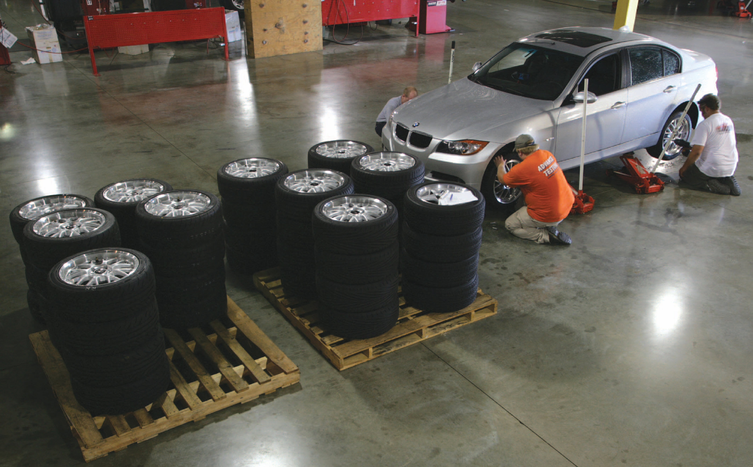
Chapter 12 Opener
Introduction to the Practice of Statistics, Sixth Edition
© 2009 W.H. Freeman and Company

Slide 3
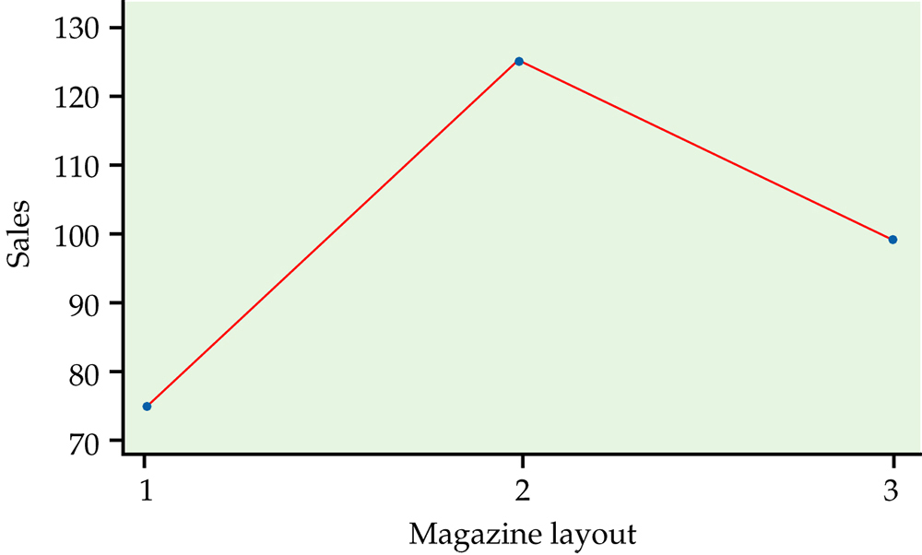
Figure 12.1
Introduction to the Practice of Statistics, Sixth Edition
© 2009 W.H. Freeman and Company

Slide 4
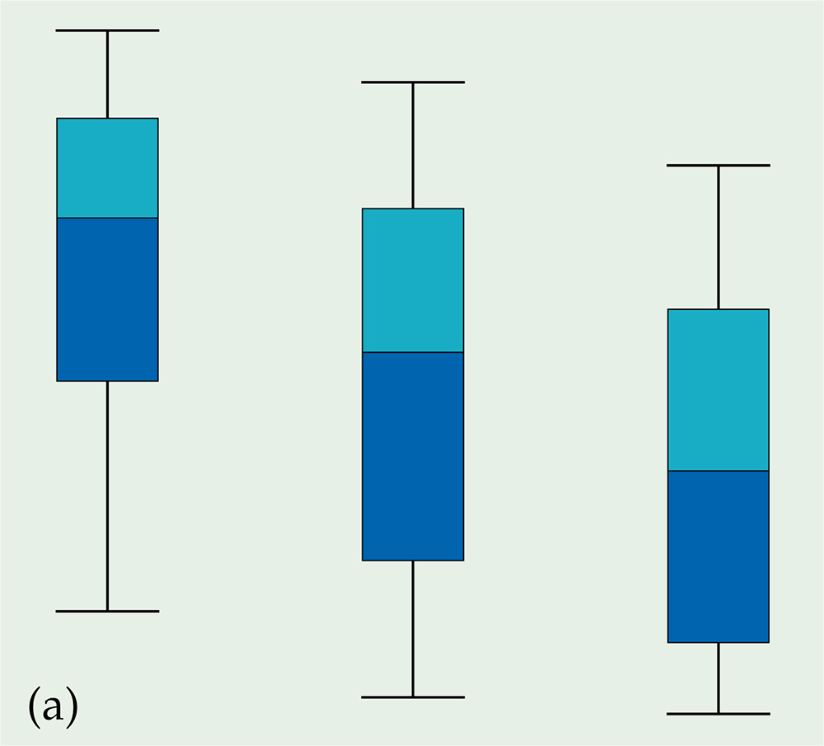
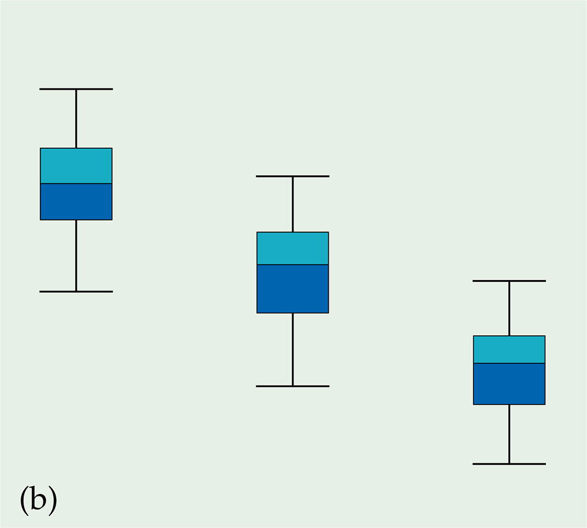
Figure 12.2
Introduction to the Practice of Statistics, Sixth Edition
© 2009 W.H. Freeman and Company

Slide 5
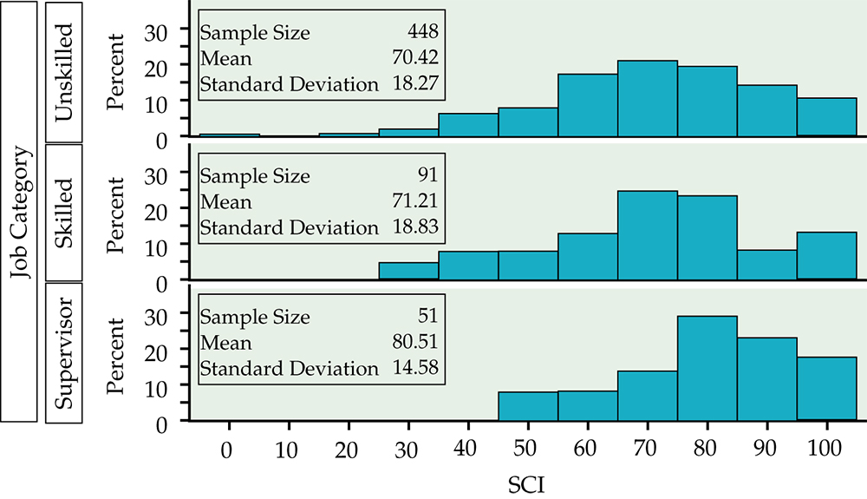
Figure 12.3
Introduction to the Practice of Statistics, Sixth Edition
© 2009 W.H. Freeman and Company

Slide 6
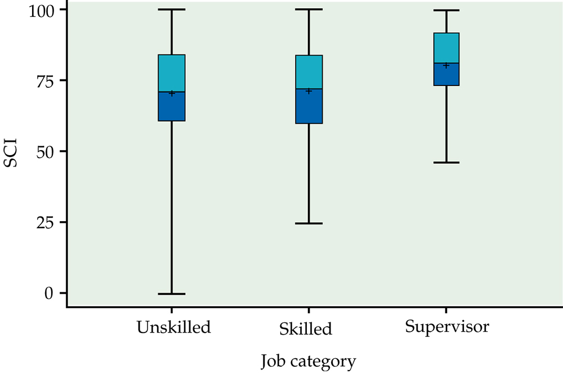
Figure 12.4
Introduction to the Practice of Statistics, Sixth Edition
© 2009 W.H. Freeman and Company

Slide 7
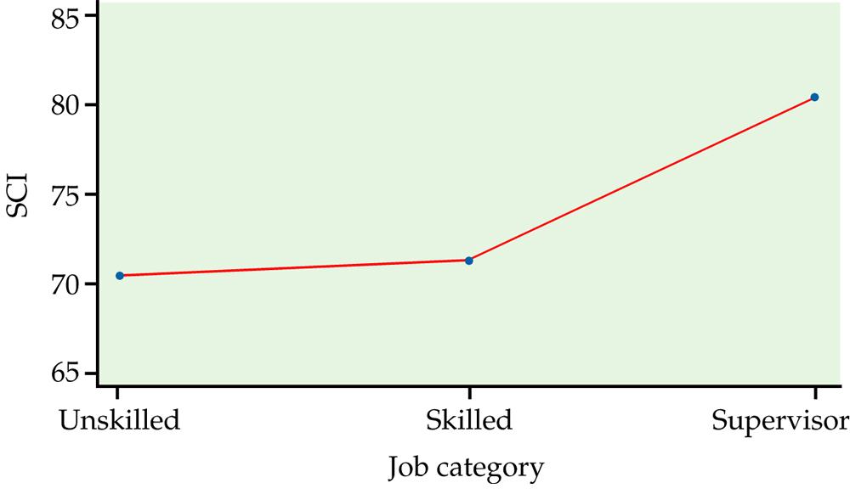
Figure 12.5
Introduction to the Practice of Statistics, Sixth Edition
© 2009 W.H. Freeman and Company

Slide 8
Definition, pg 645
Introduction to the Practice of Statistics, Sixth Edition
© 2009 W.H. Freeman and Company

Slide 9
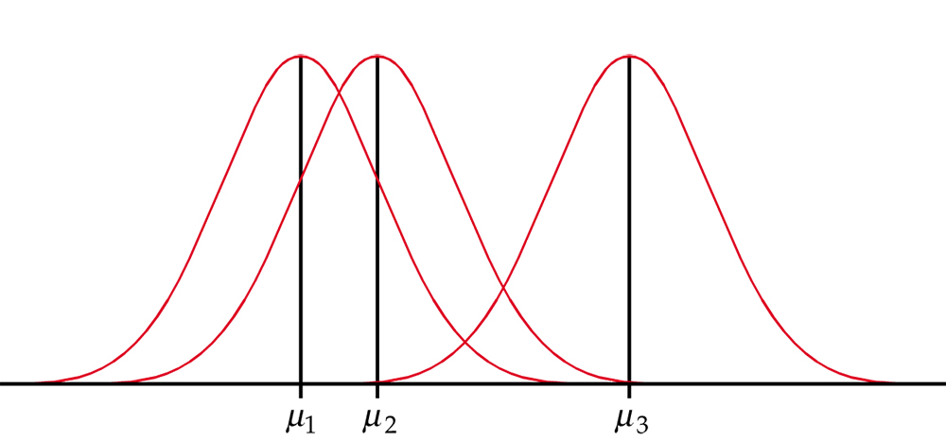
Figure 12.6
Introduction to the Practice of Statistics, Sixth Edition
© 2009 W.H. Freeman and Company

Slide 10
Definition, pg 646
Introduction to the Practice of Statistics, Sixth Edition
© 2009 W.H. Freeman and Company

Slide 11
Definition, pg 646–647
Introduction to the Practice of Statistics, Sixth Edition
© 2009 W.H. Freeman and Company

Slide 12
Definition, pg 648
Introduction to the Practice of Statistics, Sixth Edition
© 2009 W.H. Freeman and Company

Slide 13
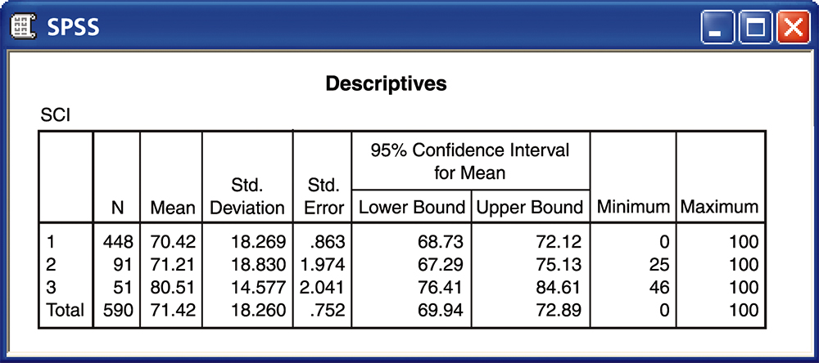
Figure 12.7
Introduction to the Practice of Statistics, Sixth Edition
© 2009 W.H. Freeman and Company

Slide 14
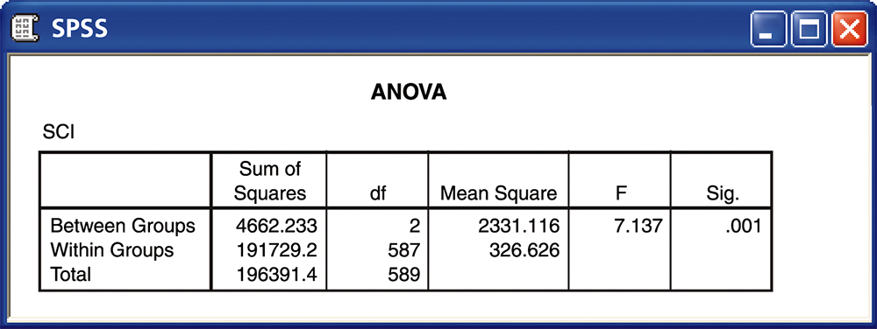
Figure 12.8
Introduction to the Practice of Statistics, Sixth Edition
© 2009 W.H. Freeman and Company

Slide 15
Definition, pg 651–652
Introduction to the Practice of Statistics, Sixth Edition
© 2009 W.H. Freeman and Company

Slide 16
Definition, pg 653
Introduction to the Practice of Statistics, Sixth Edition
© 2009 W.H. Freeman and Company

Slide 17
Definition, pg 657–658
Introduction to the Practice of Statistics, Sixth Edition
© 2009 W.H. Freeman and Company

Slide 18
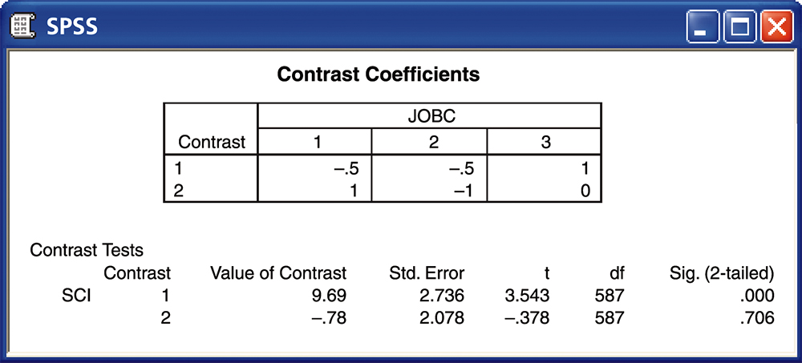
Figure 12.9
Introduction to the Practice of Statistics, Sixth Edition
© 2009 W.H. Freeman and Company

Slide 19
Definition, pg 662
Introduction to the Practice of Statistics, Sixth Edition
© 2009 W.H. Freeman and Company

Slide 20
Figure 12.10
Introduction to the Practice of Statistics, Sixth Edition
© 2009 W.H. Freeman and Company

Slide 21
Definition, pg 664
Introduction to the Practice of Statistics, Sixth Edition
© 2009 W.H. Freeman and Company

Slide 22
Table 12.1
Introduction to the Practice of Statistics, Sixth Edition
© 2009 W.H. Freeman and Company

Slide 23
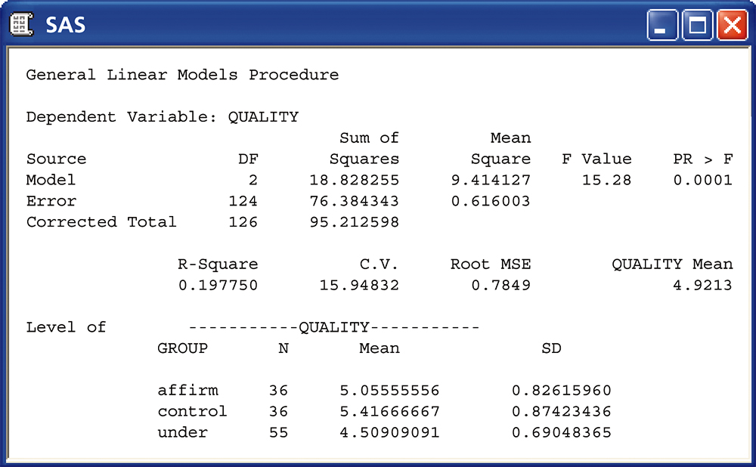
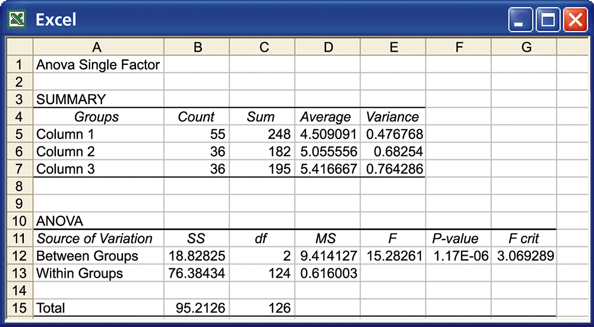
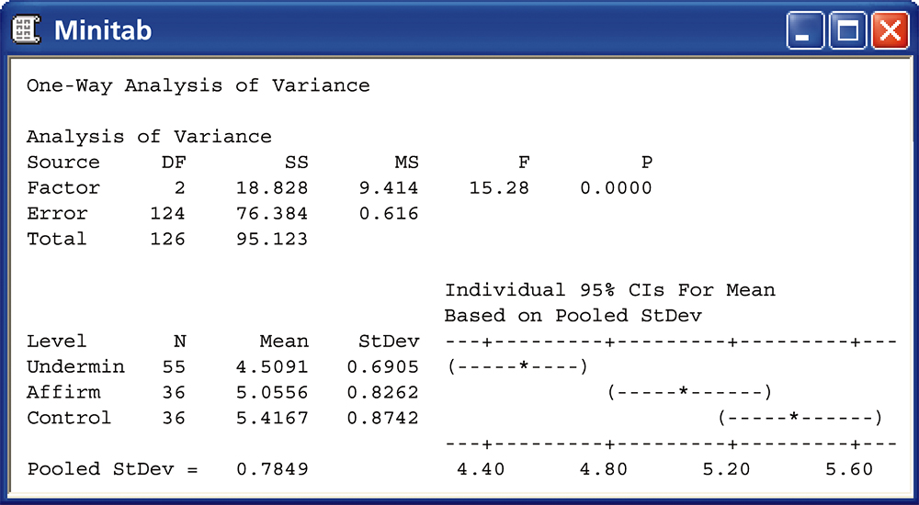
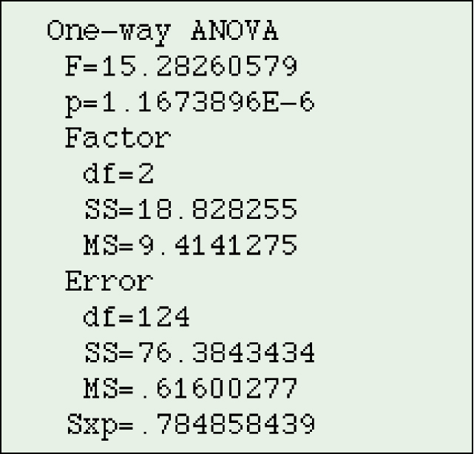
Figure 12.11
Introduction to the Practice of Statistics, Sixth Edition
© 2009 W.H. Freeman and Company

Slide 24
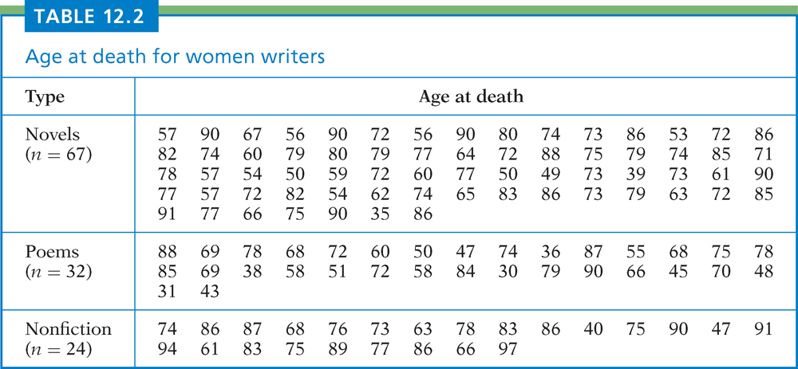
Table 12.2
Introduction to the Practice of Statistics, Sixth Edition
© 2009 W.H. Freeman and Company

Slide 25
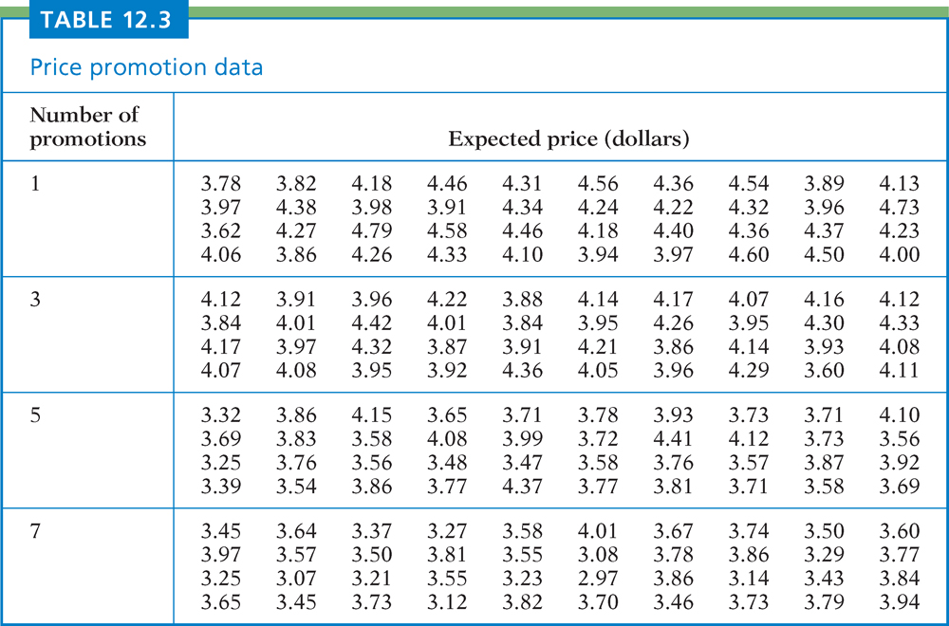
Table 12.3
Introduction to the Practice of Statistics, Sixth Edition
© 2009 W.H. Freeman and Company

Slide 26
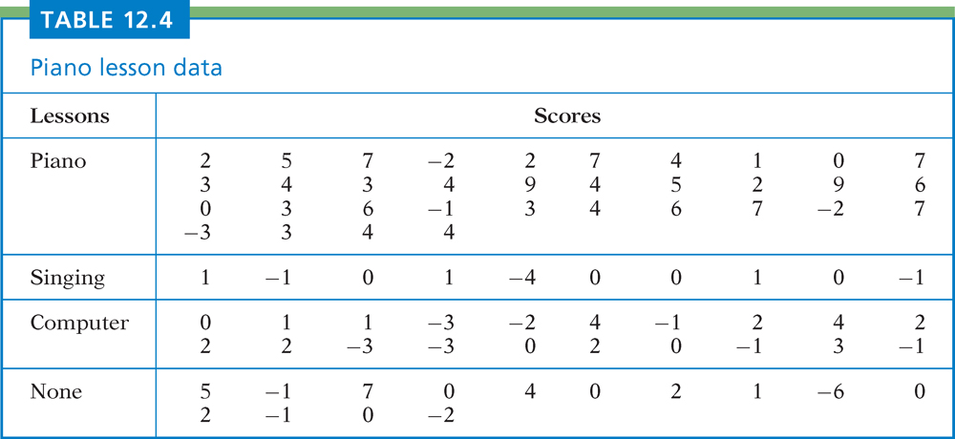
Table 12.4
Introduction to the Practice of Statistics, Sixth Edition
© 2009 W.H. Freeman and Company

