Slide 1
David S. Moore • George P. McCabe
Bruce A. Craig
Introduction to the
Practice of Statistics
Sixth Edition
Chapter 10:
Inference for Regression
Copyright © 2009 by W. H. Freeman and Company

Slide 2
Chapter 10 Opener
Introduction to the Practice of Statistics, Sixth Edition
© 2009 W.H. Freeman and Company

Slide 3
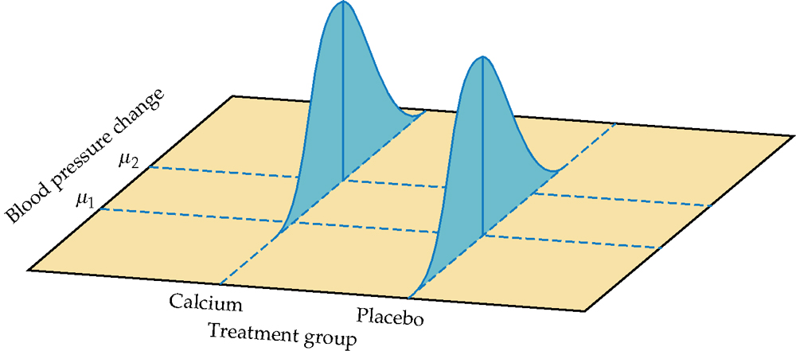
Figure 10.1
Introduction to the Practice of Statistics, Sixth Edition
© 2009 W.H. Freeman and Company

Slide 4
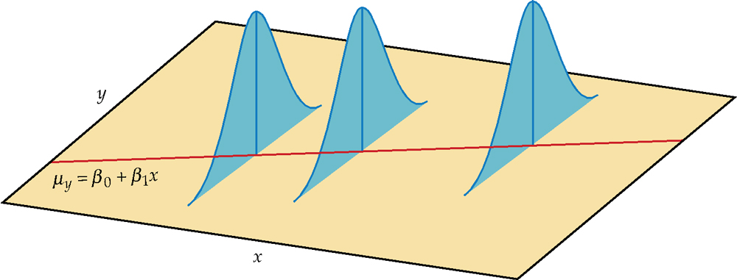
Figure 10.2
Introduction to the Practice of Statistics, Sixth Edition
© 2009 W.H. Freeman and Company

Slide 5
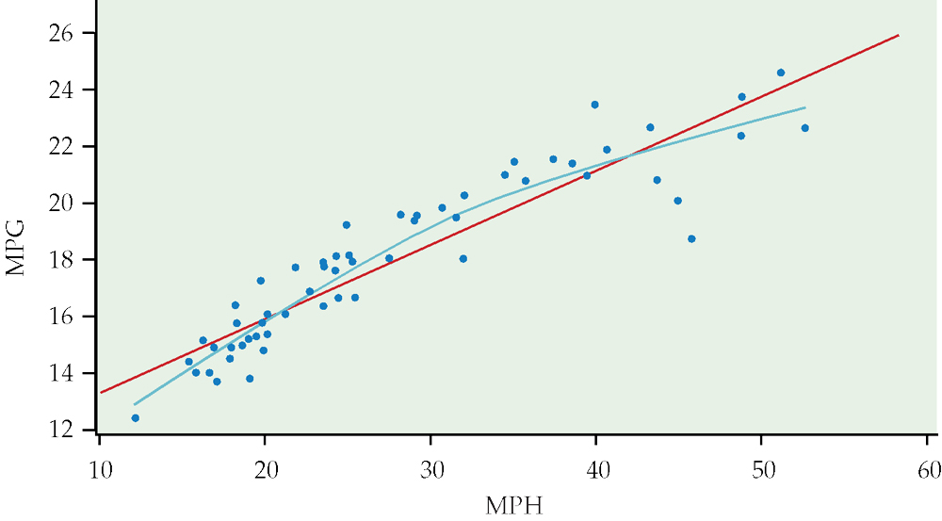
Figure 10.3
Introduction to the Practice of Statistics, Sixth Edition
© 2009 W.H. Freeman and Company

Slide 6
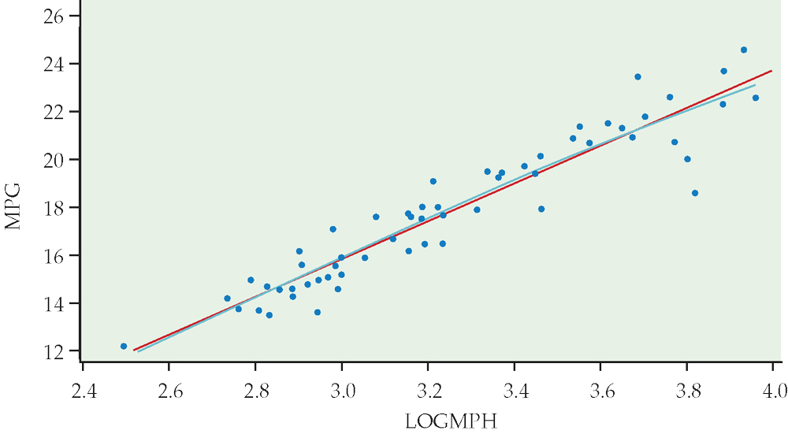
Figure 10.4
Introduction to the Practice of Statistics, Sixth Edition
© 2009 W.H. Freeman and Company

Slide 7
Definition, pg 564
Introduction to the Practice of Statistics, Sixth Edition
© 2009 W.H. Freeman and Company

Slide 8
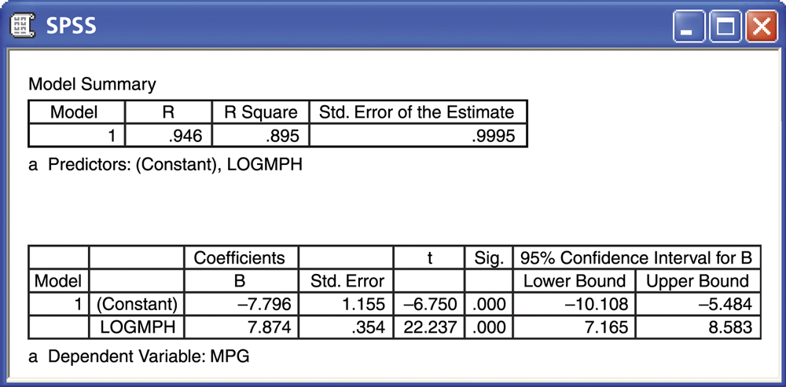
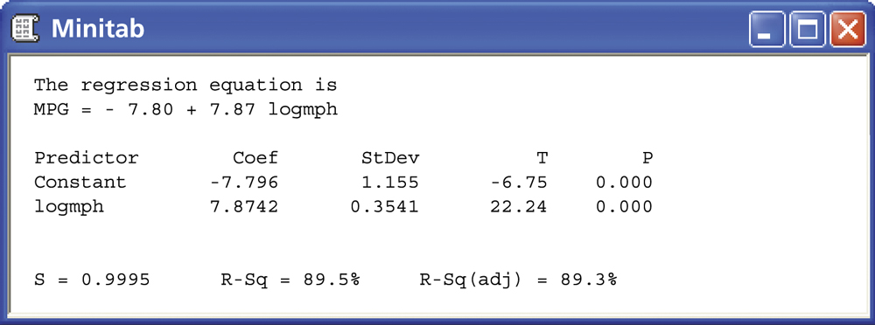
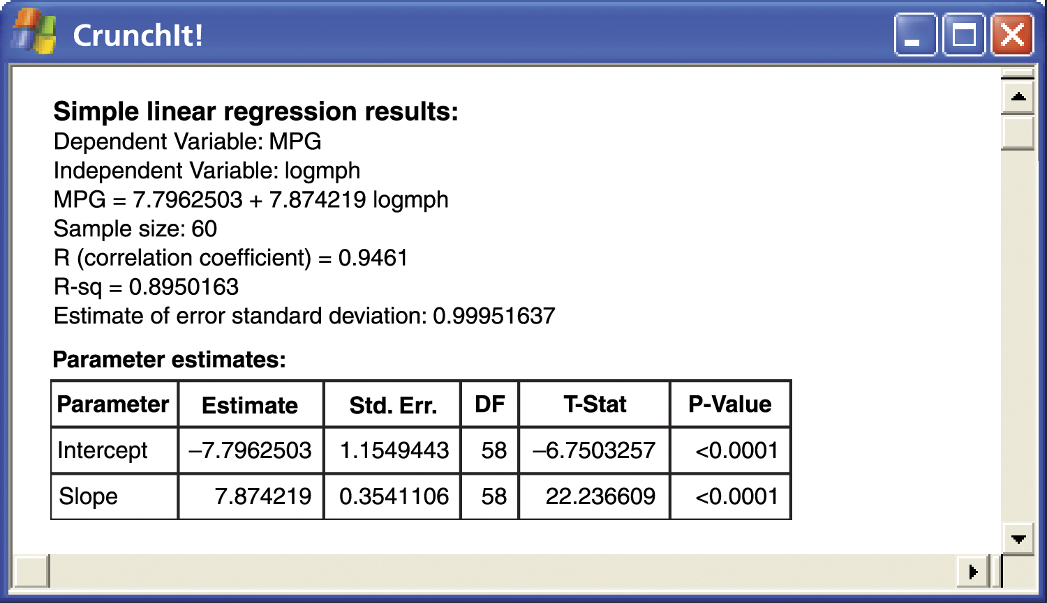
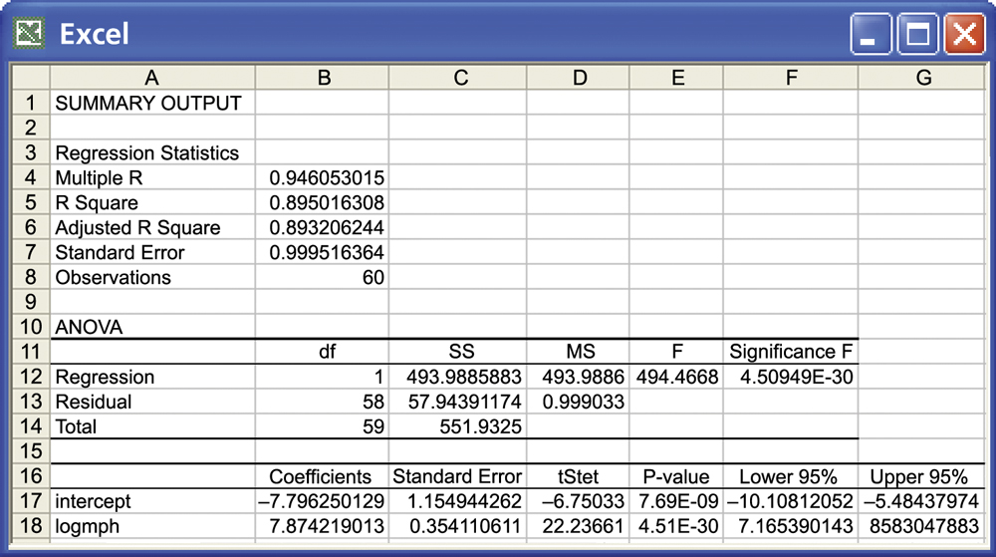
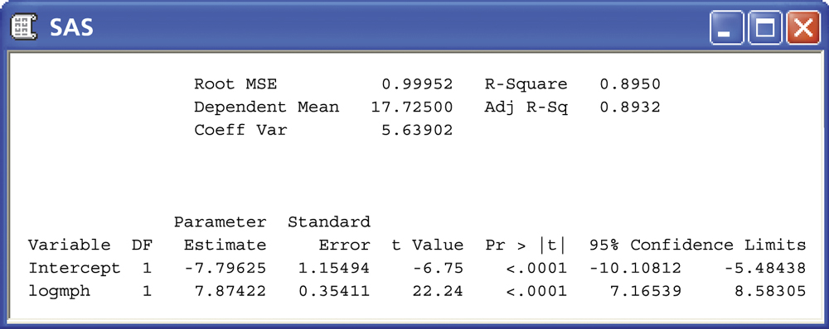
Figure 10.5
Introduction to the Practice of Statistics, Sixth Edition
© 2009 W.H. Freeman and Company

Slide 9
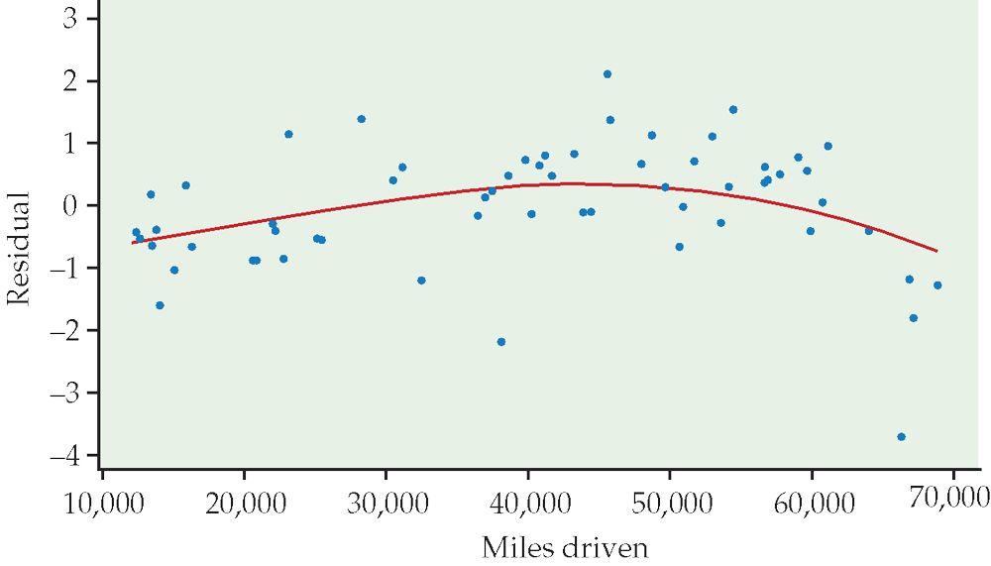
Figure 10.6
Introduction to the Practice of Statistics, Sixth Edition
© 2009 W.H. Freeman and Company

Slide 10
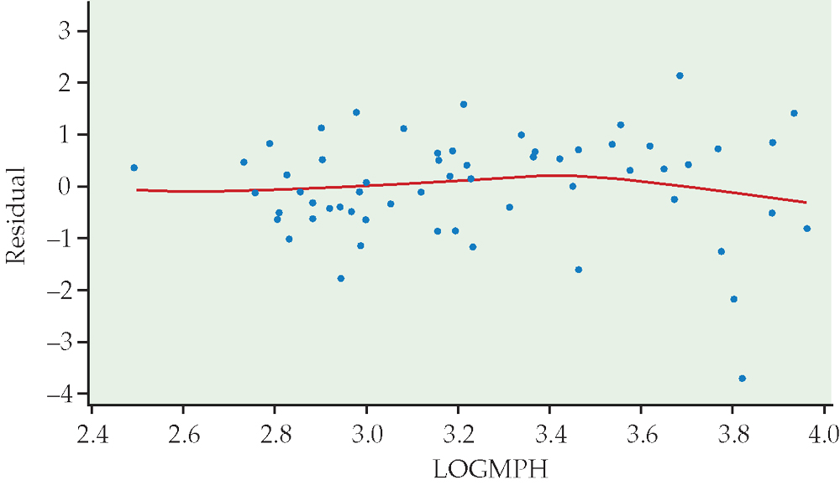
Figure 10.7
Introduction to the Practice of Statistics, Sixth Edition
© 2009 W.H. Freeman and Company

Slide 11
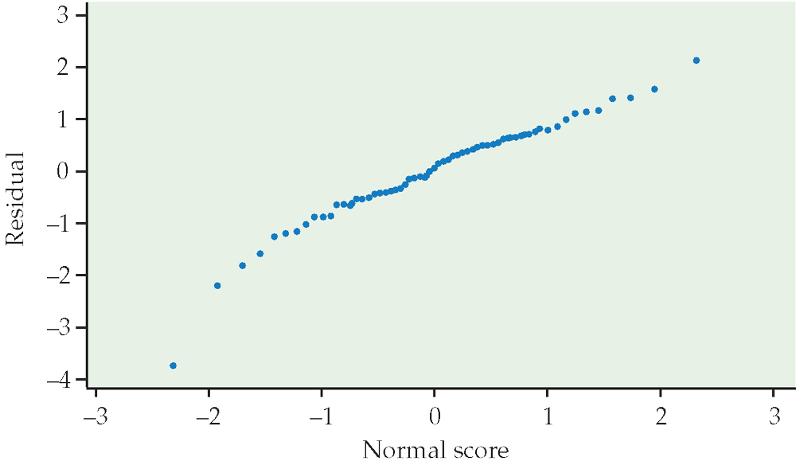
Figure 10.8
Introduction to the Practice of Statistics, Sixth Edition
© 2009 W.H. Freeman and Company

Slide 12
Definition, pg 570–571
Introduction to the Practice of Statistics, Sixth Edition
© 2009 W.H. Freeman and Company

Slide 13
Definition, pg 573
Introduction to the Practice of Statistics, Sixth Edition
© 2009 W.H. Freeman and Company

Slide 14
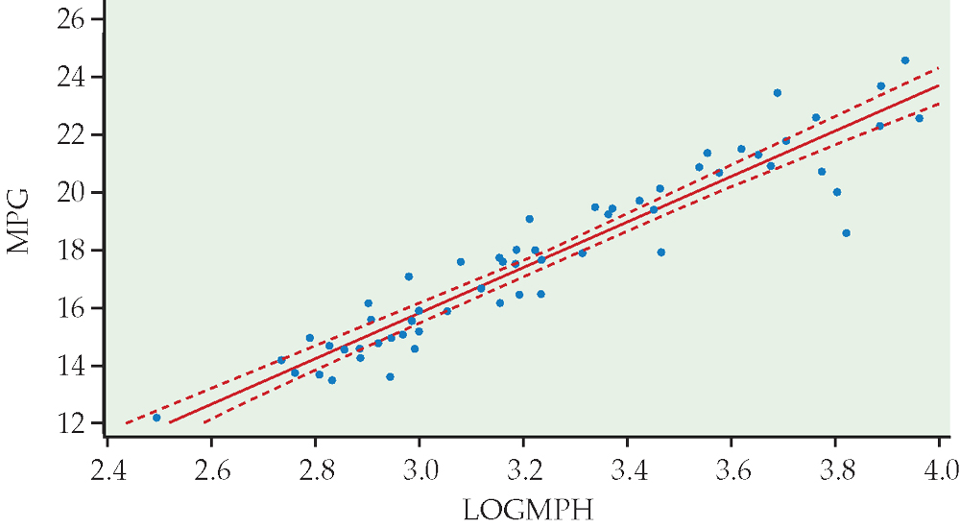
Figure 10.9
Introduction to the Practice of Statistics, Sixth Edition
© 2009 W.H. Freeman and Company

Slide 15
Definition, pg 575
Introduction to the Practice of Statistics, Sixth Edition
© 2009 W.H. Freeman and Company

Slide 16
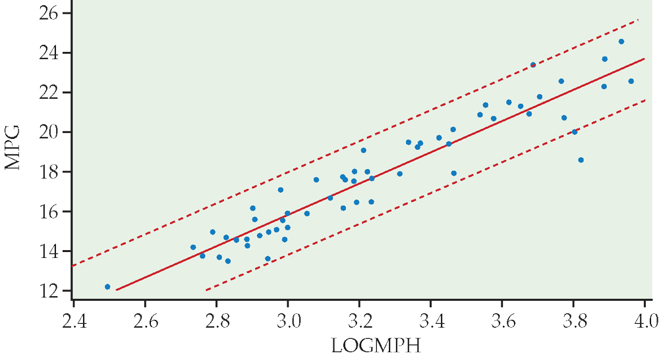
Figure 10.10
Introduction to the Practice of Statistics, Sixth Edition
© 2009 W.H. Freeman and Company

Slide 17
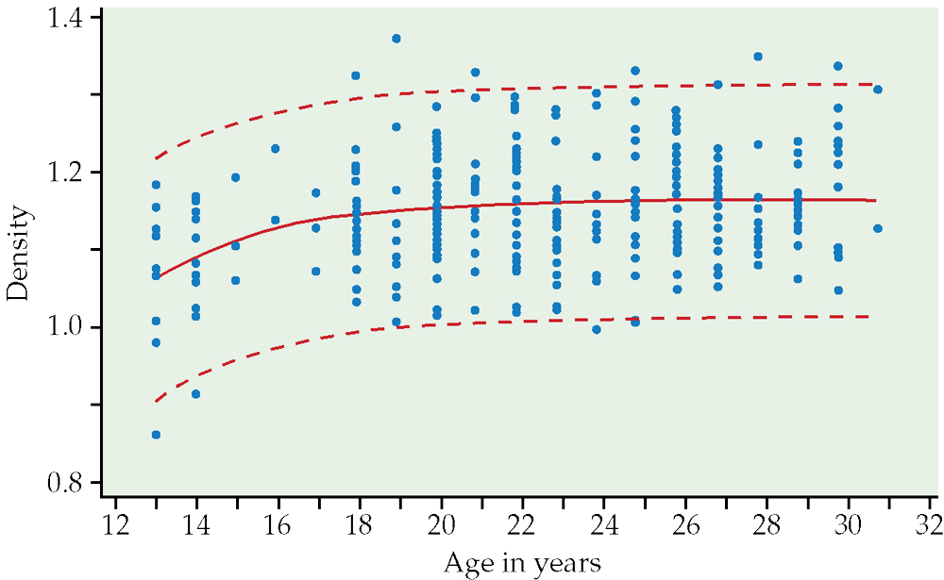
Figure 10.11
Introduction to the Practice of Statistics, Sixth Edition
© 2009 W.H. Freeman and Company

Slide 18
Definition, pg 581
Introduction to the Practice of Statistics, Sixth Edition
© 2009 W.H. Freeman and Company

Slide 19
Definition, pg 582
Introduction to the Practice of Statistics, Sixth Edition
© 2009 W.H. Freeman and Company

Slide 20
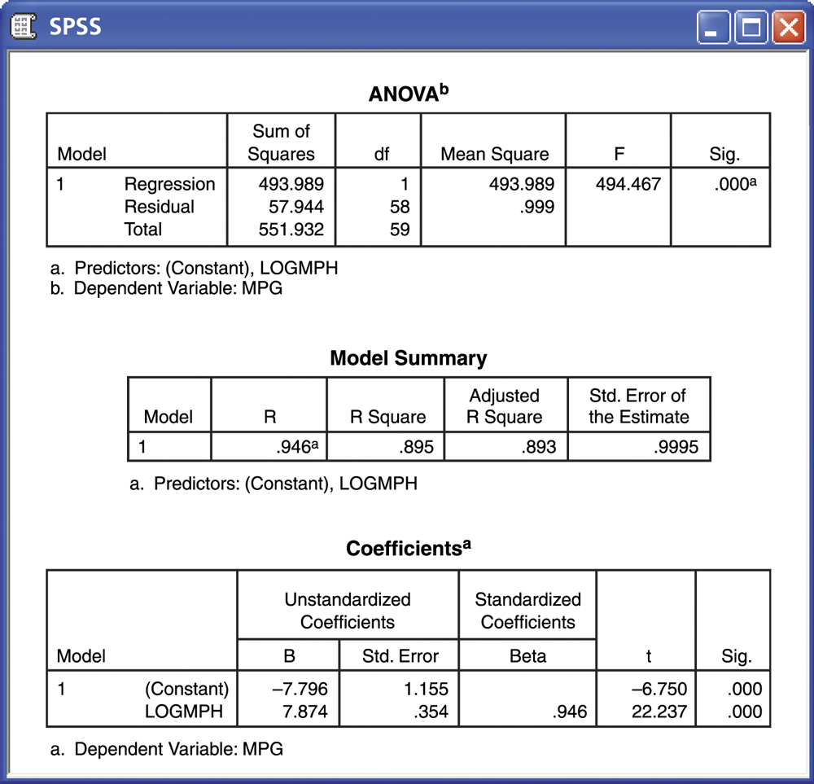
Figure 10.12
Introduction to the Practice of Statistics, Sixth Edition
© 2009 W.H. Freeman and Company

Slide 21
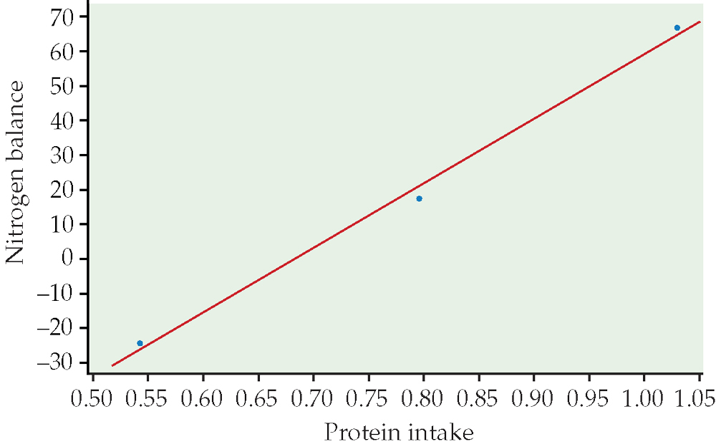
Figure 10.13
Introduction to the Practice of Statistics, Sixth Edition
© 2009 W.H. Freeman and Company

Slide 22
Definition, pg 587
Introduction to the Practice of Statistics, Sixth Edition
© 2009 W.H. Freeman and Company

Slide 23
Definition, pg 589
Introduction to the Practice of Statistics, Sixth Edition
© 2009 W.H. Freeman and Company

Slide 24
Definition, pg 591
Introduction to the Practice of Statistics, Sixth Edition
© 2009 W.H. Freeman and Company

Slide 25
Figure 10.14
Introduction to the Practice of Statistics, Sixth Edition
© 2009 W.H. Freeman and Company

Slide 26
Table 10.1
Introduction to the Practice of Statistics, Sixth Edition
© 2009 W.H. Freeman and Company

Slide 27
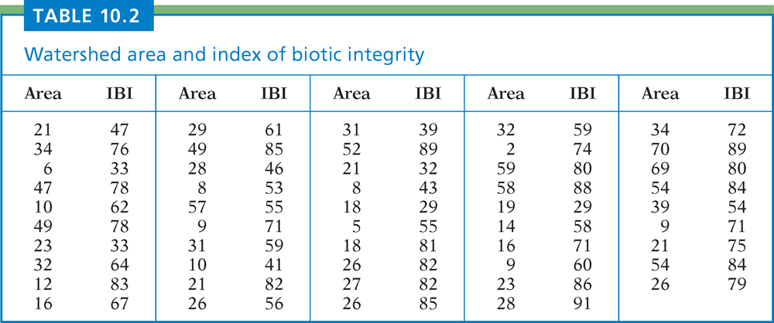
Table 10.2
Introduction to the Practice of Statistics, Sixth Edition
© 2009 W.H. Freeman and Company

Slide 28
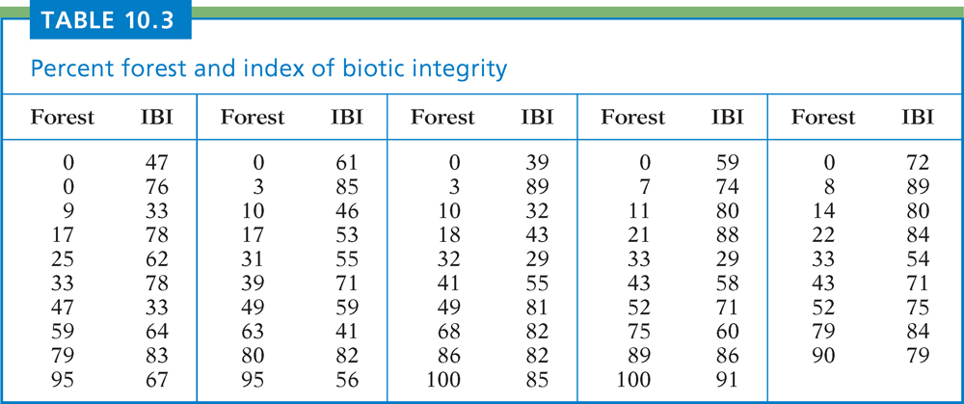
Table 10.3
Introduction to the Practice of Statistics, Sixth Edition
© 2009 W.H. Freeman and Company

Slide 29
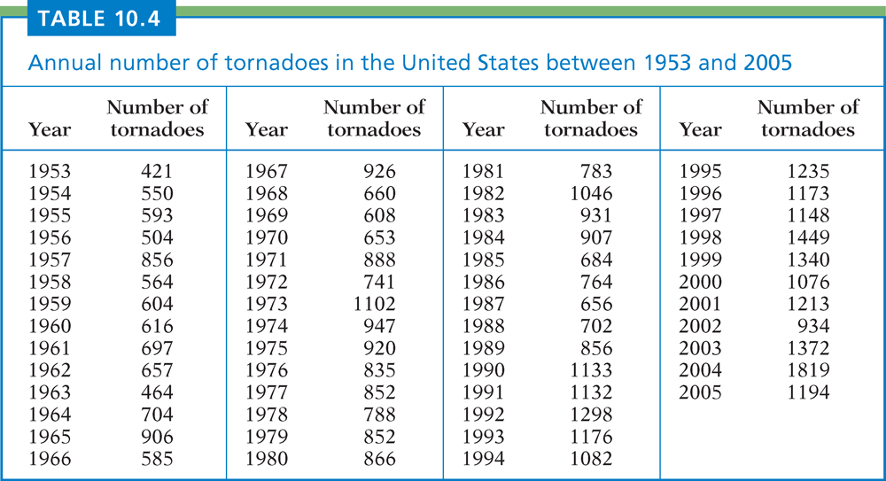
Table 10.4
Introduction to the Practice of Statistics, Sixth Edition
© 2009 W.H. Freeman and Company

Slide 30
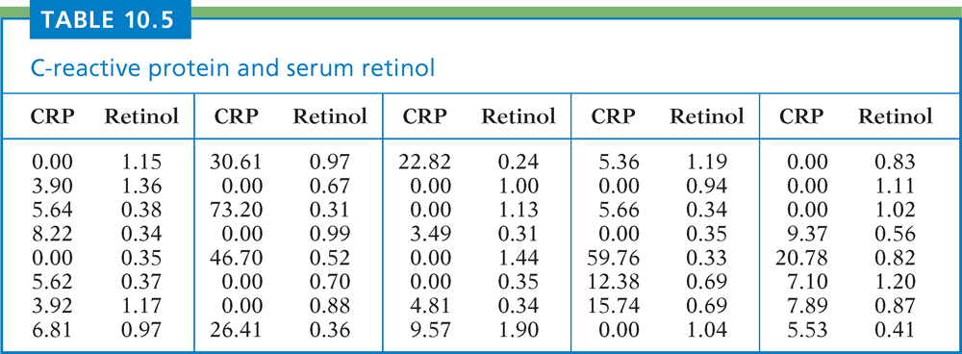
Table 10.5
Introduction to the Practice of Statistics, Sixth Edition
© 2009 W.H. Freeman and Company

Slide 31
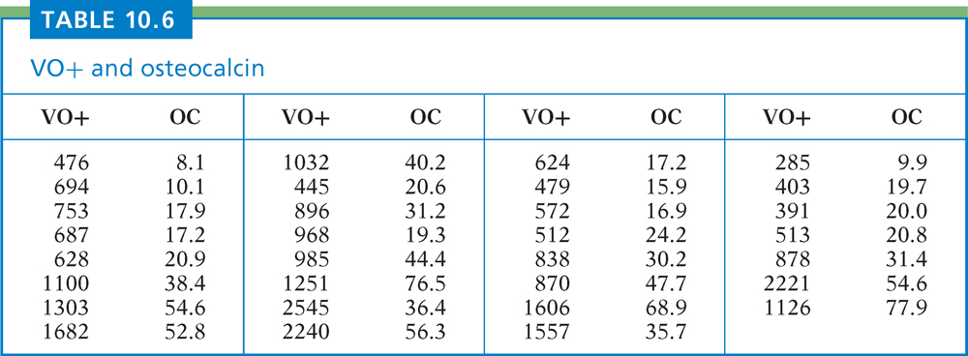
Table 10.6
Introduction to the Practice of Statistics, Sixth Edition
© 2009 W.H. Freeman and Company

Slide 32
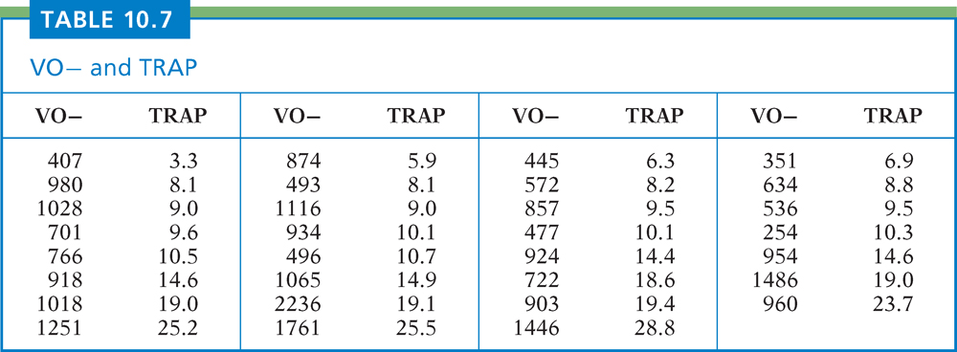
Table 10.7
Introduction to the Practice of Statistics, Sixth Edition
© 2009 W.H. Freeman and Company

Slide 33
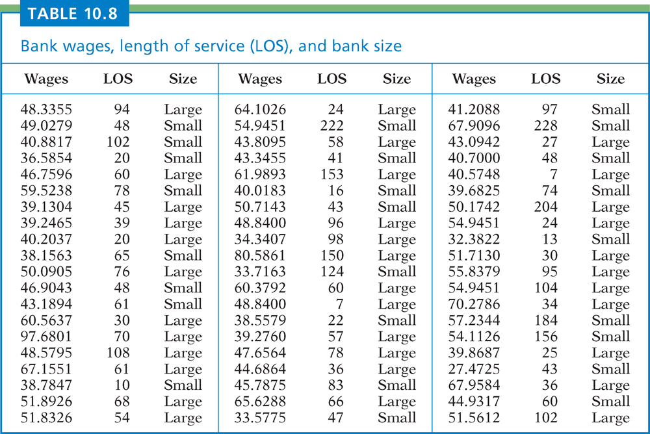
Table 10.8
Introduction to the Practice of Statistics, Sixth Edition
© 2009 W.H. Freeman and Company

Slide 34
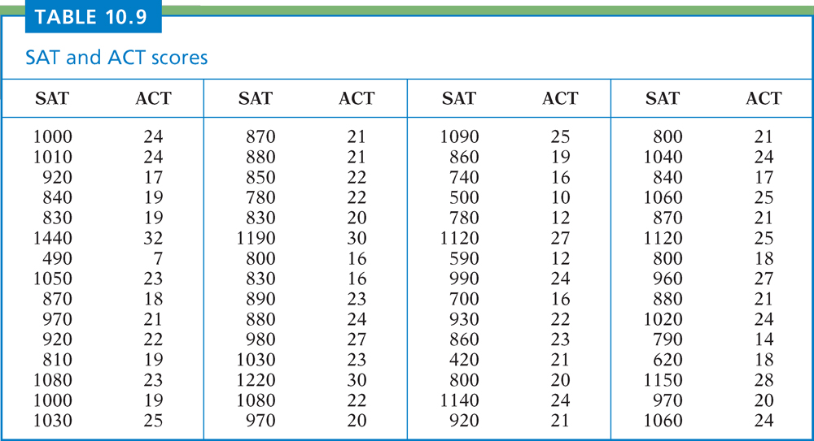
Table 10.9
Introduction to the Practice of Statistics, Sixth Edition
© 2009 W.H. Freeman and Company

