Slide 1
David S. Moore • George P. McCabe
Bruce A. Craig
Introduction to the
Practice of Statistics
Sixth Edition
Chapter 8:
Inference for Proportions
Copyright © 2009 by W. H. Freeman and Company

Slide 2
Chapter 8 Opener
Introduction to the Practice of Statistics, Sixth Edition
© 2009 W.H. Freeman and Company

Slide 3
Definition, pg 488–489
Introduction to the Practice of Statistics, Sixth Edition
© 2009 W.H. Freeman and Company

Slide 4
Figure 8.1
Introduction to the Practice of Statistics, Sixth Edition
© 2009 W.H. Freeman and Company

Slide 5
Definition, pg 491–492
Introduction to the Practice of Statistics, Sixth Edition
© 2009 W.H. Freeman and Company

Slide 6
Definition, pg 493
Introduction to the Practice of Statistics, Sixth Edition
© 2009 W.H. Freeman and Company

Slide 7
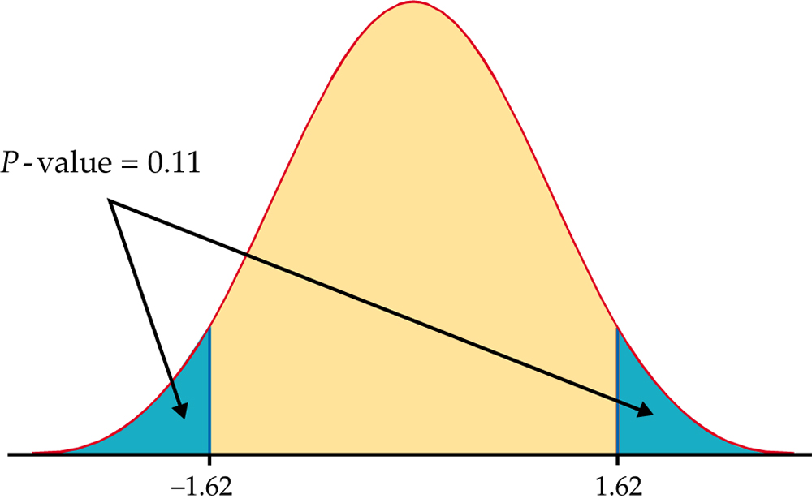
Figure 8.2
Introduction to the Practice of Statistics, Sixth Edition
© 2009 W.H. Freeman and Company

Slide 8
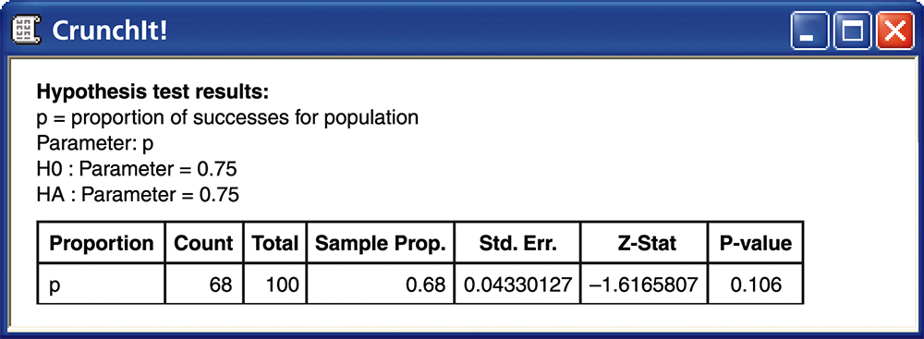
Figure 8.3
Introduction to the Practice of Statistics, Sixth Edition
© 2009 W.H. Freeman and Company

Slide 9
Definition, pg 498
Introduction to the Practice of Statistics, Sixth Edition
© 2009 W.H. Freeman and Company

Slide 10
Definition, pg 506–507
Introduction to the Practice of Statistics, Sixth Edition
© 2009 W.H. Freeman and Company

Slide 11
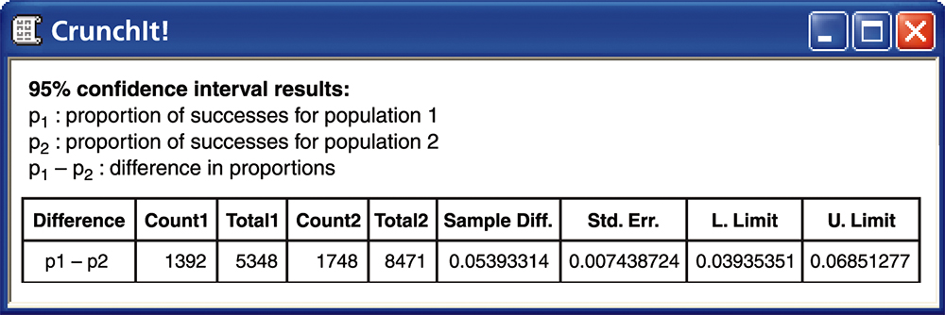
Figure 8.4
Introduction to the Practice of Statistics, Sixth Edition
© 2009 W.H. Freeman and Company

Slide 12
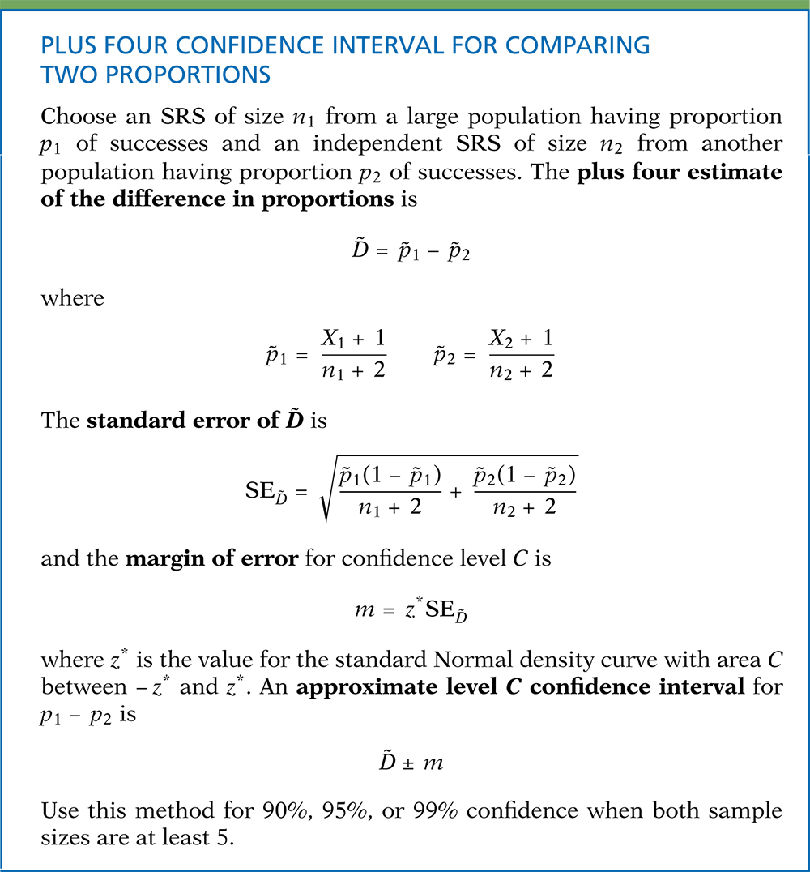
Definition, pg 509–510
Introduction to the Practice of Statistics, Sixth Edition
© 2009 W.H. Freeman and Company

Slide 13
Definition, pg 512–513
Introduction to the Practice of Statistics, Sixth Edition
© 2009 W.H. Freeman and Company

Slide 14
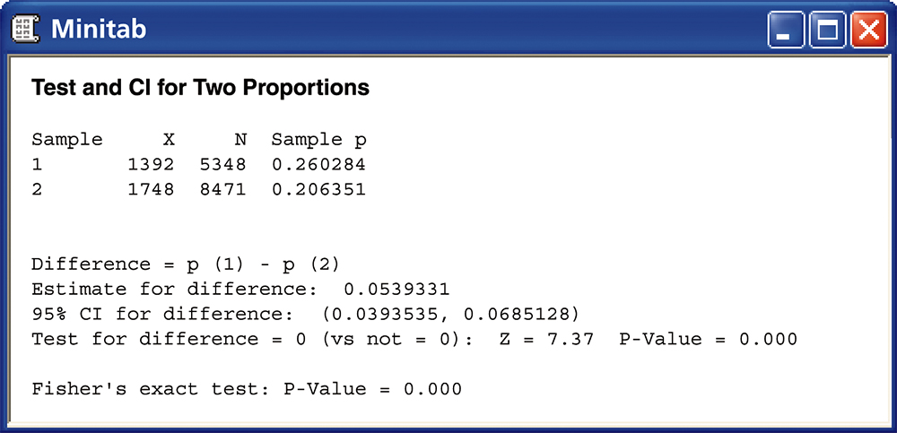
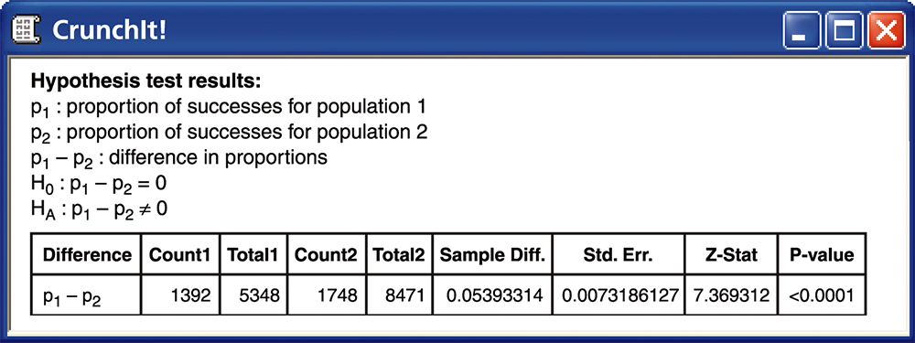
Figure 8.5
Introduction to the Practice of Statistics, Sixth Edition
© 2009 W.H. Freeman and Company

