Slide 1
David S. Moore • George P. McCabe
Bruce A. Craig
Introduction to the
Practice of Statistics
Sixth Edition
Chapter 7:
Inference for Distributions
Copyright © 2009 by W. H. Freeman and Company

Slide 2
Chapter 7 Opener
Introduction to the Practice of Statistics, Sixth Edition
© 2009 W.H. Freeman and Company

Slide 3
Definition, pg 418
Introduction to the Practice of Statistics, Sixth Edition
© 2009 W.H. Freeman and Company

Slide 4
Definition, pg 419
Introduction to the Practice of Statistics, Sixth Edition
© 2009 W.H. Freeman and Company

Slide 5
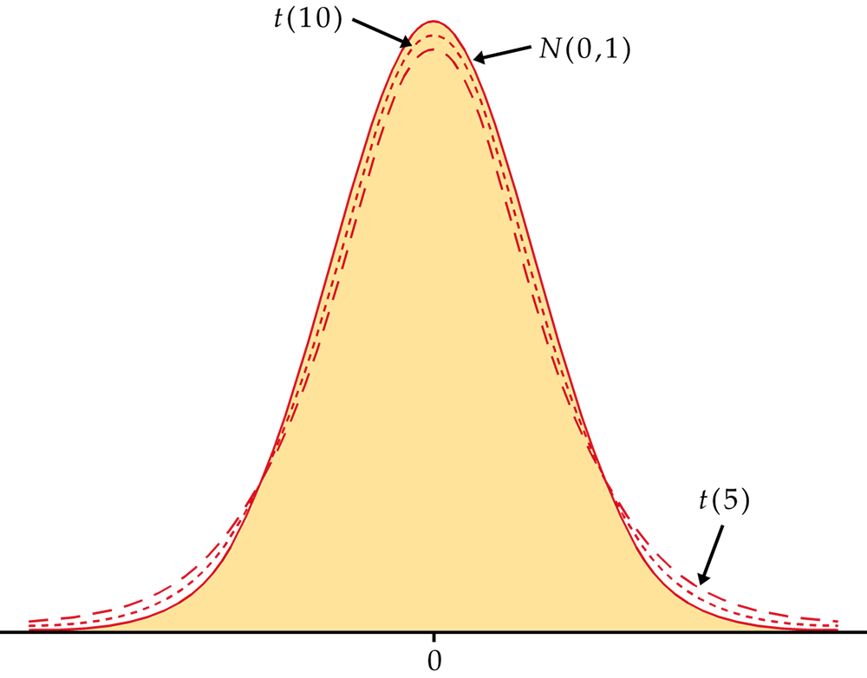
Figure 7.1
Introduction to the Practice of Statistics, Sixth Edition
© 2009 W.H. Freeman and Company

Slide 6
Definition, pg 420–421
Introduction to the Practice of Statistics, Sixth Edition
© 2009 W.H. Freeman and Company

Slide 7
Definition, pg 422
Introduction to the Practice of Statistics, Sixth Edition
© 2009 W.H. Freeman and Company

Slide 8
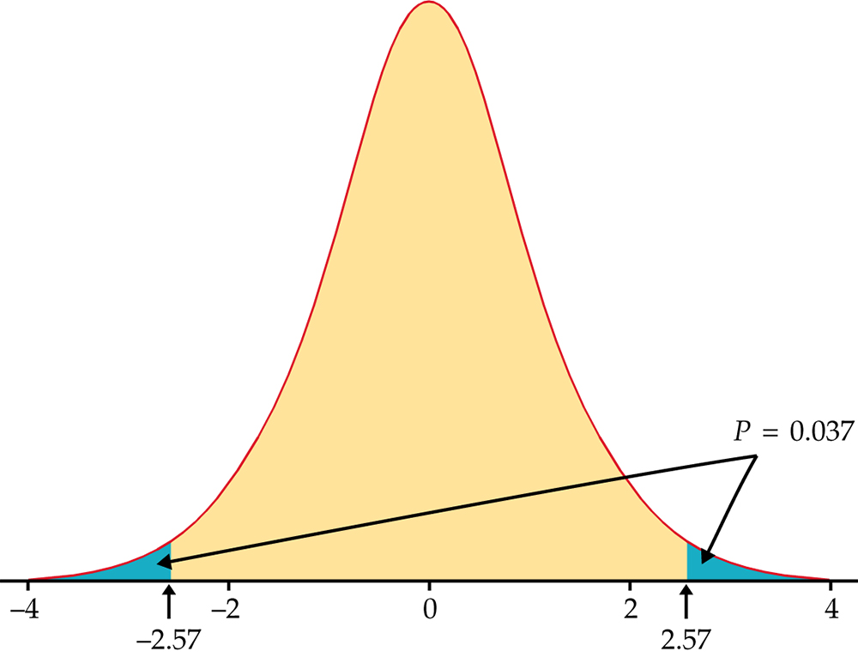
Figure 7.2
Introduction to the Practice of Statistics, Sixth Edition
© 2009 W.H. Freeman and Company

Slide 9
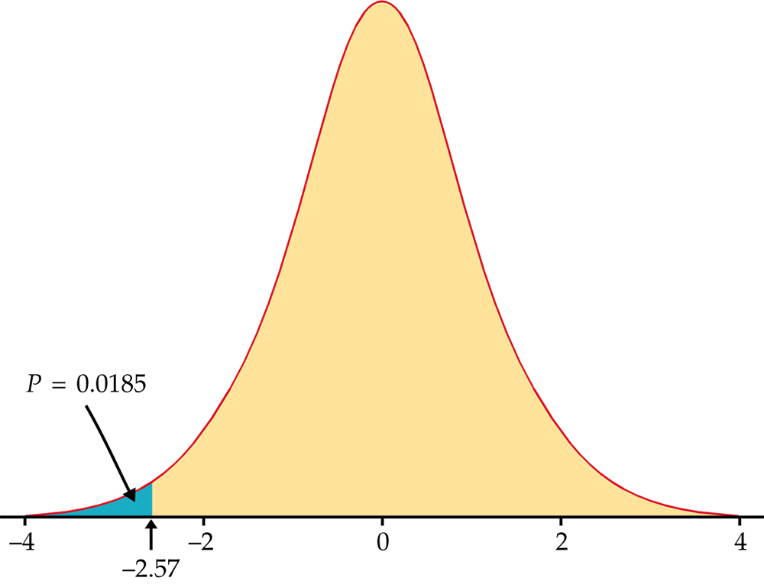
Figure 7.3
Introduction to the Practice of Statistics, Sixth Edition
© 2009 W.H. Freeman and Company

Slide 10
Table 7.1
Introduction to the Practice of Statistics, Sixth Edition
© 2009 W.H. Freeman and Company

Slide 11
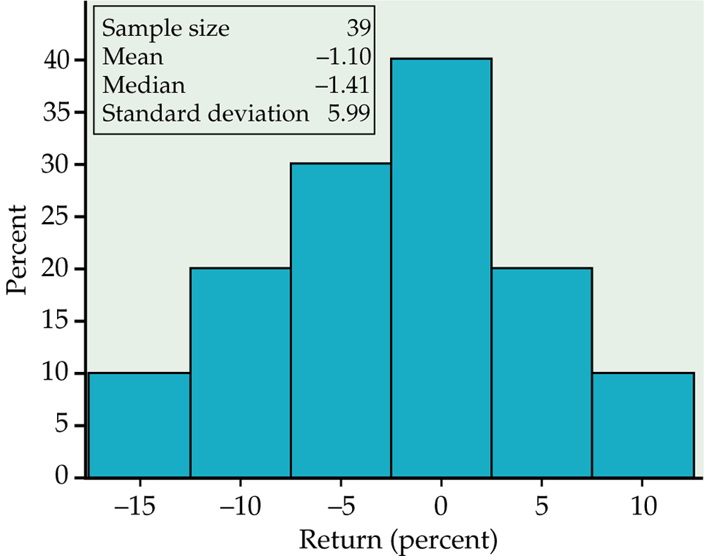
Figure 7.4
Introduction to the Practice of Statistics, Sixth Edition
© 2009 W.H. Freeman and Company

Slide 12
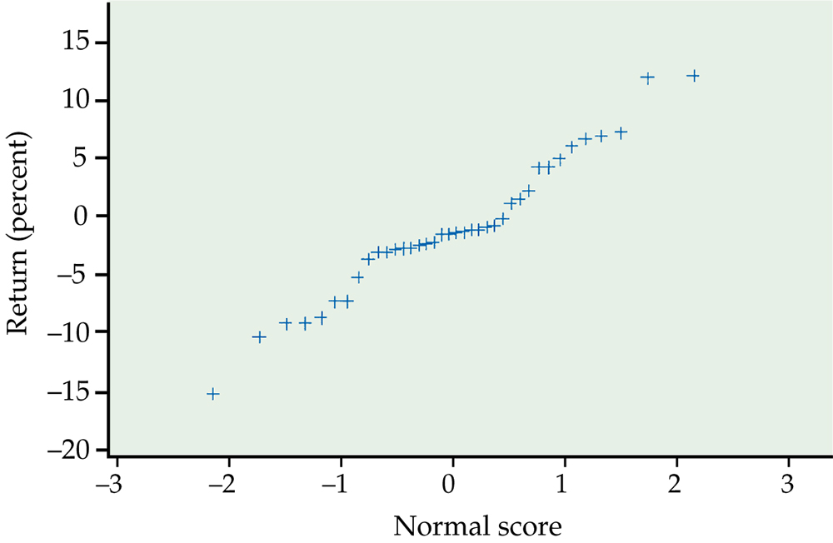
Figure 7.5
Introduction to the Practice of Statistics, Sixth Edition
© 2009 W.H. Freeman and Company

Slide 13
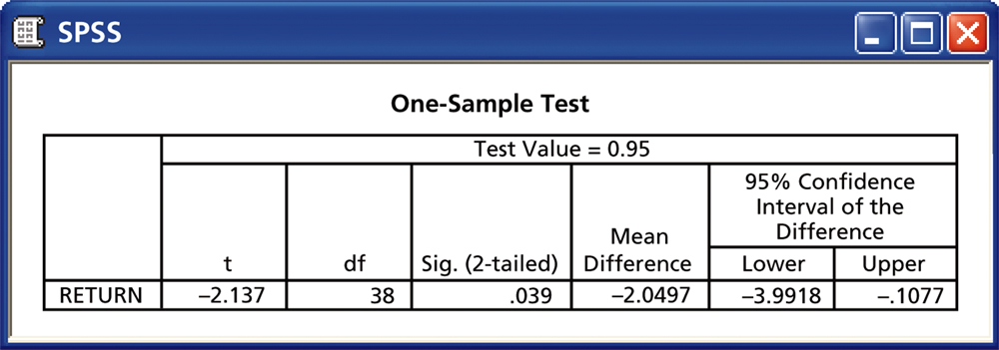
Figure 7.6
Introduction to the Practice of Statistics, Sixth Edition
© 2009 W.H. Freeman and Company

Slide 14
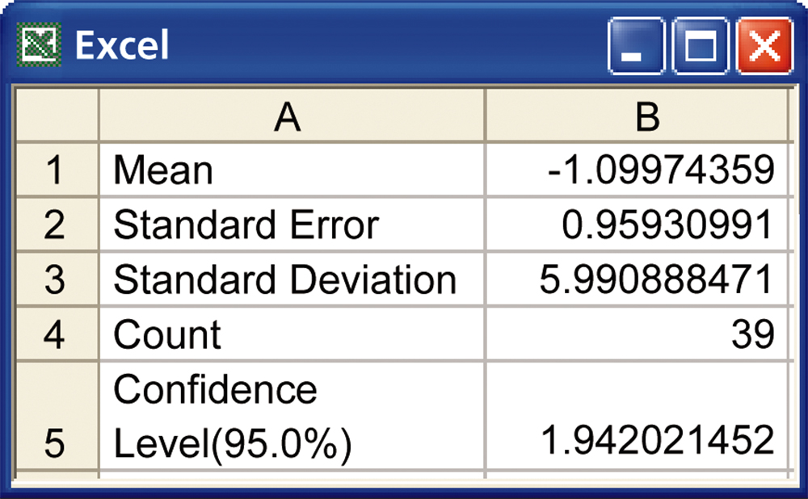
Figure 7.7
Introduction to the Practice of Statistics, Sixth Edition
© 2009 W.H. Freeman and Company

Slide 15
Table 7.2
Introduction to the Practice of Statistics, Sixth Edition
© 2009 W.H. Freeman and Company

Slide 16
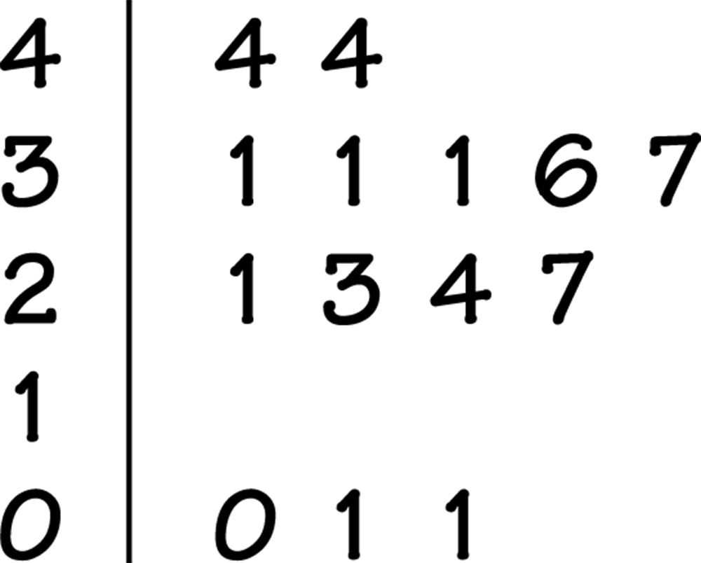
Figure 7.8
Introduction to the Practice of Statistics, Sixth Edition
© 2009 W.H. Freeman and Company

Slide 17
Definition, pg 432
Introduction to the Practice of Statistics, Sixth Edition
© 2009 W.H. Freeman and Company

Slide 18
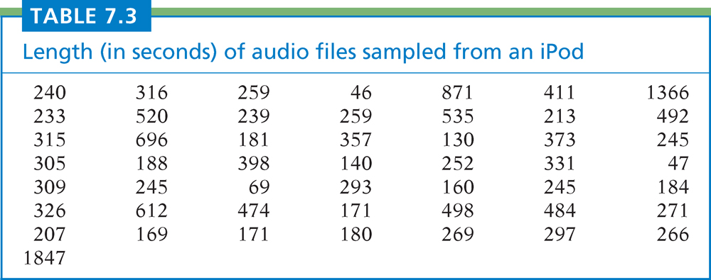
Table 7.3
Introduction to the Practice of Statistics, Sixth Edition
© 2009 W.H. Freeman and Company

Slide 19
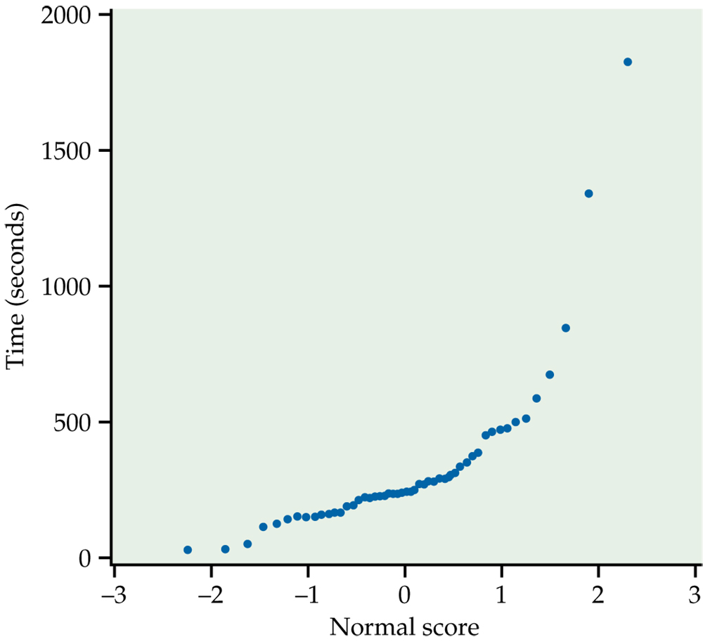
Figure 7.9
Introduction to the Practice of Statistics, Sixth Edition
© 2009 W.H. Freeman and Company

Slide 20
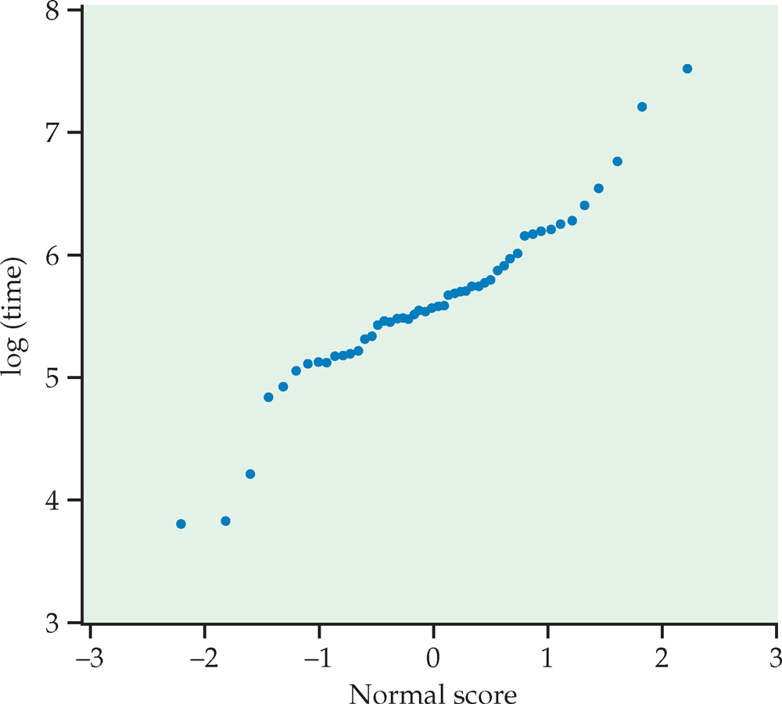
Figure 7.10
Introduction to the Practice of Statistics, Sixth Edition
© 2009 W.H. Freeman and Company

Slide 21
Definition, pg 439
Introduction to the Practice of Statistics, Sixth Edition
© 2009 W.H. Freeman and Company

Slide 22
Figure 7.11
Introduction to the Practice of Statistics, Sixth Edition
© 2009 W.H. Freeman and Company

Slide 23
Definition, pg 447
Introduction to the Practice of Statistics, Sixth Edition
© 2009 W.H. Freeman and Company

Slide 24
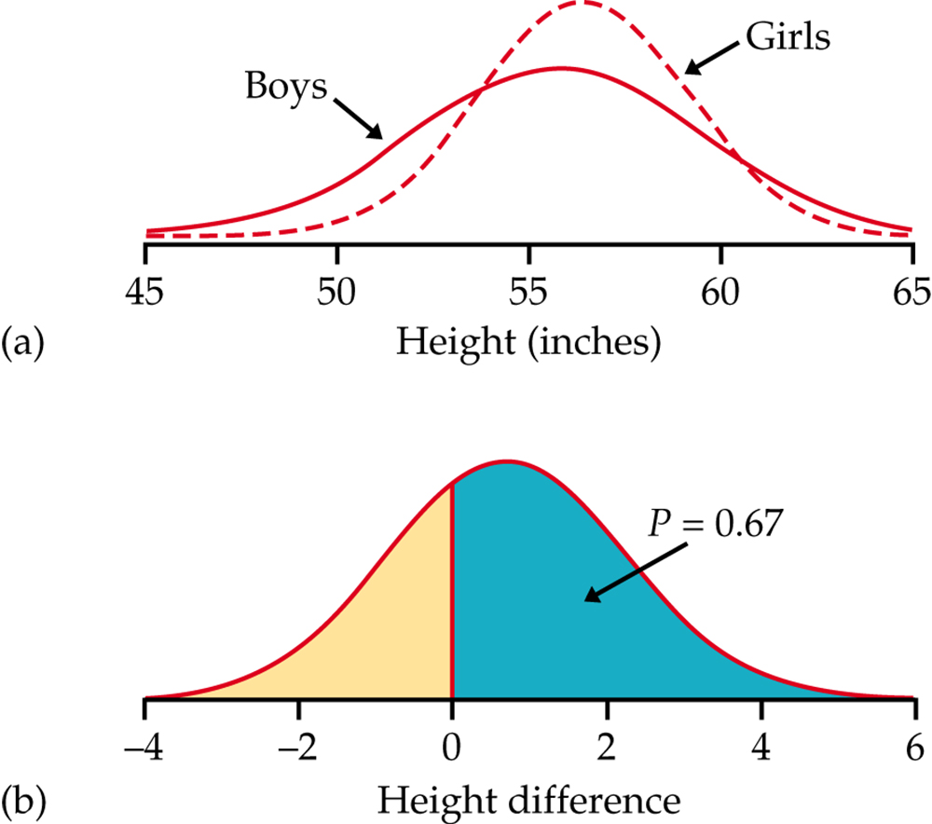
Figure 7.12
Introduction to the Practice of Statistics, Sixth Edition
© 2009 W.H. Freeman and Company

Slide 25
Definition, pg 450
Introduction to the Practice of Statistics, Sixth Edition
© 2009 W.H. Freeman and Company

Slide 26
Definition, pg 451
Introduction to the Practice of Statistics, Sixth Edition
© 2009 W.H. Freeman and Company

Slide 27
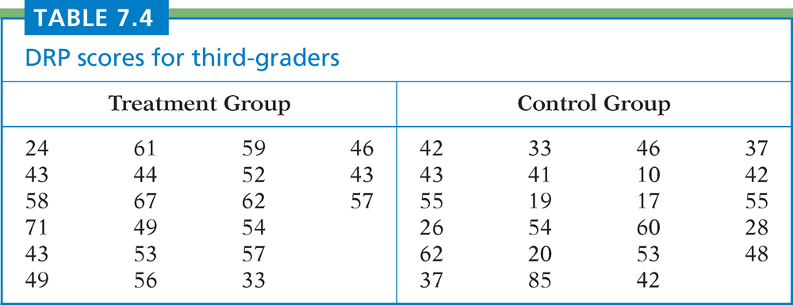
Table 7.4
Introduction to the Practice of Statistics, Sixth Edition
© 2009 W.H. Freeman and Company

Slide 28
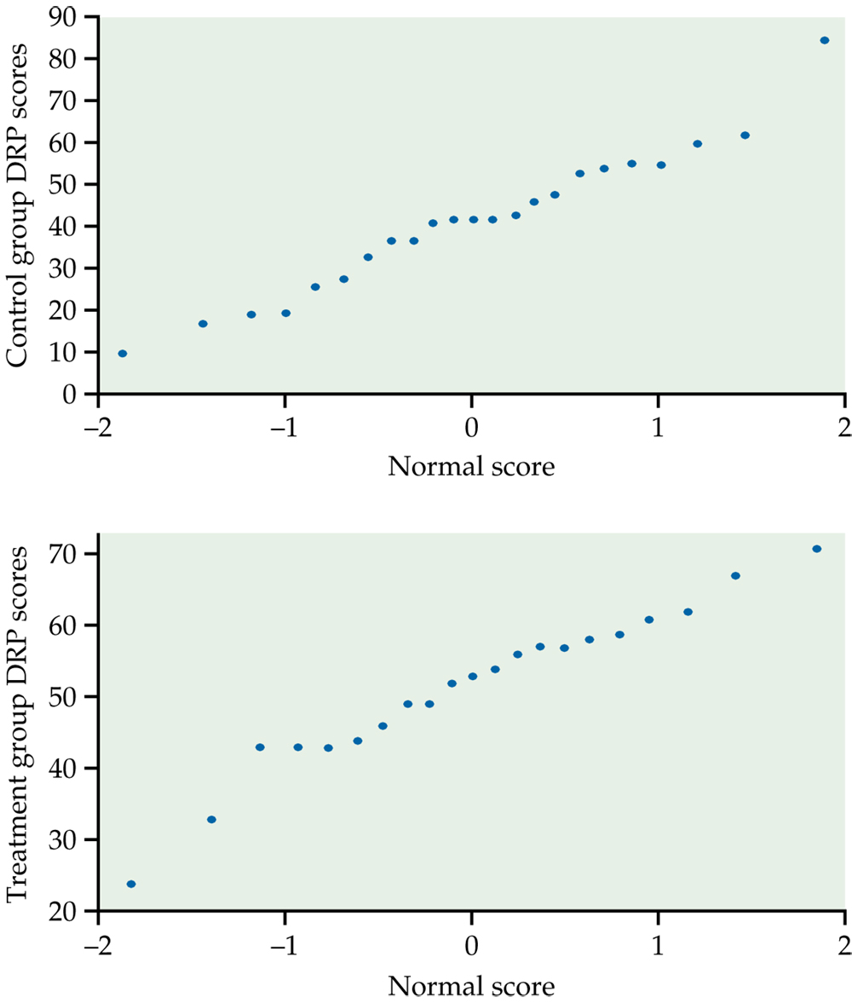
Figure 7.13
Introduction to the Practice of Statistics, Sixth Edition
© 2009 W.H. Freeman and Company

Slide 29
Definition, pg 454
Introduction to the Practice of Statistics, Sixth Edition
© 2009 W.H. Freeman and Company

Slide 30
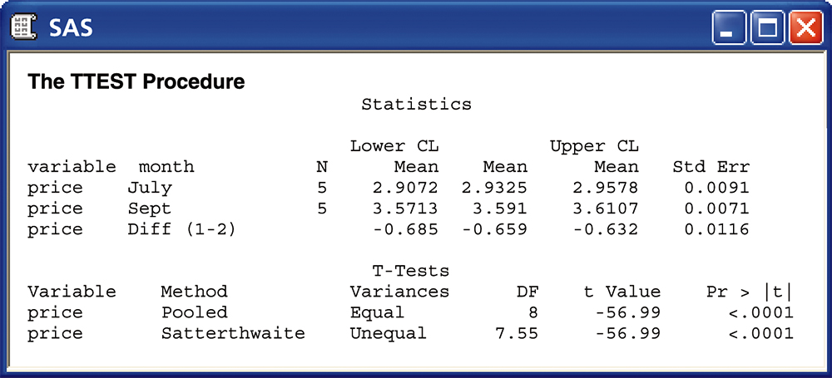
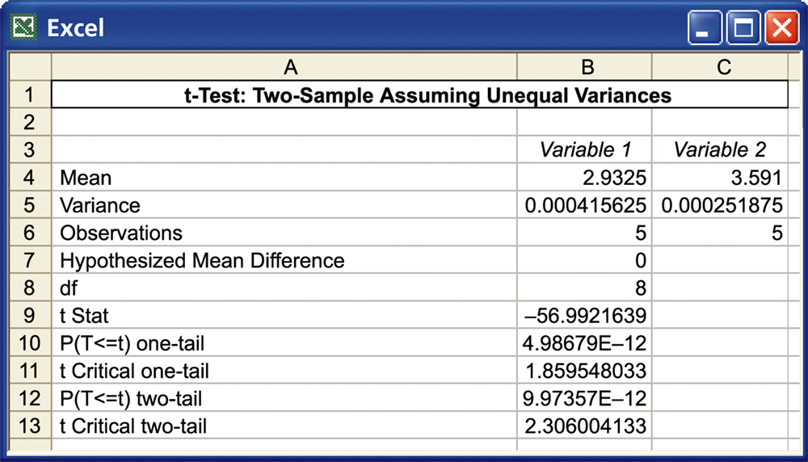
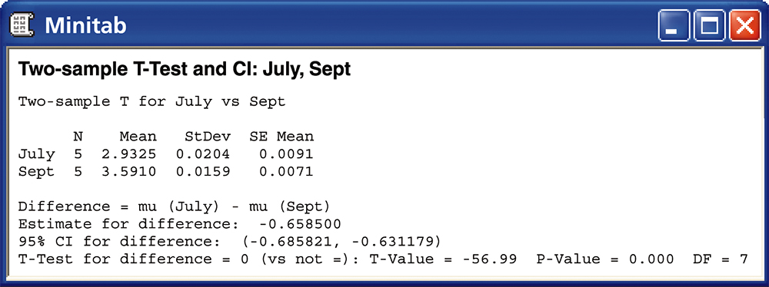
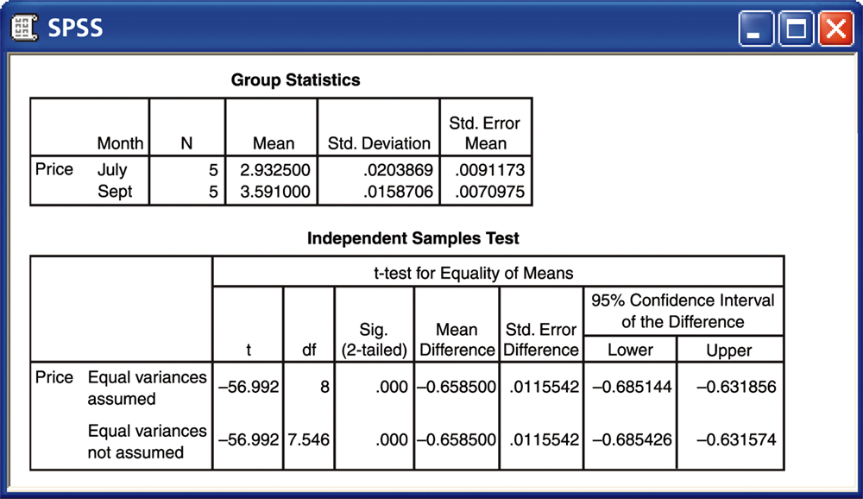
Figure 7.14
Introduction to the Practice of Statistics, Sixth Edition
© 2009 W.H. Freeman and Company

Slide 31
Definition, pg 462
Introduction to the Practice of Statistics, Sixth Edition
© 2009 W.H. Freeman and Company

Slide 32
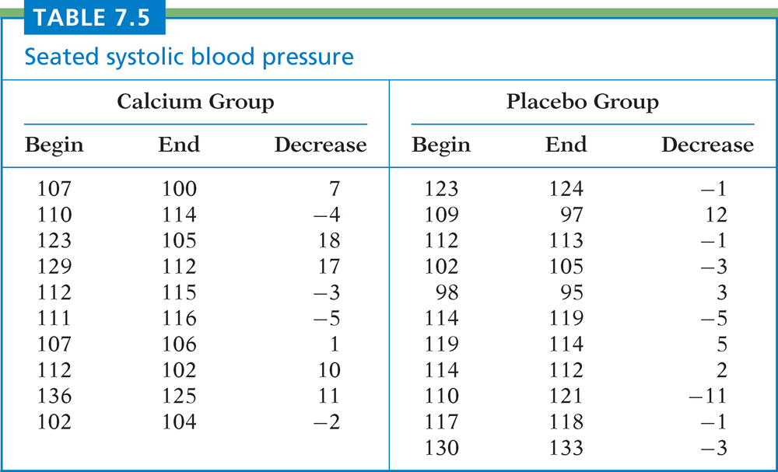
Table 7.5
Introduction to the Practice of Statistics, Sixth Edition
© 2009 W.H. Freeman and Company

Slide 33
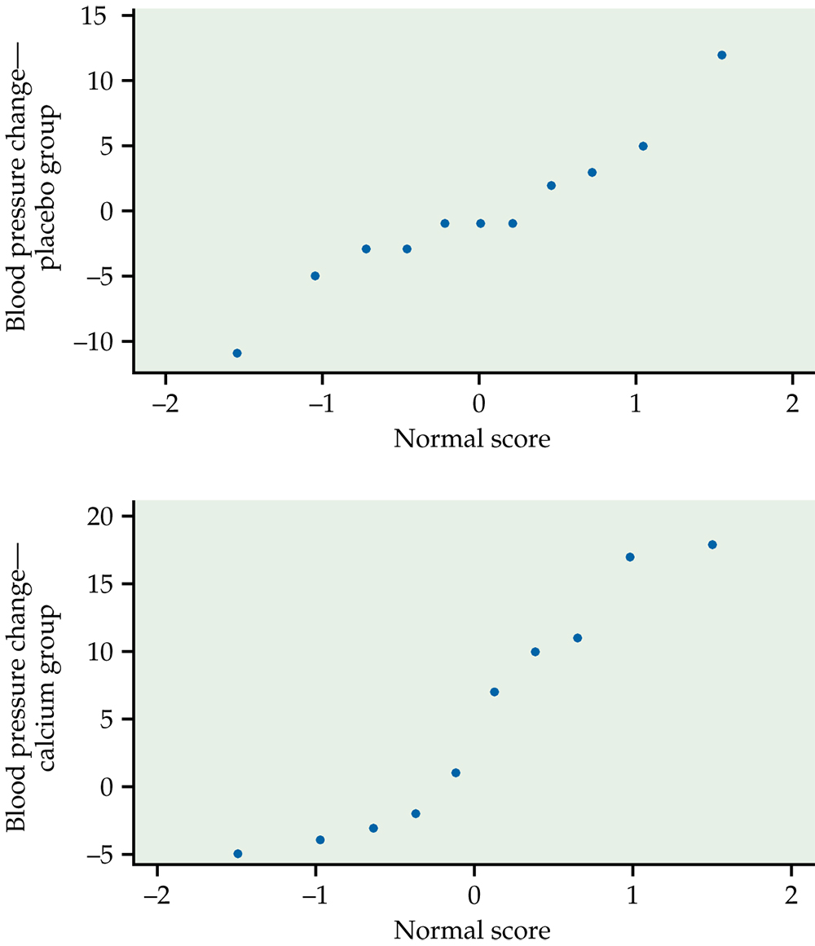
Figure 7.15
Introduction to the Practice of Statistics, Sixth Edition
© 2009 W.H. Freeman and Company

Slide 34
Definition, pg 474
Introduction to the Practice of Statistics, Sixth Edition
© 2009 W.H. Freeman and Company

Slide 35
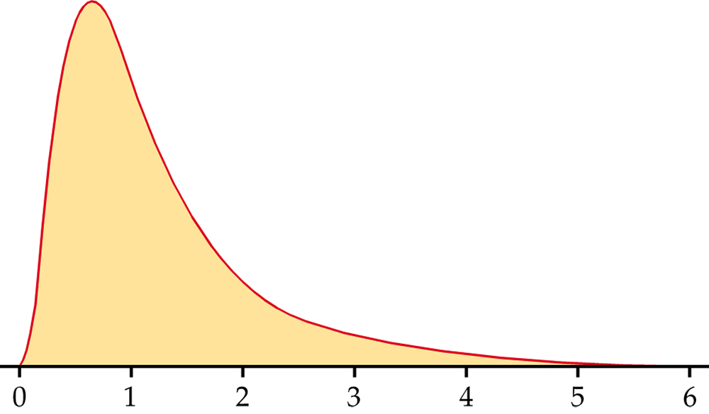
Figure 7.16
Introduction to the Practice of Statistics, Sixth Edition
© 2009 W.H. Freeman and Company

