Slide 1
David S. Moore • George P. McCabe
Bruce A. Craig
Introduction to the
Practice of Statistics
Sixth Edition
Chapter 6:
Introduction to Inference
Copyright © 2009 by W. H. Freeman and Company

Slide 2
Chapter 6 Opener
Introduction to the Practice of Statistics, Sixth Edition
© 2009 W.H. Freeman and Company

Slide 3
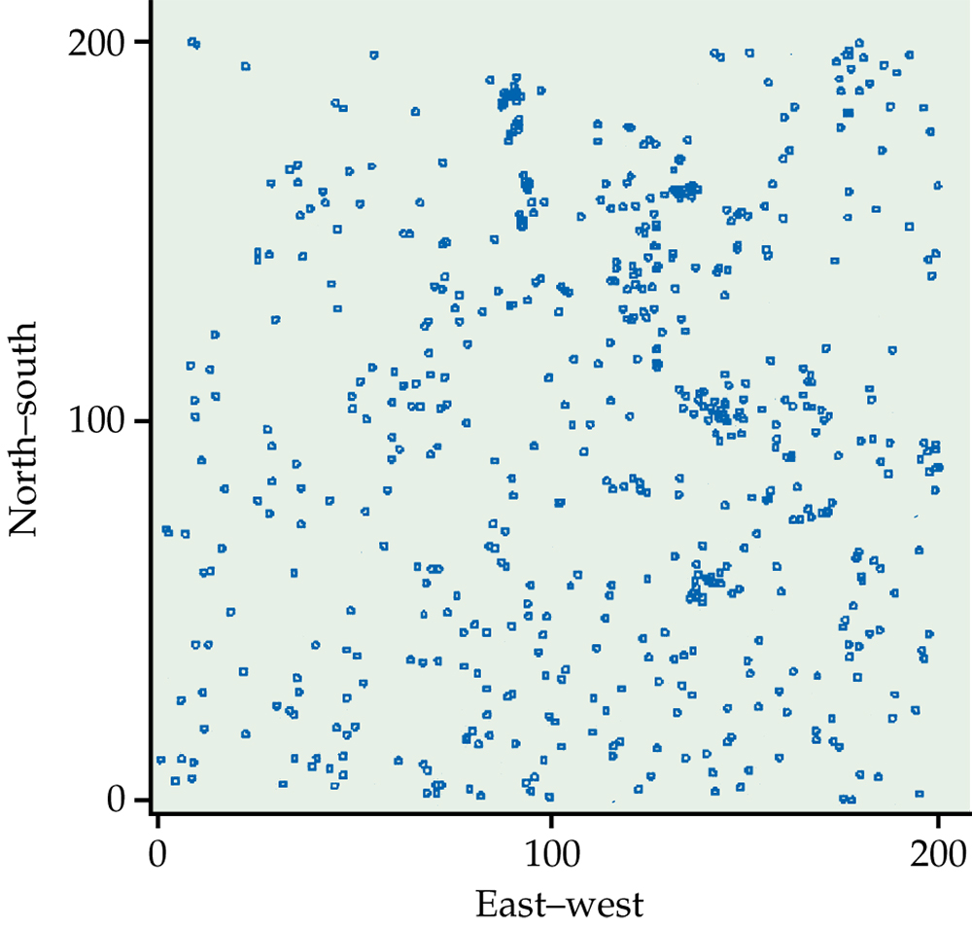
Figure 6.1
Introduction to the Practice of Statistics, Sixth Edition
© 2009 W.H. Freeman and Company

Slide 4
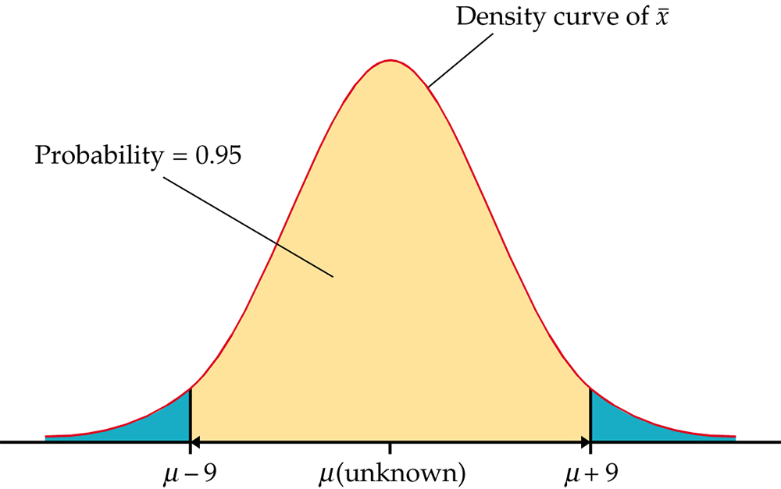
Figure 6.2
Introduction to the Practice of Statistics, Sixth Edition
© 2009 W.H. Freeman and Company

Slide 5
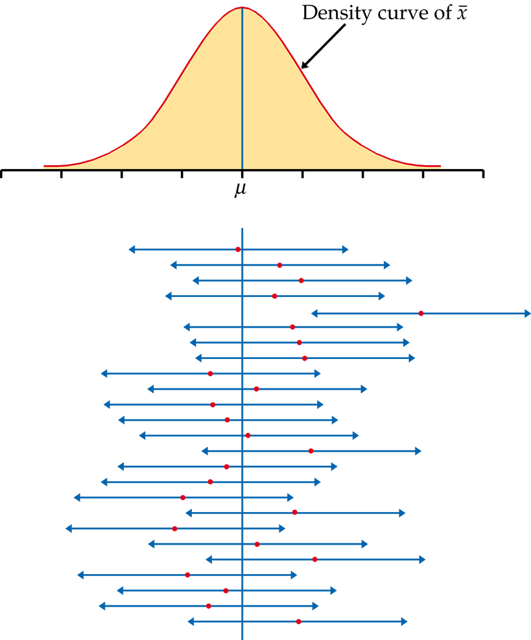
Figure 6.3
Introduction to the Practice of Statistics, Sixth Edition
© 2009 W.H. Freeman and Company

Slide 6
Definition, pg 359
Introduction to the Practice of Statistics, Sixth Edition
© 2009 W.H. Freeman and Company

Slide 7
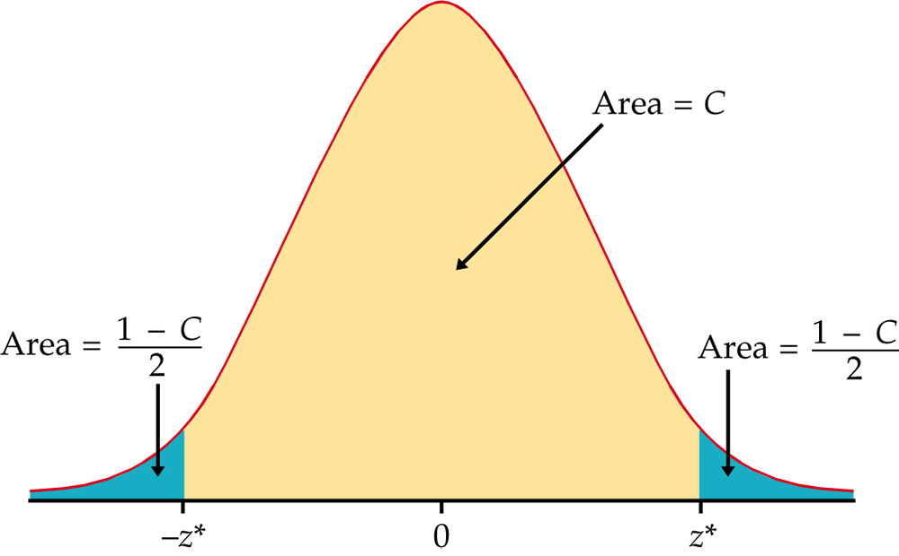
Figure 6.4
Introduction to the Practice of Statistics, Sixth Edition
© 2009 W.H. Freeman and Company

Slide 8
Definition, pg 361
Introduction to the Practice of Statistics, Sixth Edition
© 2009 W.H. Freeman and Company

Slide 9
Figure 6.5
Introduction to the Practice of Statistics, Sixth Edition
© 2009 W.H. Freeman and Company

Slide 10
Figure 6.6
Introduction to the Practice of Statistics, Sixth Edition
© 2009 W.H. Freeman and Company

Slide 11
Definition, pg 364
Introduction to the Practice of Statistics, Sixth Edition
© 2009 W.H. Freeman and Company

Slide 12
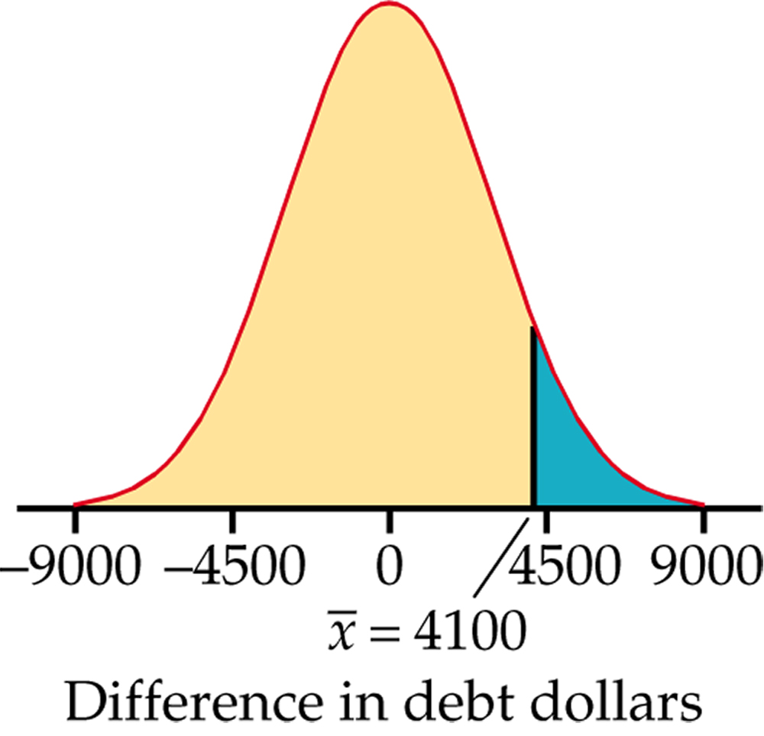
Figure 6.7
Introduction to the Practice of Statistics, Sixth Edition
© 2009 W.H. Freeman and Company

Slide 13
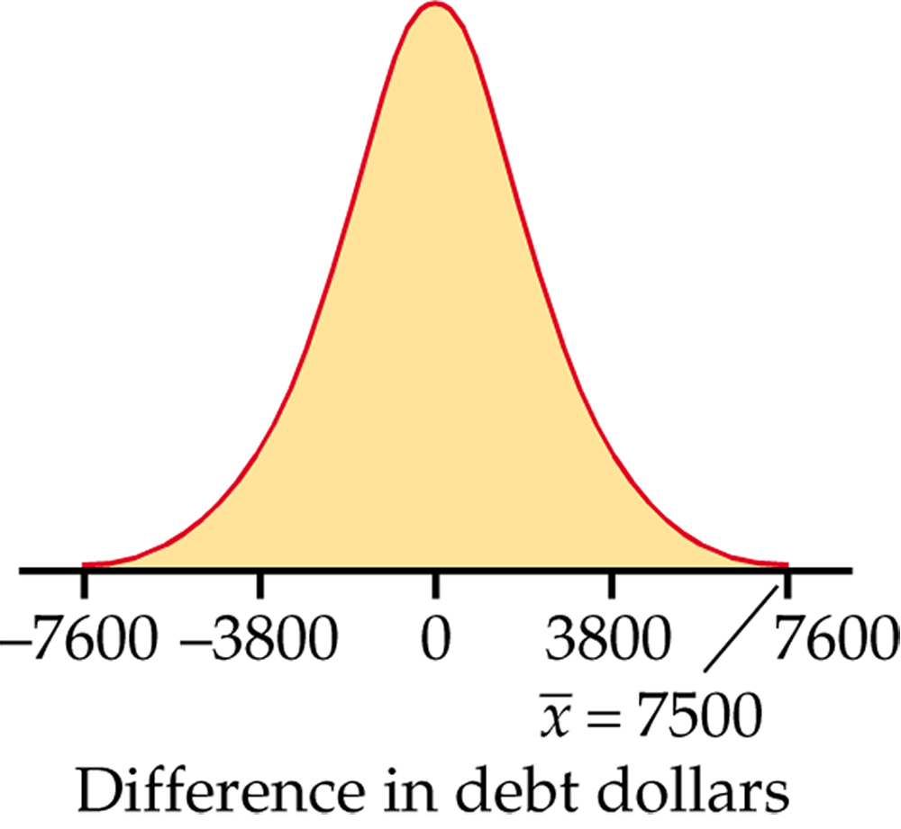
Figure 6.8
Introduction to the Practice of Statistics, Sixth Edition
© 2009 W.H. Freeman and Company

Slide 14
Definition, pg 375
Introduction to the Practice of Statistics, Sixth Edition
© 2009 W.H. Freeman and Company

Slide 15
Definition, pg 377
Introduction to the Practice of Statistics, Sixth Edition
© 2009 W.H. Freeman and Company

Slide 16
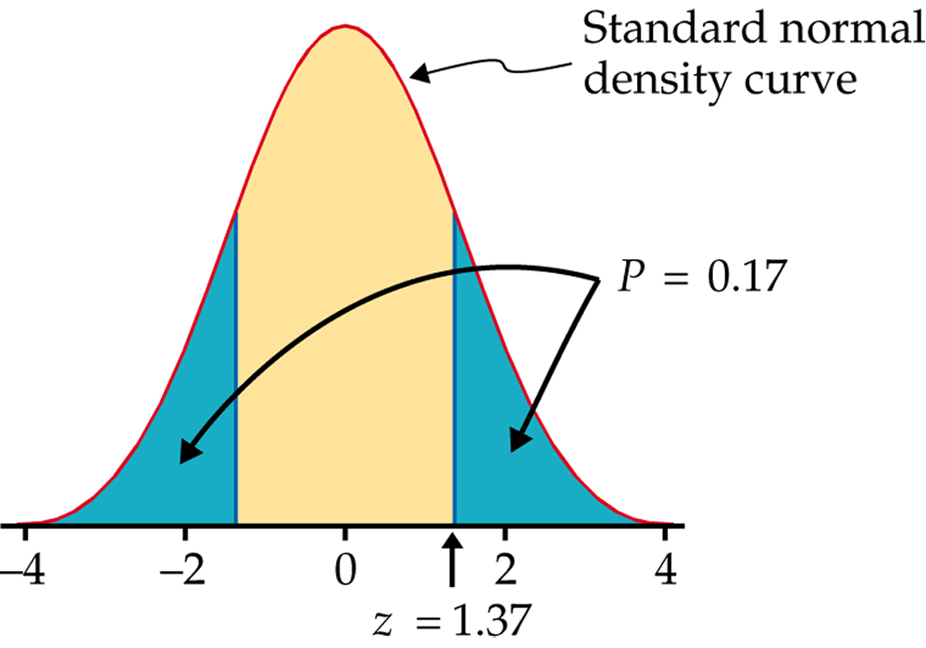
Figure 6.9
Introduction to the Practice of Statistics, Sixth Edition
© 2009 W.H. Freeman and Company

Slide 17
Definition, pg 379
Introduction to the Practice of Statistics, Sixth Edition
© 2009 W.H. Freeman and Company

Slide 18
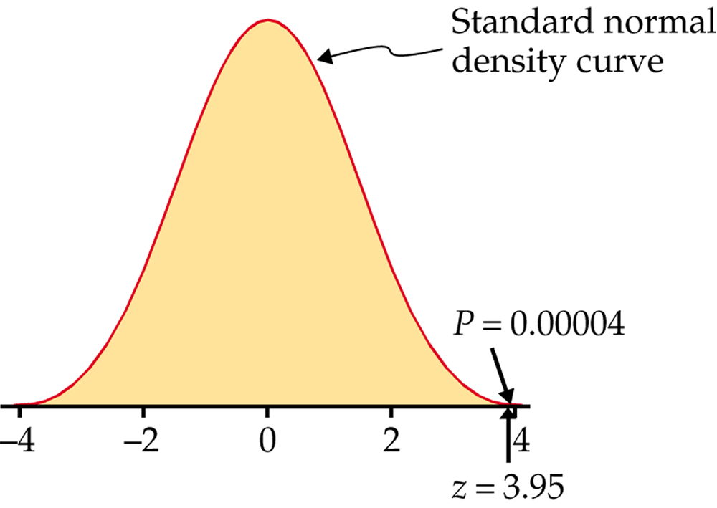
Figure 6.10
Introduction to the Practice of Statistics, Sixth Edition
© 2009 W.H. Freeman and Company

Slide 19
Definition, pg 383
Introduction to the Practice of Statistics, Sixth Edition
© 2009 W.H. Freeman and Company

Slide 20
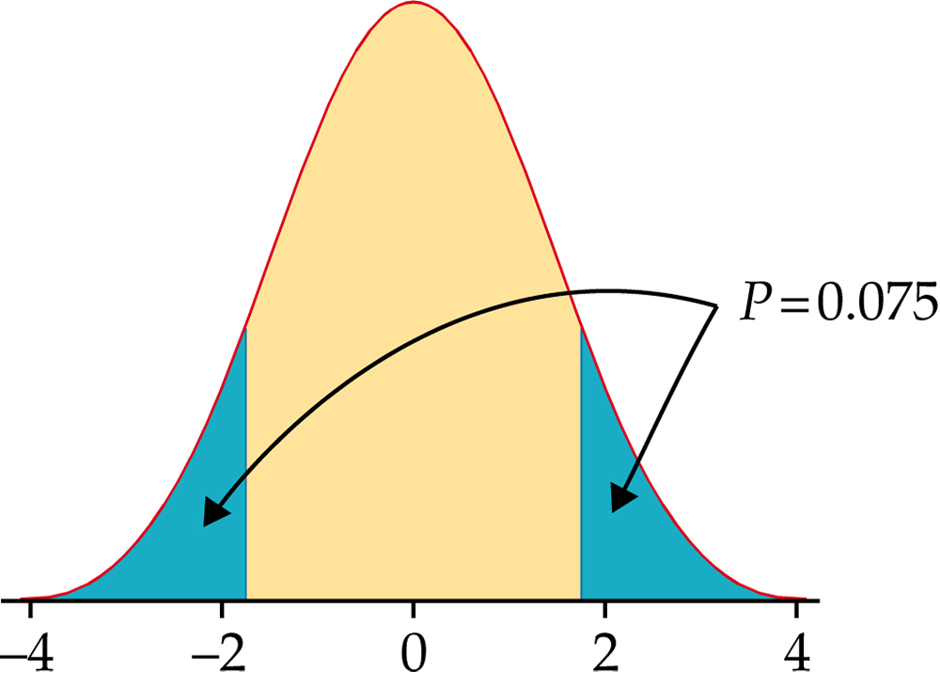
Figure 6.11
Introduction to the Practice of Statistics, Sixth Edition
© 2009 W.H. Freeman and Company

Slide 21
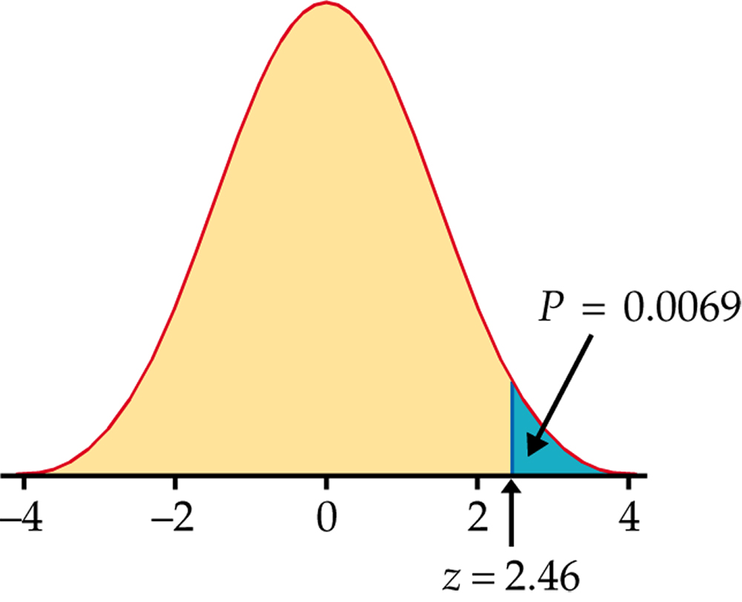
Figure 6.12
Introduction to the Practice of Statistics, Sixth Edition
© 2009 W.H. Freeman and Company

Slide 22
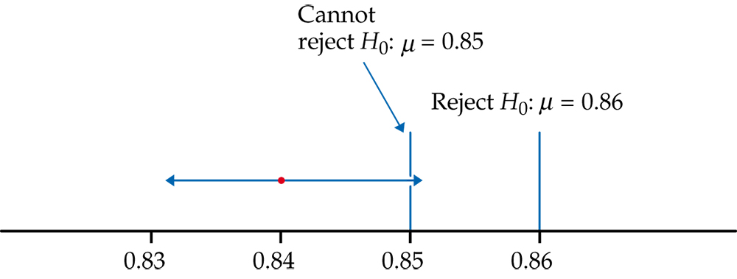
Figure 6.13
Introduction to the Practice of Statistics, Sixth Edition
© 2009 W.H. Freeman and Company

Slide 23
Definition, pg 388
Introduction to the Practice of Statistics, Sixth Edition
© 2009 W.H. Freeman and Company

Slide 24
Figure 6.14
Introduction to the Practice of Statistics, Sixth Edition
© 2009 W.H. Freeman and Company

Slide 25
Definition, pg 402
Introduction to the Practice of Statistics, Sixth Edition
© 2009 W.H. Freeman and Company

Slide 26
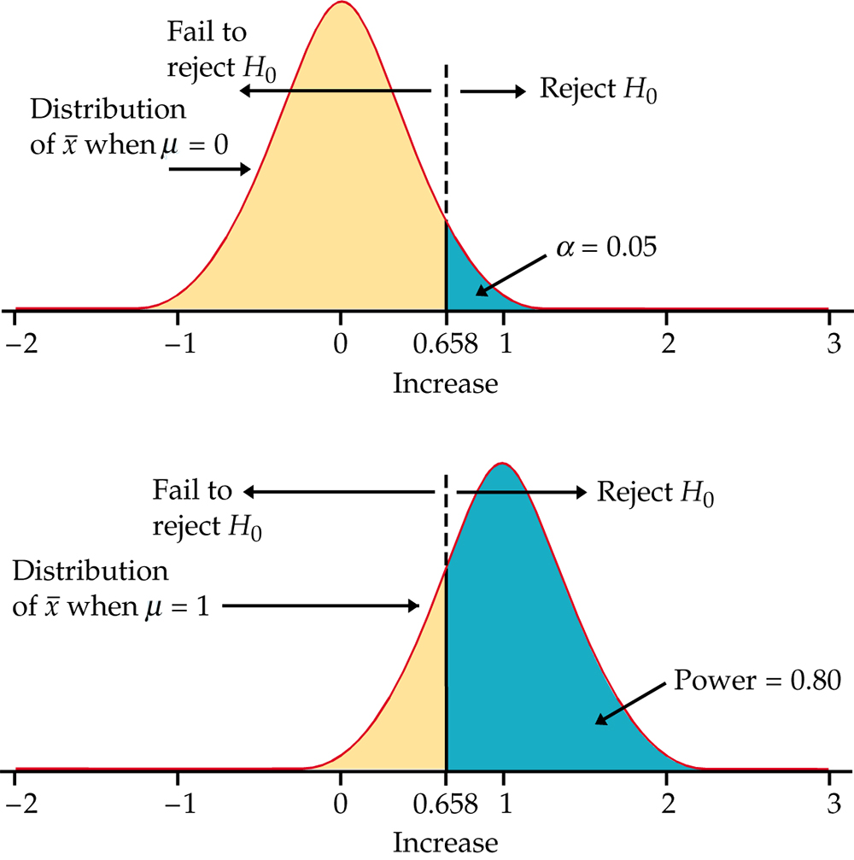
Figure 6.15
Introduction to the Practice of Statistics, Sixth Edition
© 2009 W.H. Freeman and Company

Slide 27
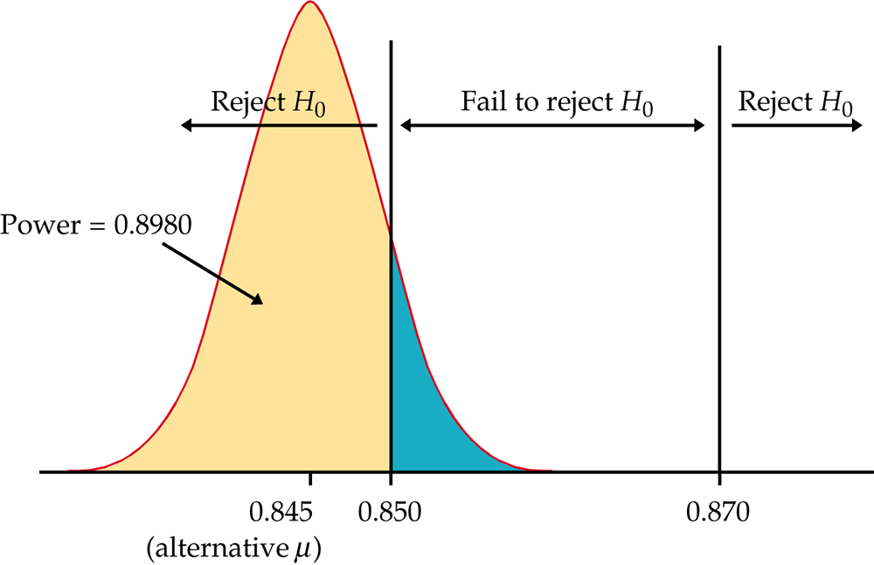
Figure 6.16
Introduction to the Practice of Statistics, Sixth Edition
© 2009 W.H. Freeman and Company

Slide 28
Definition, pg 406
Introduction to the Practice of Statistics, Sixth Edition
© 2009 W.H. Freeman and Company

Slide 29
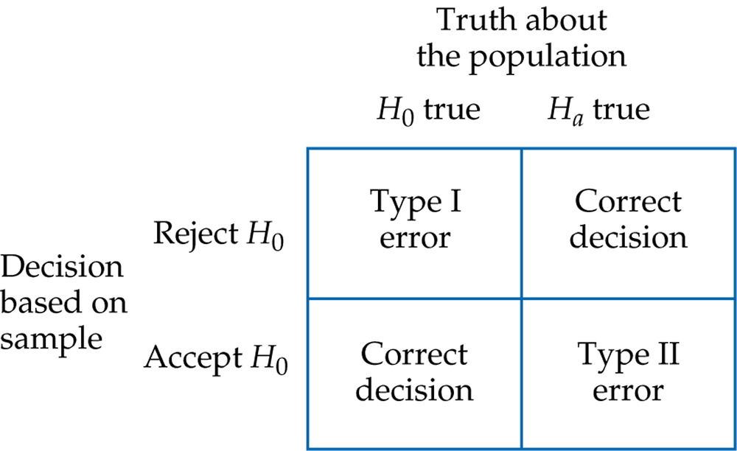
Figure 6.17
Introduction to the Practice of Statistics, Sixth Edition
© 2009 W.H. Freeman and Company

Slide 30
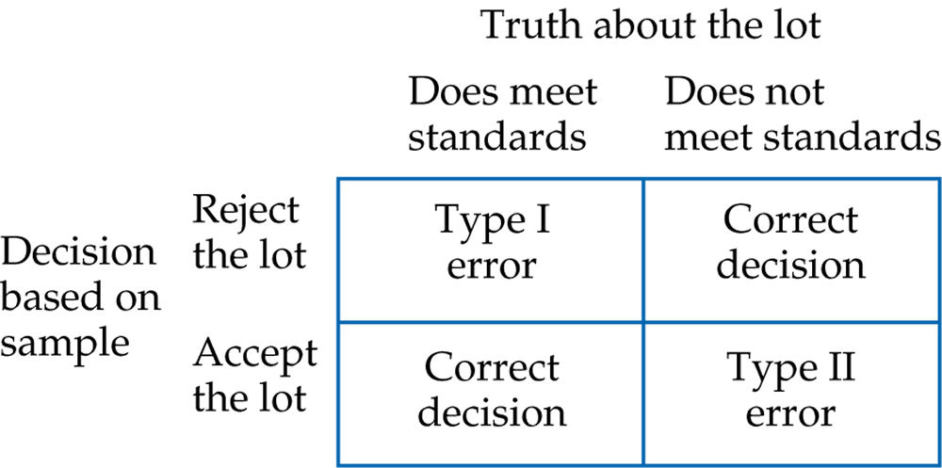
Figure 6.18
Introduction to the Practice of Statistics, Sixth Edition
© 2009 W.H. Freeman and Company

Slide 31
Definition, pg 408
Introduction to the Practice of Statistics, Sixth Edition
© 2009 W.H. Freeman and Company

Slide 32
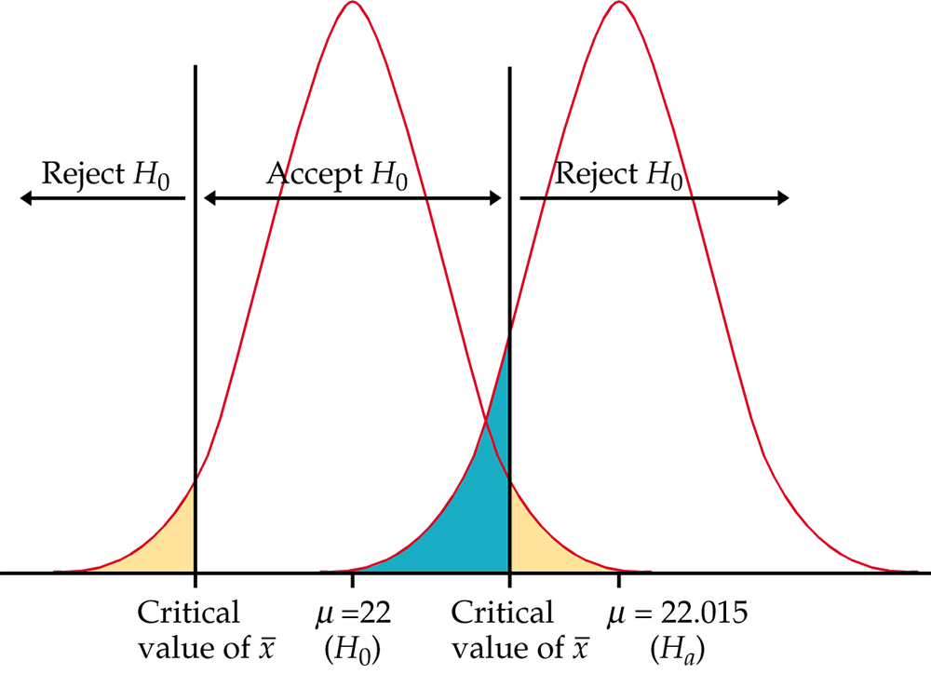
Figure 6.19
Introduction to the Practice of Statistics, Sixth Edition
© 2009 W.H. Freeman and Company

Slide 33
Definition, pg 409
Introduction to the Practice of Statistics, Sixth Edition
© 2009 W.H. Freeman and Company

