Slide 1
David S. Moore • George P. McCabe
Bruce A. Craig
Introduction to the
Practice of Statistics
Sixth Edition
Chapter 5:
Sampling Distributions
Copyright © 2009 by W. H. Freeman and Company

Slide 2
Chapter 5 Opener
Introduction to the Practice of Statistics, Sixth Edition
© 2009 W.H. Freeman and Company

Slide 3
Definition, pg 312
Introduction to the Practice of Statistics, Sixth Edition
© 2009 W.H. Freeman and Company

Slide 4
Definition, pg 312
Introduction to the Practice of Statistics, Sixth Edition
© 2009 W.H. Freeman and Company

Slide 5
Definition, pg 314
Introduction to the Practice of Statistics, Sixth Edition
© 2009 W.H. Freeman and Company

Slide 6
Definition, pg 314–315
Introduction to the Practice of Statistics, Sixth Edition
© 2009 W.H. Freeman and Company

Slide 7
Definition, pg 316
Introduction to the Practice of Statistics, Sixth Edition
© 2009 W.H. Freeman and Company

Slide 8
Figure 5.1
Introduction to the Practice of Statistics, Sixth Edition
© 2009 W.H. Freeman and Company

Slide 9
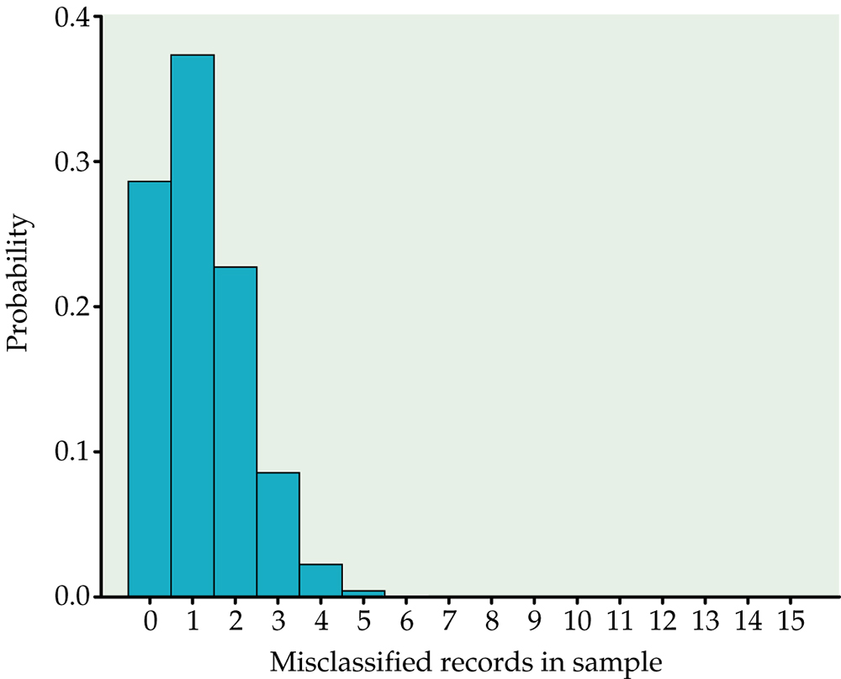
Figure 5.2
Introduction to the Practice of Statistics, Sixth Edition
© 2009 W.H. Freeman and Company

Slide 10
Definition, pg 320
Introduction to the Practice of Statistics, Sixth Edition
© 2009 W.H. Freeman and Company

Slide 11
Definition, pg 321–322
Introduction to the Practice of Statistics, Sixth Edition
© 2009 W.H. Freeman and Company

Slide 12
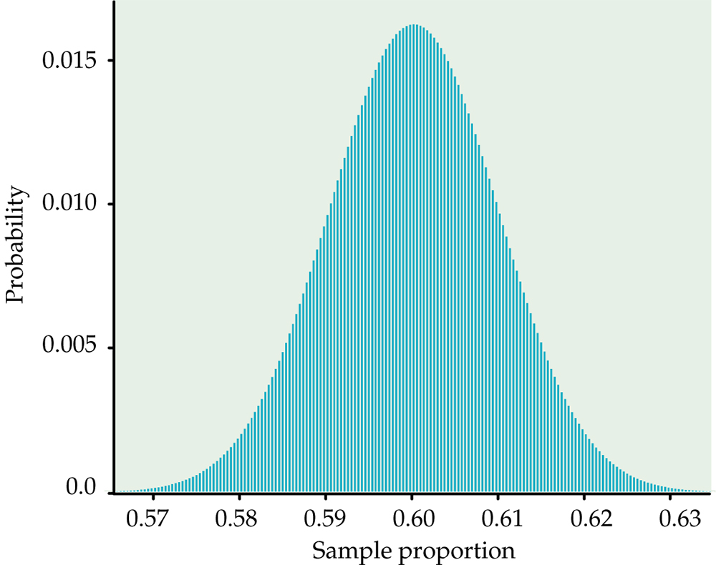
Figure 5.3
Introduction to the Practice of Statistics, Sixth Edition
© 2009 W.H. Freeman and Company

Slide 13
Definition, pg 323
Introduction to the Practice of Statistics, Sixth Edition
© 2009 W.H. Freeman and Company

Slide 14
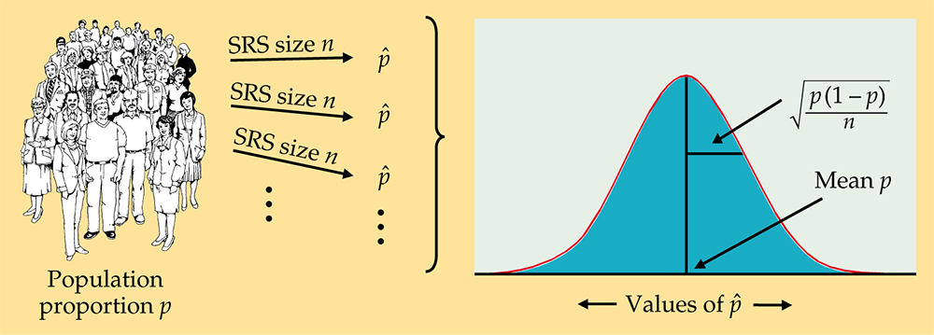
Figure 5.4
Introduction to the Practice of Statistics, Sixth Edition
© 2009 W.H. Freeman and Company

Slide 15
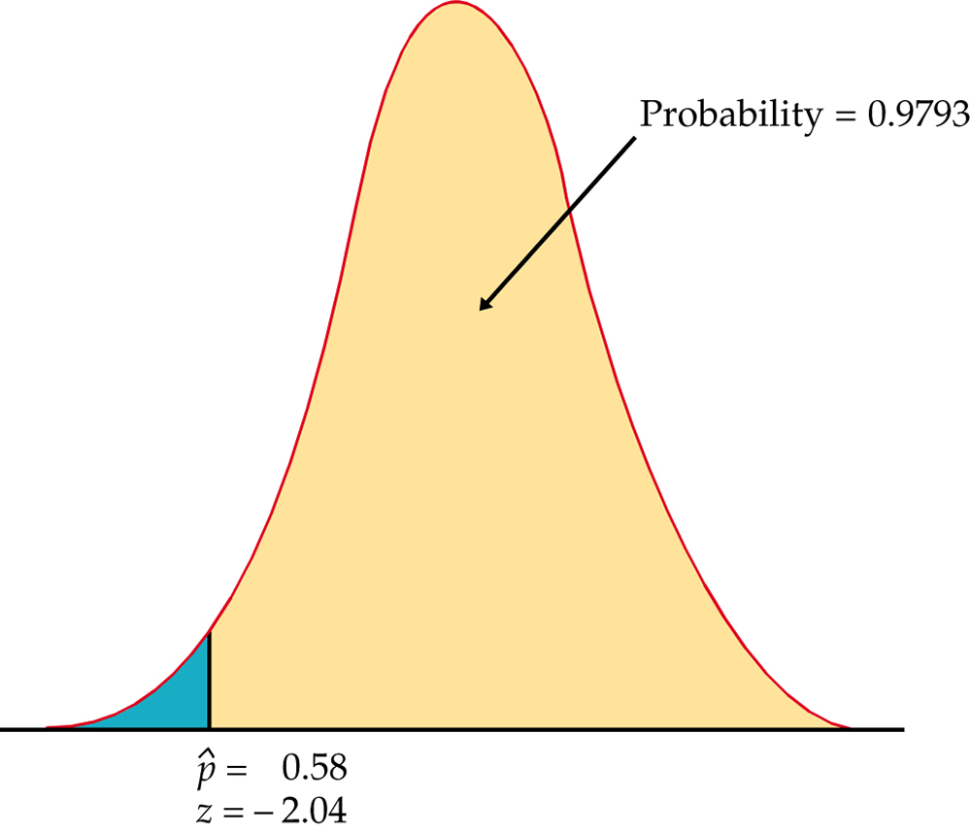
Figure 5.5
Introduction to the Practice of Statistics, Sixth Edition
© 2009 W.H. Freeman and Company

Slide 16
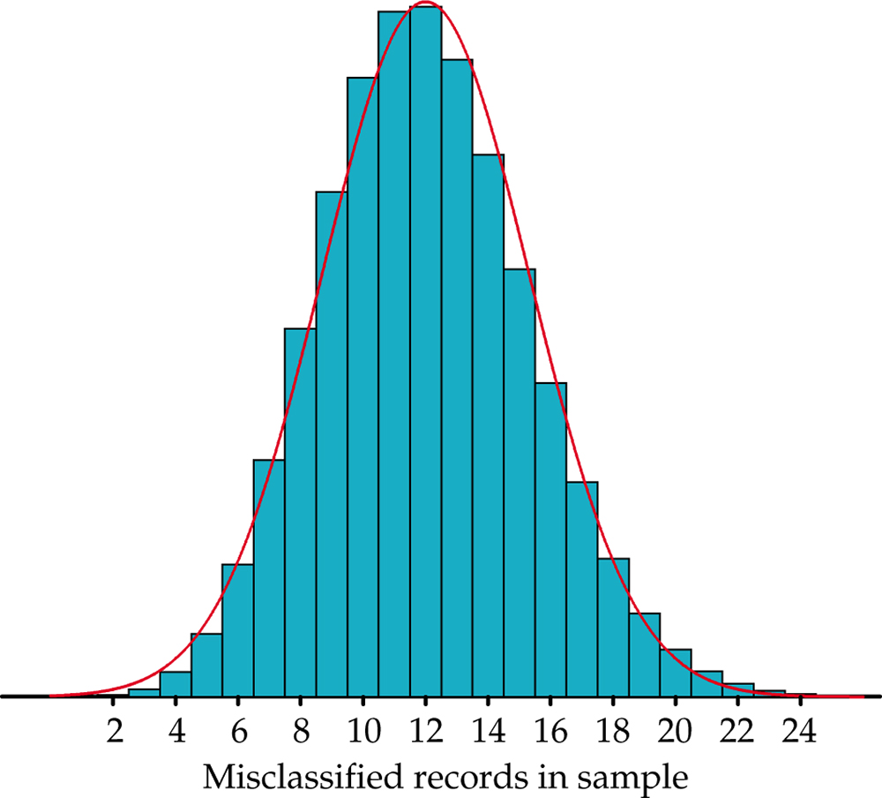
Figure 5.6
Introduction to the Practice of Statistics, Sixth Edition
© 2009 W.H. Freeman and Company

Slide 17
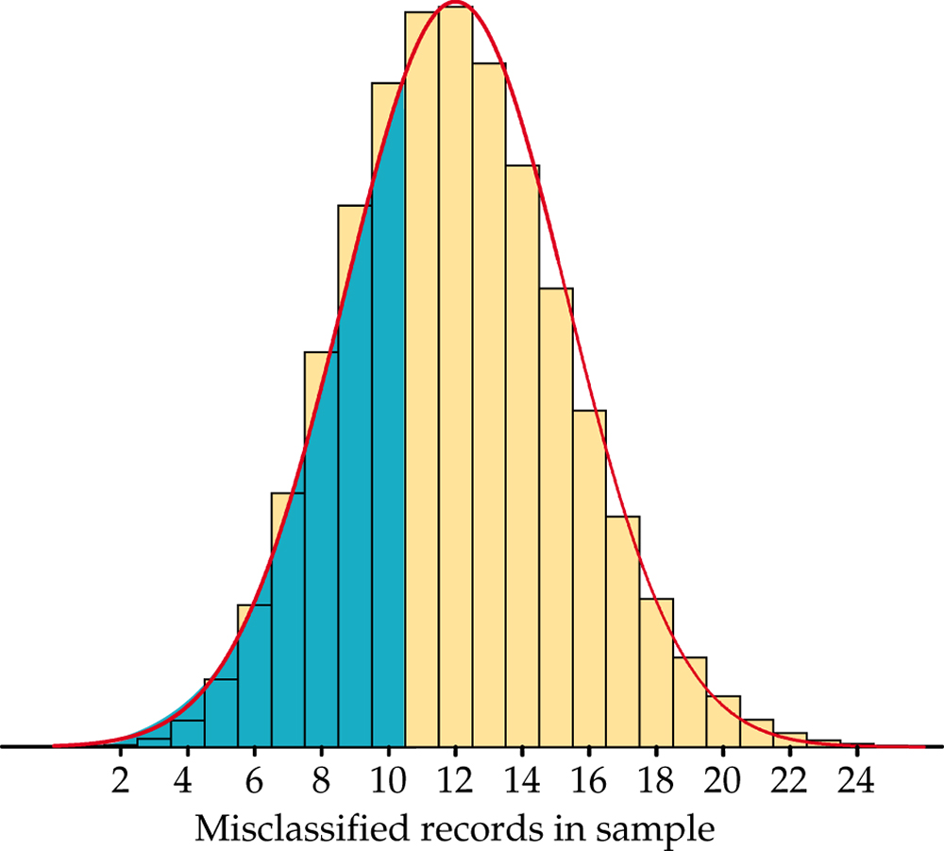
Figure 5.7
Introduction to the Practice of Statistics, Sixth Edition
© 2009 W.H. Freeman and Company

Slide 18
Definition, pg 328
Introduction to the Practice of Statistics, Sixth Edition
© 2009 W.H. Freeman and Company

Slide 19
Definition, pg 329
Introduction to the Practice of Statistics, Sixth Edition
© 2009 W.H. Freeman and Company

Slide 20
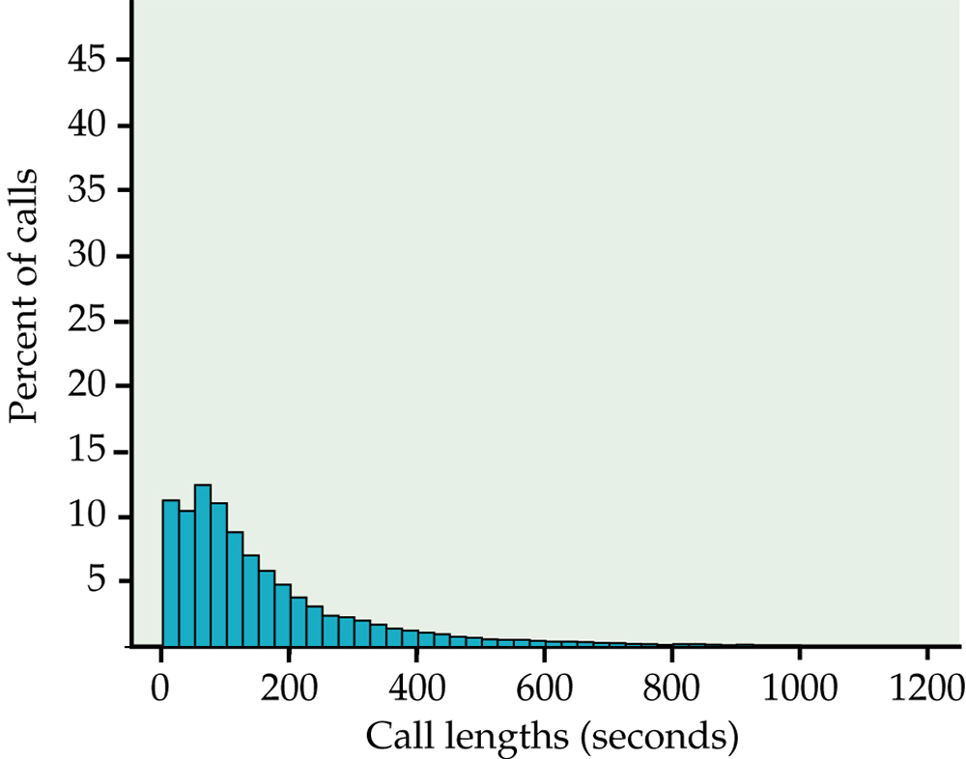
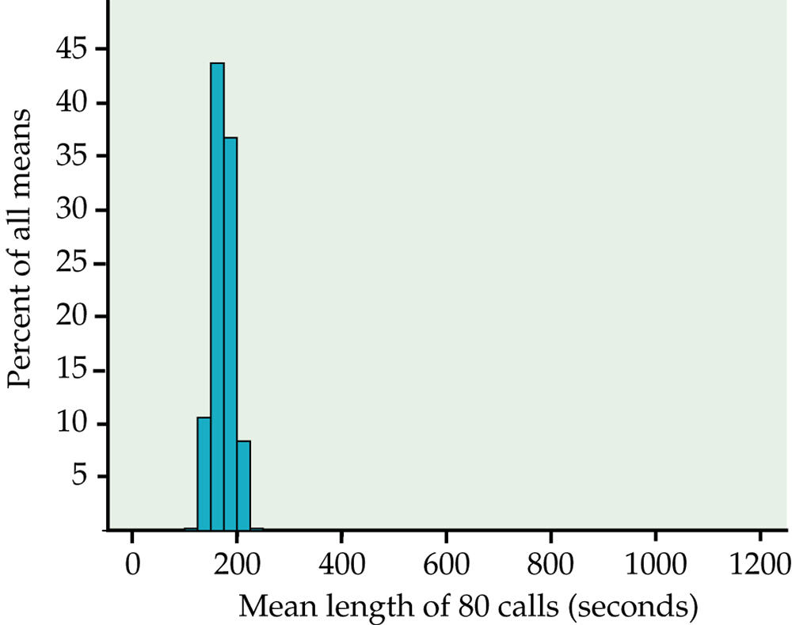
Figure 5.8
Introduction to the Practice of Statistics, Sixth Edition
© 2009 W.H. Freeman and Company

Slide 21
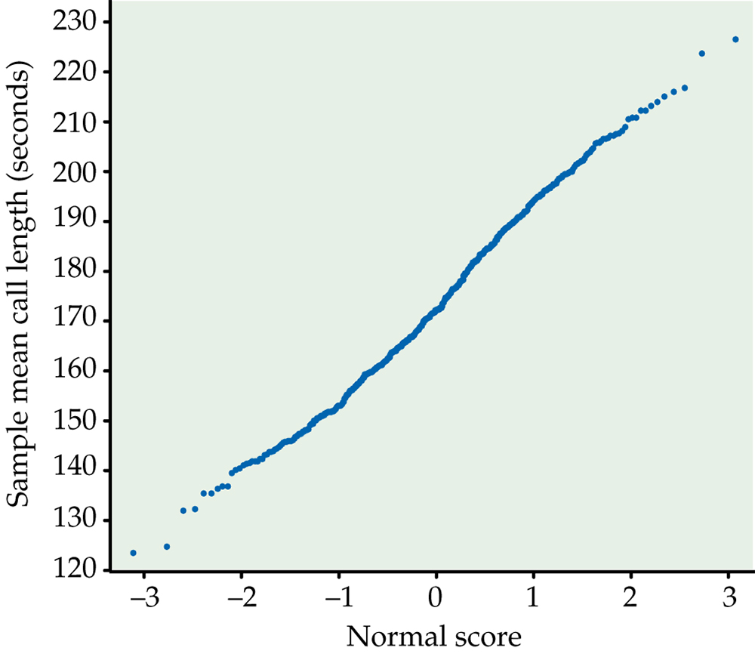
Figure 5.9
Introduction to the Practice of Statistics, Sixth Edition
© 2009 W.H. Freeman and Company

Slide 22
Definition, pg 337
Introduction to the Practice of Statistics, Sixth Edition
© 2009 W.H. Freeman and Company

Slide 23
Definition, pg 338
Introduction to the Practice of Statistics, Sixth Edition
© 2009 W.H. Freeman and Company

Slide 24
Definition, pg 339
Introduction to the Practice of Statistics, Sixth Edition
© 2009 W.H. Freeman and Company

Slide 25
Definition, pg 339
Introduction to the Practice of Statistics, Sixth Edition
© 2009 W.H. Freeman and Company

Slide 26
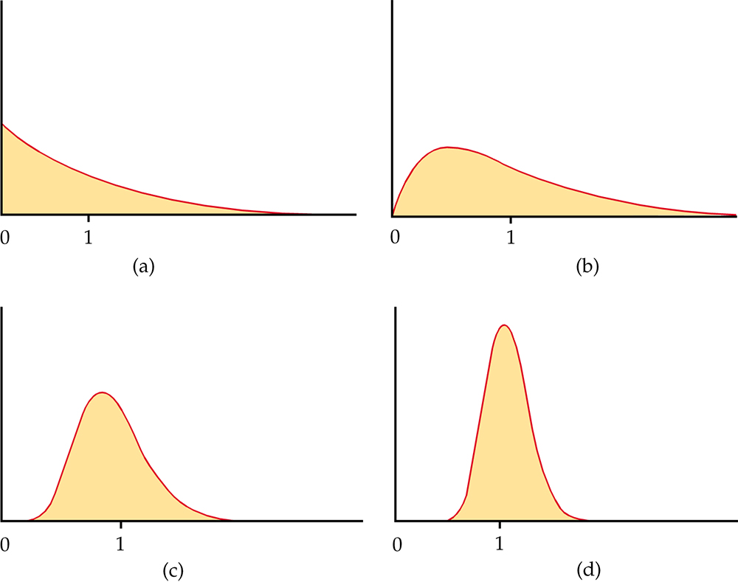
Figure 5.10
Introduction to the Practice of Statistics, Sixth Edition
© 2009 W.H. Freeman and Company

Slide 27
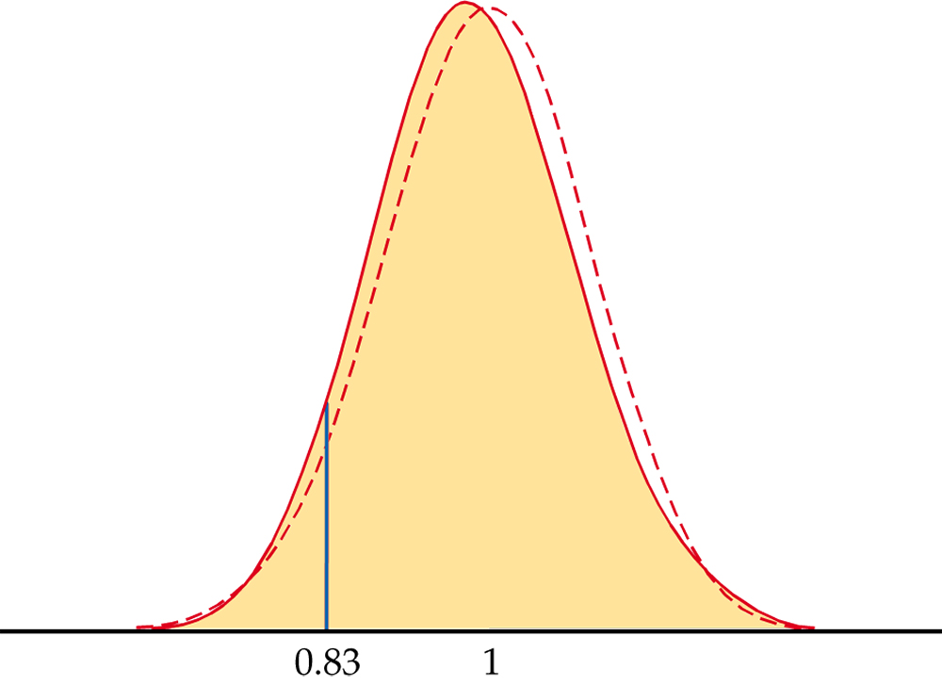
Figure 5.11
Introduction to the Practice of Statistics, Sixth Edition
© 2009 W.H. Freeman and Company

Slide 28
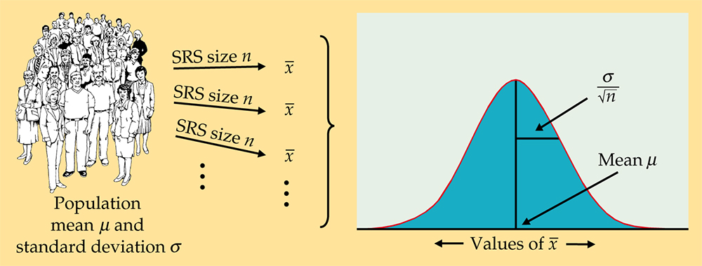
Figure 5.12
Introduction to the Practice of Statistics, Sixth Edition
© 2009 W.H. Freeman and Company

Slide 29
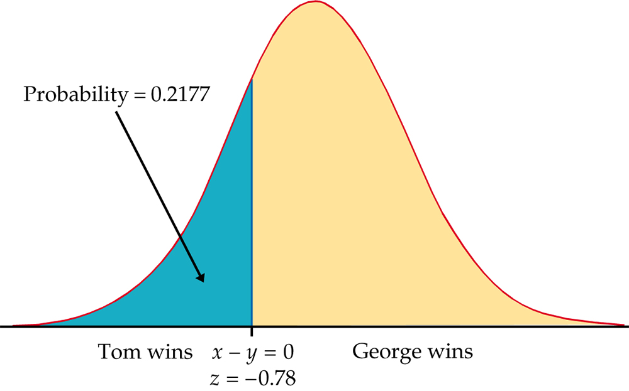
Figure 5.13
Introduction to the Practice of Statistics, Sixth Edition
© 2009 W.H. Freeman and Company

Slide 30
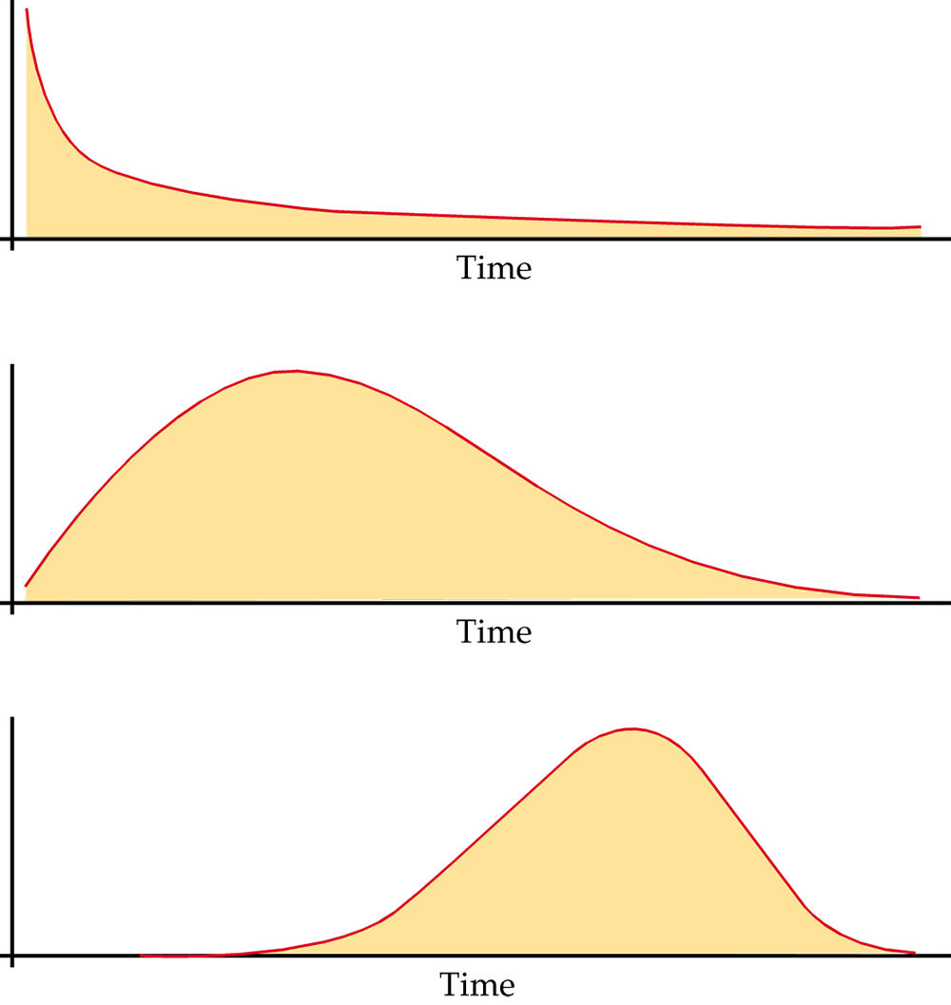
Figure 5.14
Introduction to the Practice of Statistics, Sixth Edition
© 2009 W.H. Freeman and Company

