Slide 1
David S. Moore • George P. McCabe
Bruce A. Craig
Introduction to the
Practice of Statistics
Sixth Edition
Chapter 4:
Probability: The Study of Randomness
Copyright © 2009 by W. H. Freeman and Company

Slide 2
Chapter 4 Opener
Introduction to the Practice of Statistics, Sixth Edition
© 2009 W.H. Freeman and Company

Slide 3
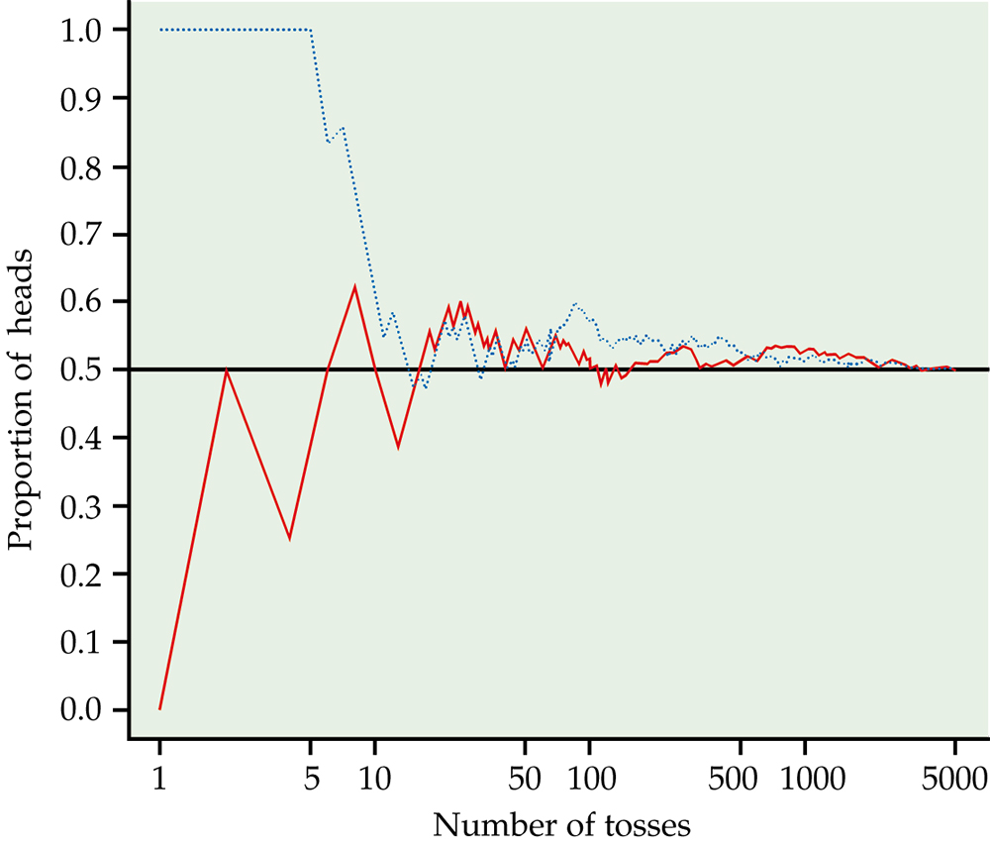
Figure 4.1
Introduction to the Practice of Statistics, Sixth Edition
© 2009 W.H. Freeman and Company

Slide 4
Definition, pg 239
Introduction to the Practice of Statistics, Sixth Edition
© 2009 W.H. Freeman and Company

Slide 5
Definition, pg 243
Introduction to the Practice of Statistics, Sixth Edition
© 2009 W.H. Freeman and Company

Slide 6
Definition, pg 245
Introduction to the Practice of Statistics, Sixth Edition
© 2009 W.H. Freeman and Company

Slide 7
Definition, pg 246
Introduction to the Practice of Statistics, Sixth Edition
© 2009 W.H. Freeman and Company

Slide 8
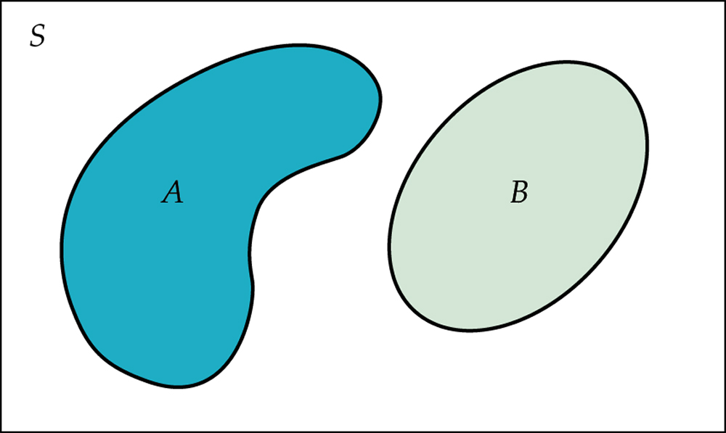
Figure 4.2
Introduction to the Practice of Statistics, Sixth Edition
© 2009 W.H. Freeman and Company

Slide 9
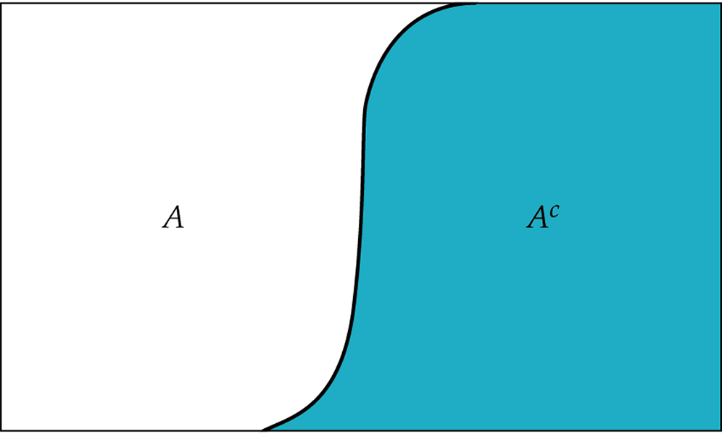
Figure 4.3
Introduction to the Practice of Statistics, Sixth Edition
© 2009 W.H. Freeman and Company

Slide 10
Definition, pg 248
Introduction to the Practice of Statistics, Sixth Edition
© 2009 W.H. Freeman and Company

Slide 11
Definition, pg 250
Introduction to the Practice of Statistics, Sixth Edition
© 2009 W.H. Freeman and Company

Slide 12
Definition, pg 251
Introduction to the Practice of Statistics, Sixth Edition
© 2009 W.H. Freeman and Company

Slide 13
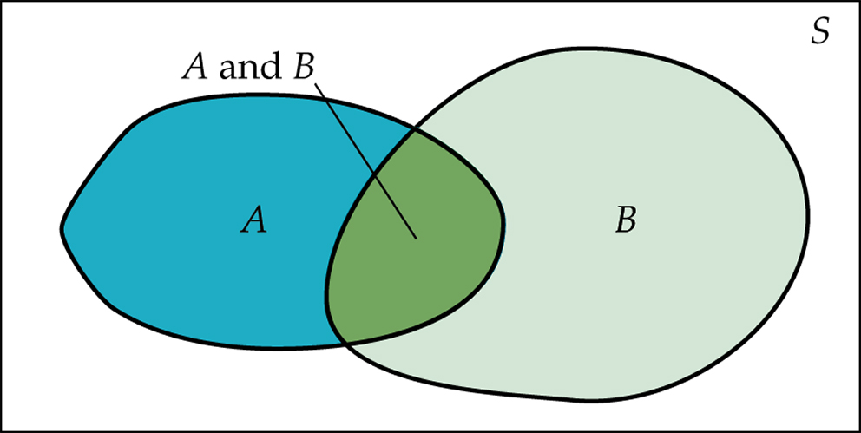
Figure 4.4
Introduction to the Practice of Statistics, Sixth Edition
© 2009 W.H. Freeman and Company

Slide 14
Definition, pg 259
Introduction to the Practice of Statistics, Sixth Edition
© 2009 W.H. Freeman and Company

Slide 15
Definition, pg 259
Introduction to the Practice of Statistics, Sixth Edition
© 2009 W.H. Freeman and Company

Slide 16
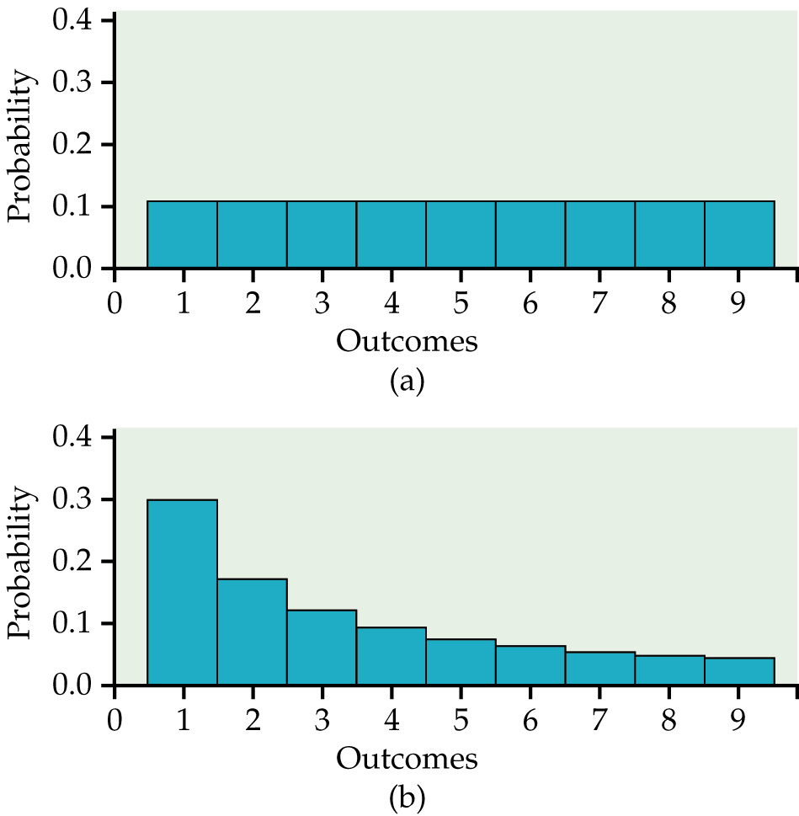
Figure 4.5
Introduction to the Practice of Statistics, Sixth Edition
© 2009 W.H. Freeman and Company

Slide 17
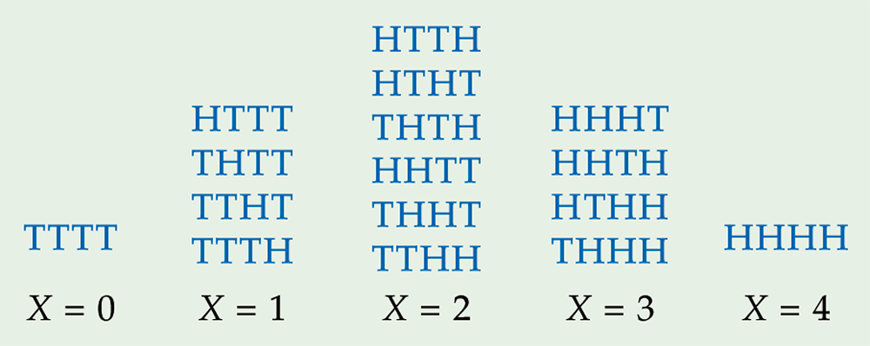
Figure 4.6
Introduction to the Practice of Statistics, Sixth Edition
© 2009 W.H. Freeman and Company

Slide 18
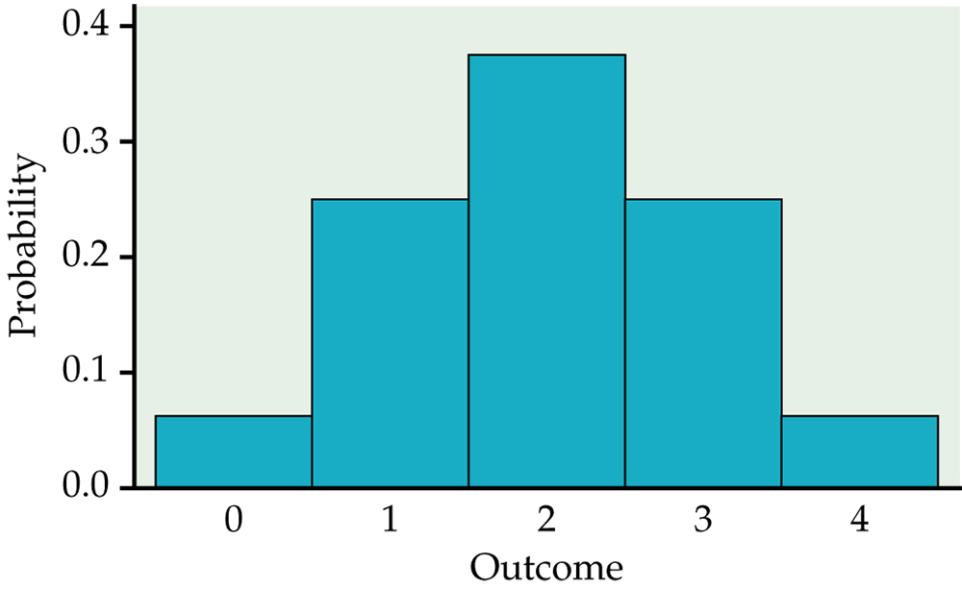
Figure 4.7
Introduction to the Practice of Statistics, Sixth Edition
© 2009 W.H. Freeman and Company

Slide 19
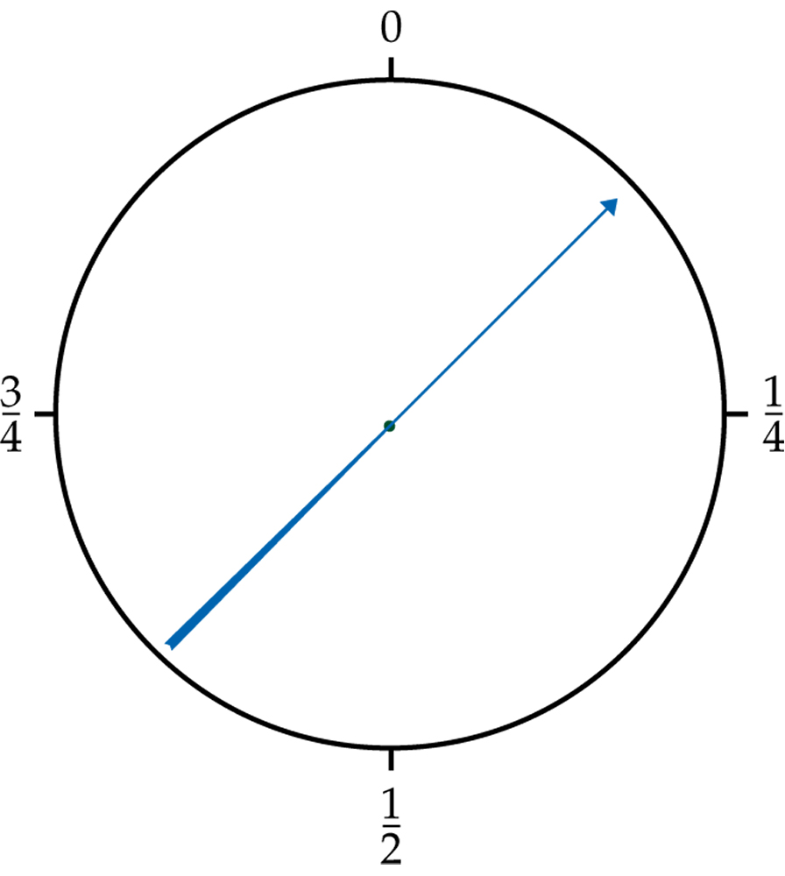
Figure 4.8
Introduction to the Practice of Statistics, Sixth Edition
© 2009 W.H. Freeman and Company

Slide 20
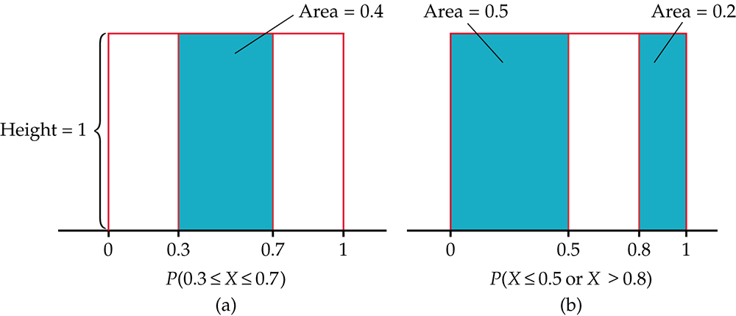
Figure 4.9
Introduction to the Practice of Statistics, Sixth Edition
© 2009 W.H. Freeman and Company

Slide 21
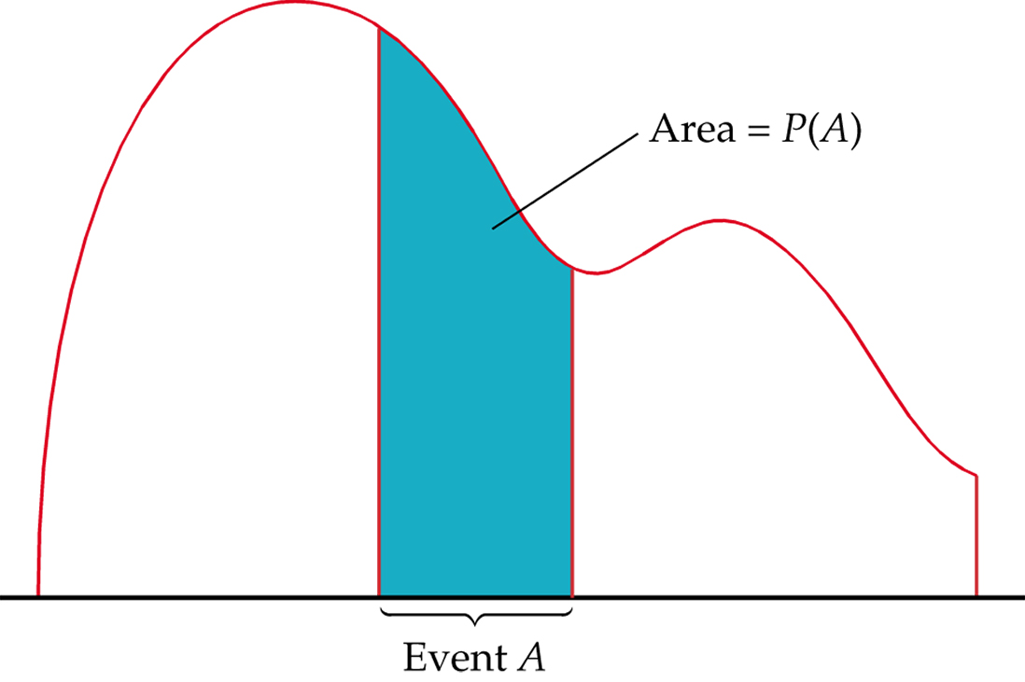
Figure 4.10
Introduction to the Practice of Statistics, Sixth Edition
© 2009 W.H. Freeman and Company

Slide 22
Definition, pg 265
Introduction to the Practice of Statistics, Sixth Edition
© 2009 W.H. Freeman and Company

Slide 23
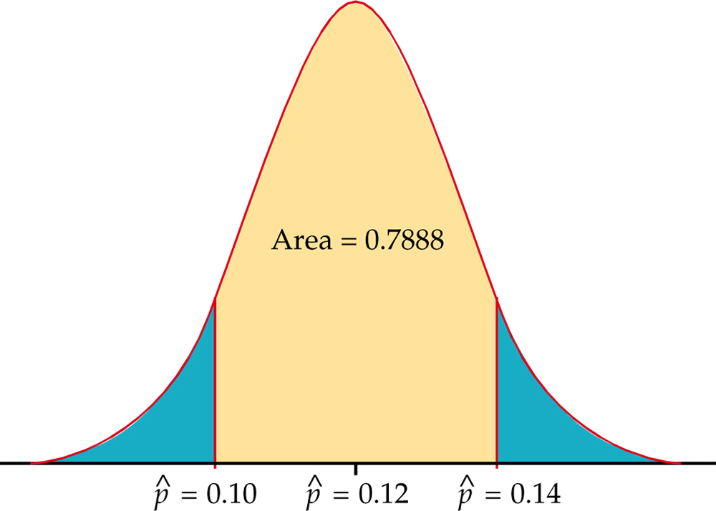
Figure 4.11
Introduction to the Practice of Statistics, Sixth Edition
© 2009 W.H. Freeman and Company

Slide 24
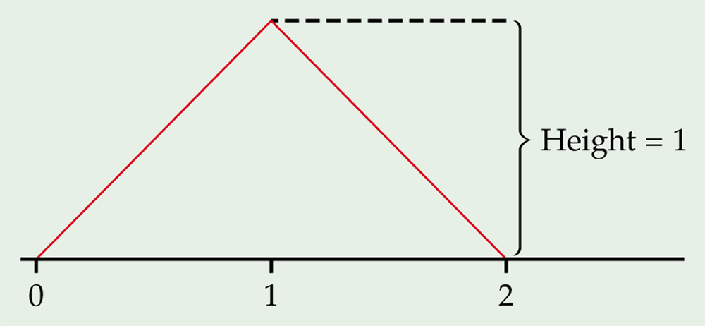
Figure 4.12
Introduction to the Practice of Statistics, Sixth Edition
© 2009 W.H. Freeman and Company

Slide 25
Definition, pg 271–272
Introduction to the Practice of Statistics, Sixth Edition
© 2009 W.H. Freeman and Company

Slide 26
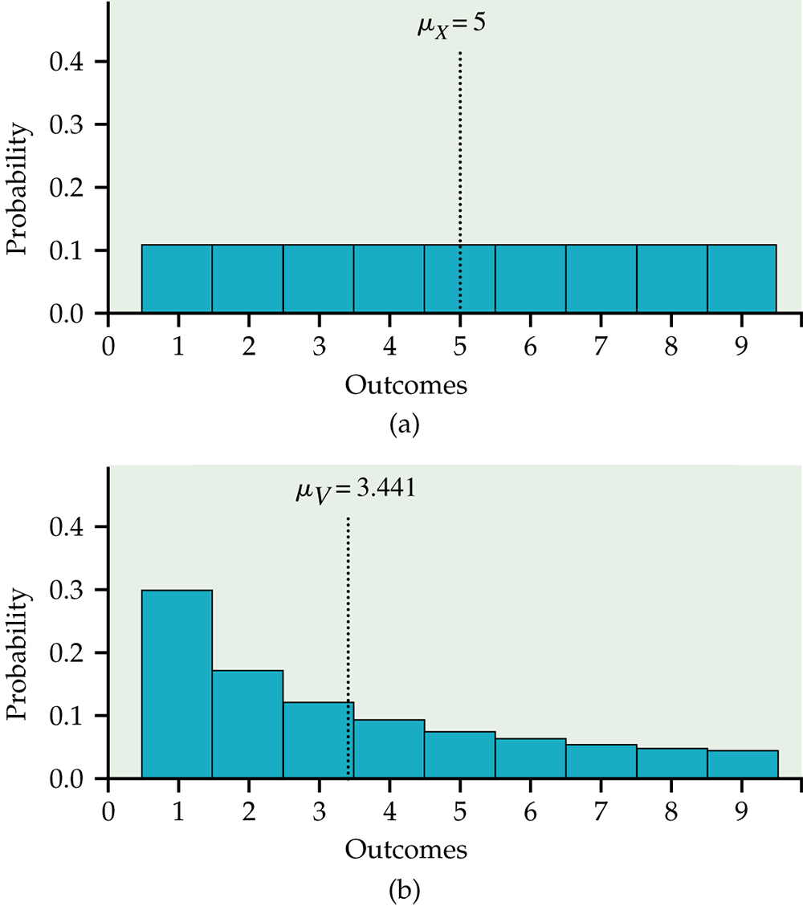
Figure 4.13
Introduction to the Practice of Statistics, Sixth Edition
© 2009 W.H. Freeman and Company

Slide 27
Definition, pg 274
Introduction to the Practice of Statistics, Sixth Edition
© 2009 W.H. Freeman and Company

Slide 28
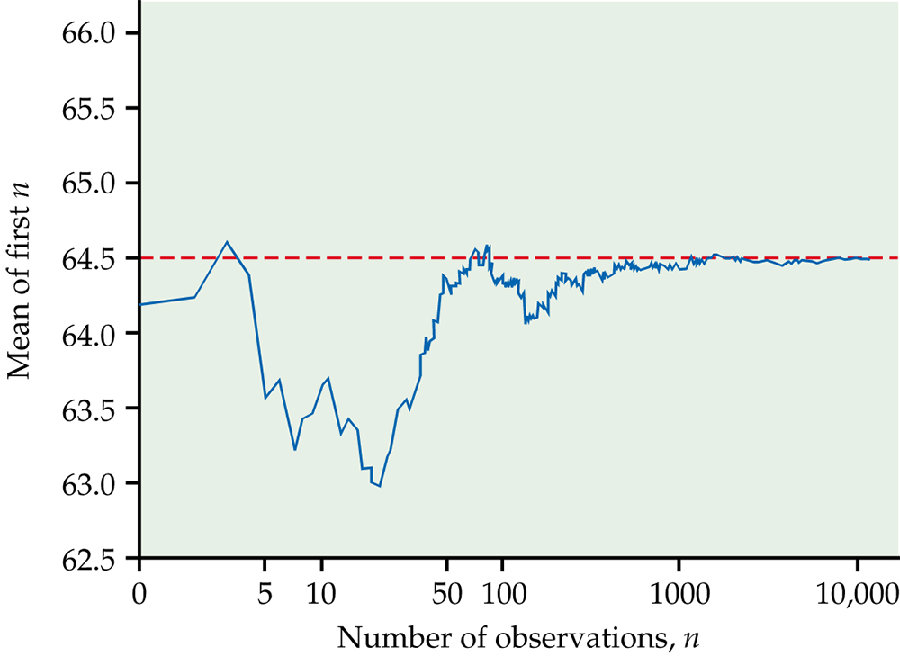
Figure 4.14
Introduction to the Practice of Statistics, Sixth Edition
© 2009 W.H. Freeman and Company

Slide 29
Definition, pg 278
Introduction to the Practice of Statistics, Sixth Edition
© 2009 W.H. Freeman and Company

Slide 30
Definition, pg 280
Introduction to the Practice of Statistics, Sixth Edition
© 2009 W.H. Freeman and Company

Slide 31
Definition, pg 282
Introduction to the Practice of Statistics, Sixth Edition
© 2009 W.H. Freeman and Company

Slide 32
Figure 4.15
Introduction to the Practice of Statistics, Sixth Edition
© 2009 W.H. Freeman and Company

Slide 33
Definition, pg 290
Introduction to the Practice of Statistics, Sixth Edition
© 2009 W.H. Freeman and Company

Slide 34
Definition, pg 290
Introduction to the Practice of Statistics, Sixth Edition
© 2009 W.H. Freeman and Company

Slide 35
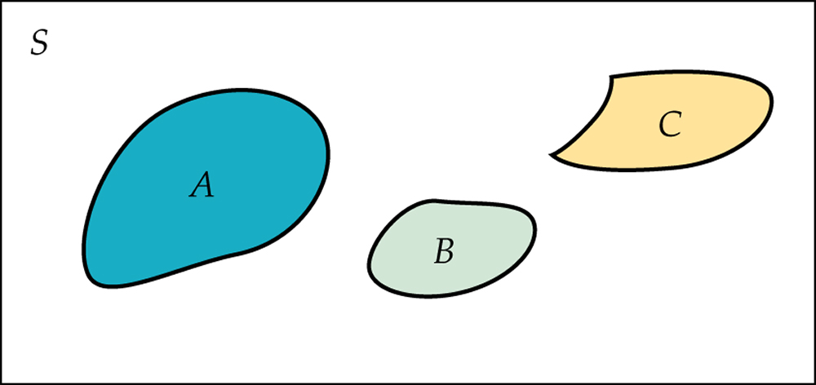
Figure 4.16
Introduction to the Practice of Statistics, Sixth Edition
© 2009 W.H. Freeman and Company

Slide 36
Definition, pg 291
Introduction to the Practice of Statistics, Sixth Edition
© 2009 W.H. Freeman and Company

Slide 37
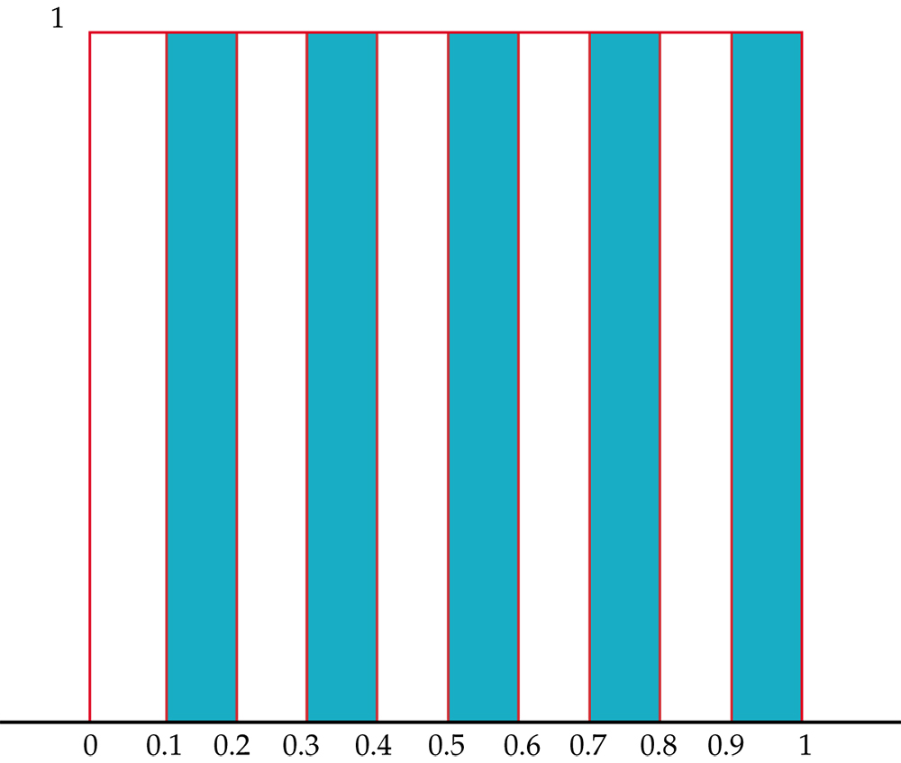
Figure 4.17
Introduction to the Practice of Statistics, Sixth Edition
© 2009 W.H. Freeman and Company

Slide 38
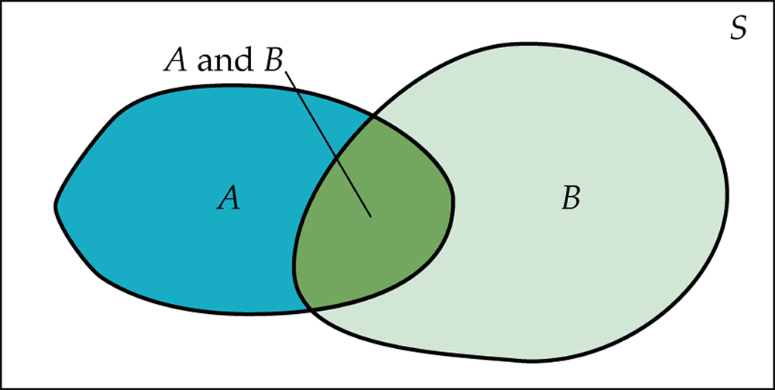
Figure 4.18
Introduction to the Practice of Statistics, Sixth Edition
© 2009 W.H. Freeman and Company

Slide 39
Definition, pg 292
Introduction to the Practice of Statistics, Sixth Edition
© 2009 W.H. Freeman and Company

Slide 40
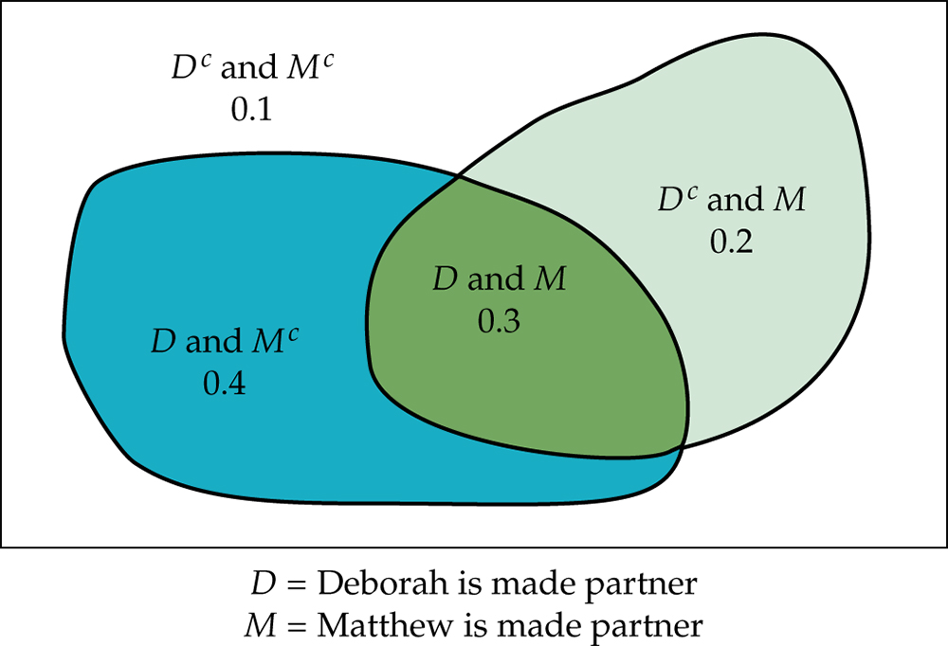
Figure 4.19
Introduction to the Practice of Statistics, Sixth Edition
© 2009 W.H. Freeman and Company

Slide 41
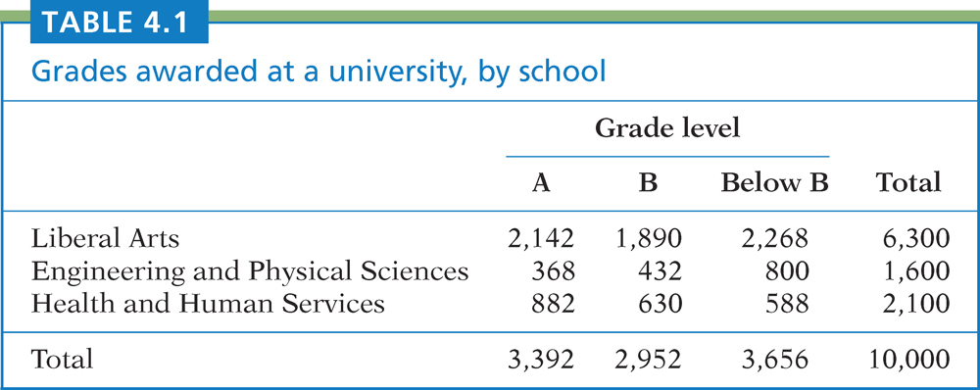
Table 4.1
Introduction to the Practice of Statistics, Sixth Edition
© 2009 W.H. Freeman and Company

Slide 42
Definition, pg 295–296
Introduction to the Practice of Statistics, Sixth Edition
© 2009 W.H. Freeman and Company

Slide 43
Definition, pg 297
Introduction to the Practice of Statistics, Sixth Edition
© 2009 W.H. Freeman and Company

Slide 44
Definition, pg 298
Introduction to the Practice of Statistics, Sixth Edition
© 2009 W.H. Freeman and Company

Slide 45
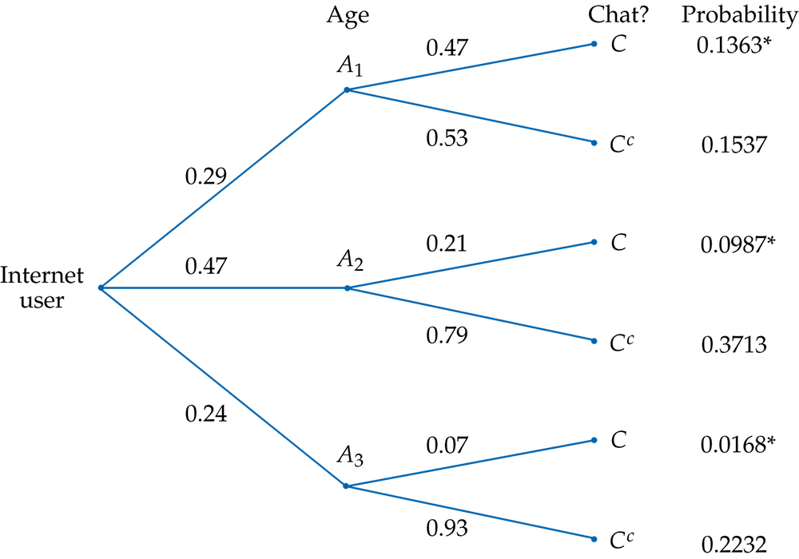
Figure 4.20
Introduction to the Practice of Statistics, Sixth Edition
© 2009 W.H. Freeman and Company

Slide 46
Definition, pg 301–302
Introduction to the Practice of Statistics, Sixth Edition
© 2009 W.H. Freeman and Company

Slide 47
Definition, pg 302
Introduction to the Practice of Statistics, Sixth Edition
© 2009 W.H. Freeman and Company

