Slide 1
David S. Moore • George P. McCabe
Bruce A. Craig
Introduction to the
Practice of Statistics
Sixth Edition
Chapter 3:
Producing Data
Copyright © 2009 by W. H. Freeman and Company

Slide 2
Chapter 3 Opener
Introduction to the Practice of Statistics, Sixth Edition
© 2009 W.H. Freeman and Company

Slide 3
Definition, pg 172
Introduction to the Practice of Statistics, Sixth Edition
© 2009 W.H. Freeman and Company

Slide 4
Definition, pg 172
Introduction to the Practice of Statistics, Sixth Edition
© 2009 W.H. Freeman and Company

Slide 5
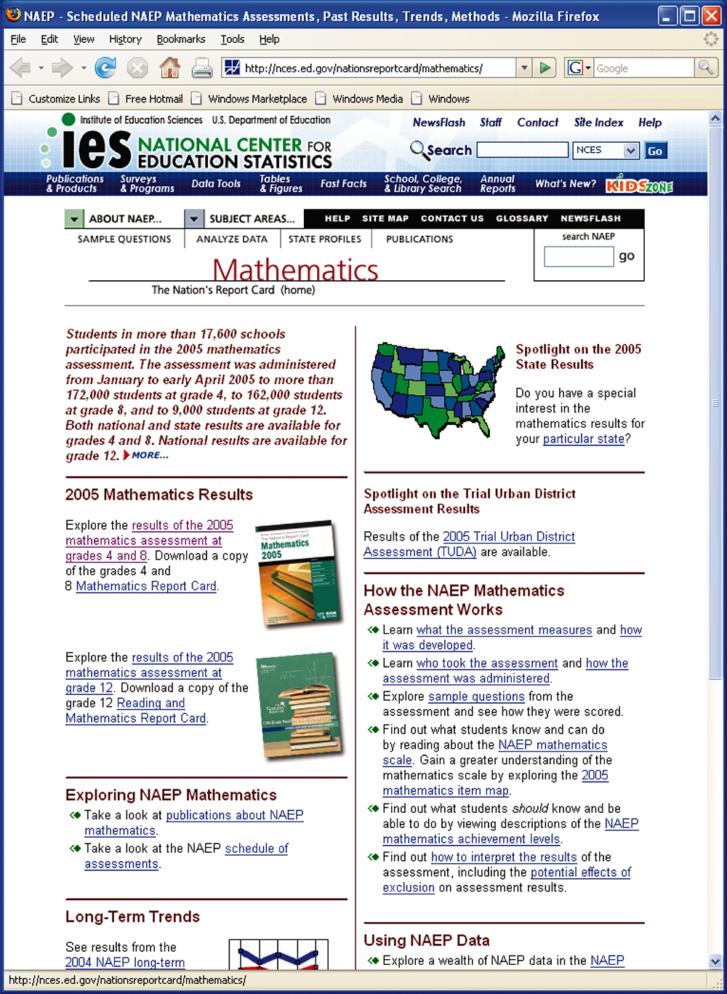
Figure 3.1
Introduction to the Practice of Statistics, Sixth Edition
© 2009 W.H. Freeman and Company

Slide 6
Definition, pg 175
Introduction to the Practice of Statistics, Sixth Edition
© 2009 W.H. Freeman and Company

Slide 7
Definition, pg 178
Introduction to the Practice of Statistics, Sixth Edition
© 2009 W.H. Freeman and Company

Slide 8
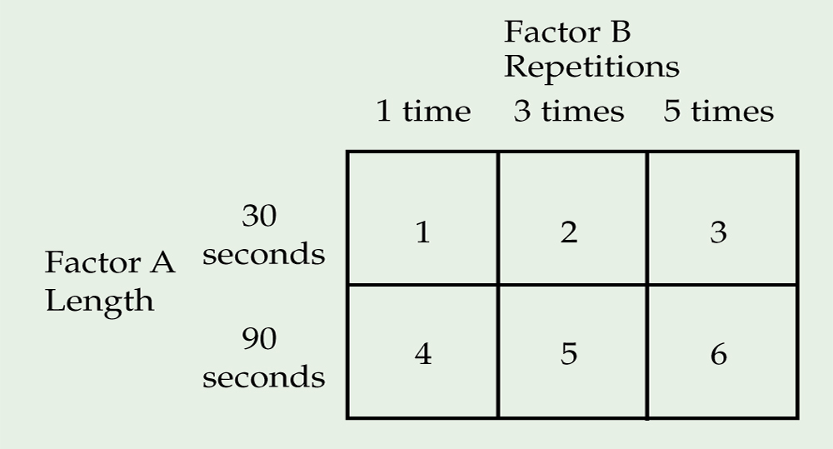
Figure 3.2
Introduction to the Practice of Statistics, Sixth Edition
© 2009 W.H. Freeman and Company

Slide 9
Definition, pg 181
Introduction to the Practice of Statistics, Sixth Edition
© 2009 W.H. Freeman and Company

Slide 10
Figure 3.3
Introduction to the Practice of Statistics, Sixth Edition
© 2009 W.H. Freeman and Company

Slide 11
Definition, pg 183–184
Introduction to the Practice of Statistics, Sixth Edition
© 2009 W.H. Freeman and Company

Slide 12
Definition, pg 184
Introduction to the Practice of Statistics, Sixth Edition
© 2009 W.H. Freeman and Company

Slide 13
Definition, pg 184
Introduction to the Practice of Statistics, Sixth Edition
© 2009 W.H. Freeman and Company

Slide 14
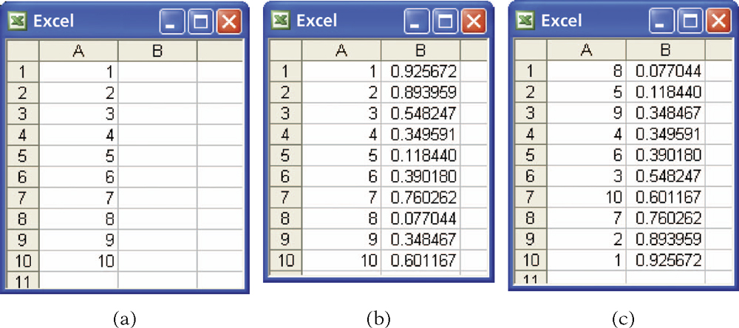
Figure 3.4
Introduction to the Practice of Statistics, Sixth Edition
© 2009 W.H. Freeman and Company

Slide 15
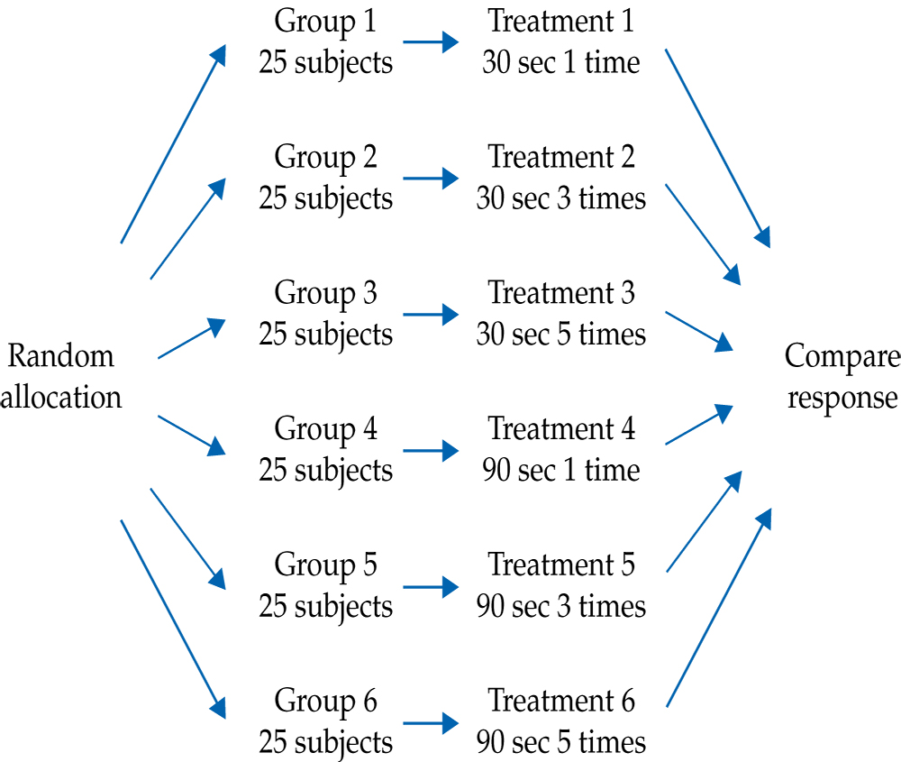
Figure 3.5
Introduction to the Practice of Statistics, Sixth Edition
© 2009 W.H. Freeman and Company

Slide 16
Definition, pg 190
Introduction to the Practice of Statistics, Sixth Edition
© 2009 W.H. Freeman and Company

Slide 17
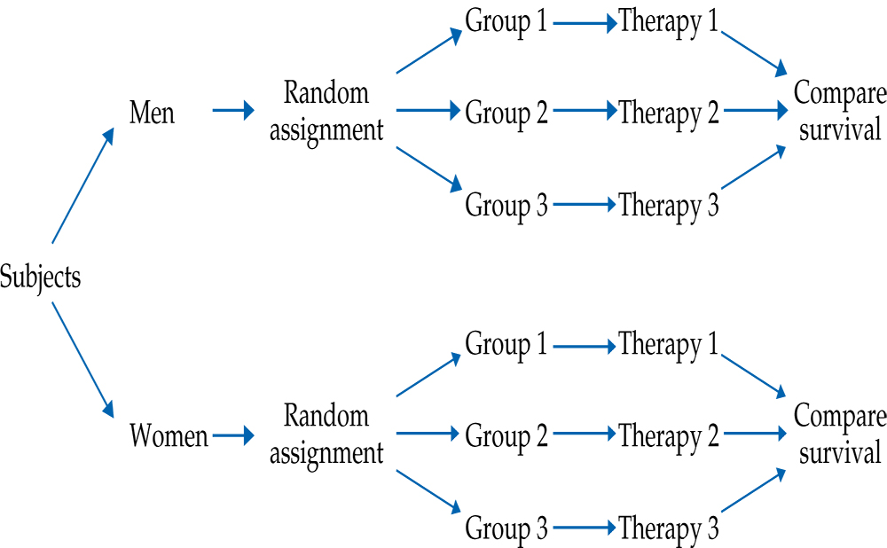
Figure 3.6
Introduction to the Practice of Statistics, Sixth Edition
© 2009 W.H. Freeman and Company

Slide 18
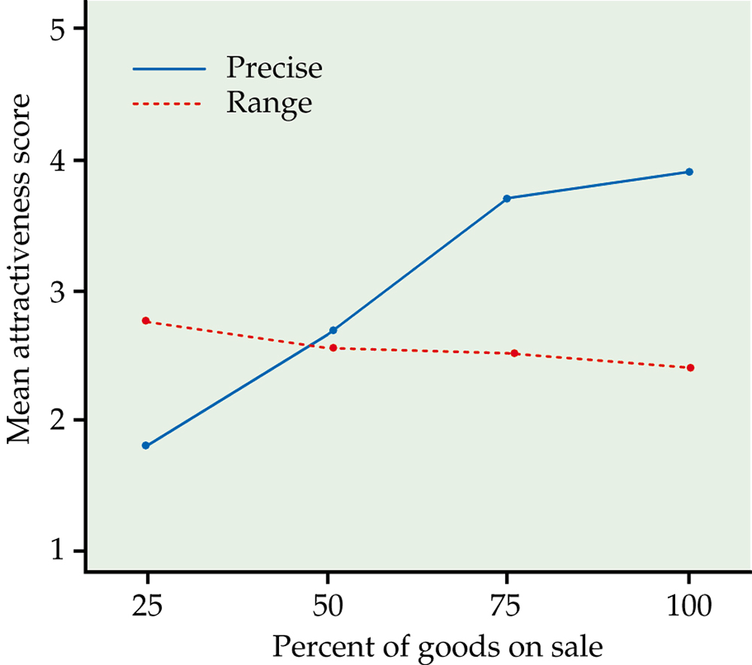
Figure 3.7
Introduction to the Practice of Statistics, Sixth Edition
© 2009 W.H. Freeman and Company

Slide 19
Definition, pg 198
Introduction to the Practice of Statistics, Sixth Edition
© 2009 W.H. Freeman and Company

Slide 20
Definition, pg 200
Introduction to the Practice of Statistics, Sixth Edition
© 2009 W.H. Freeman and Company

Slide 21
Definition, pg 200
Introduction to the Practice of Statistics, Sixth Edition
© 2009 W.H. Freeman and Company

Slide 22
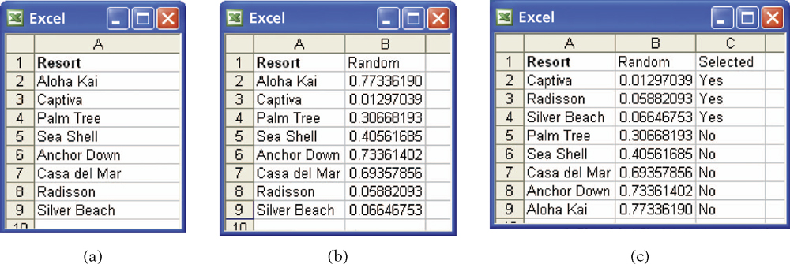
Figure 3.8
Introduction to the Practice of Statistics, Sixth Edition
© 2009 W.H. Freeman and Company

Slide 23
Definition, pg 202
Introduction to the Practice of Statistics, Sixth Edition
© 2009 W.H. Freeman and Company

Slide 24
Definition, pg 203
Introduction to the Practice of Statistics, Sixth Edition
© 2009 W.H. Freeman and Company

Slide 25
Definition, pg 204
Introduction to the Practice of Statistics, Sixth Edition
© 2009 W.H. Freeman and Company

Slide 26
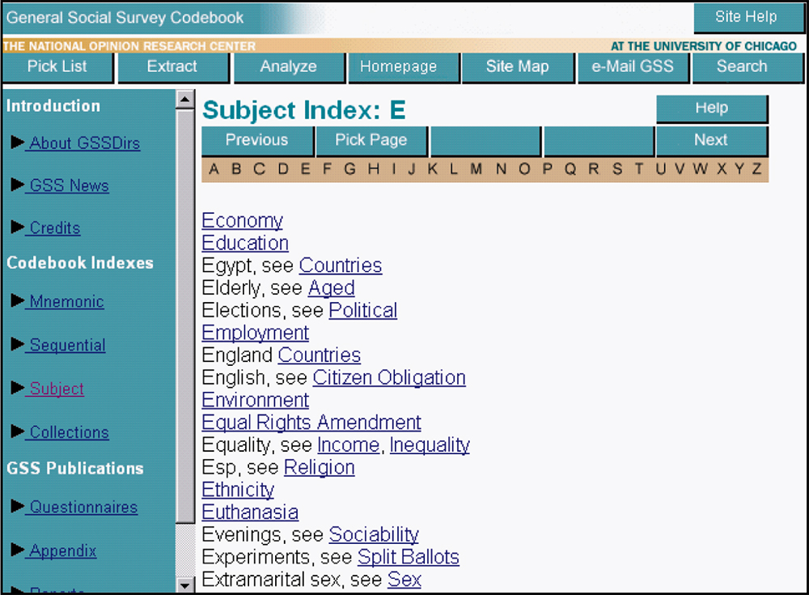
Figure 3.9
Introduction to the Practice of Statistics, Sixth Edition
© 2009 W.H. Freeman and Company

Slide 27
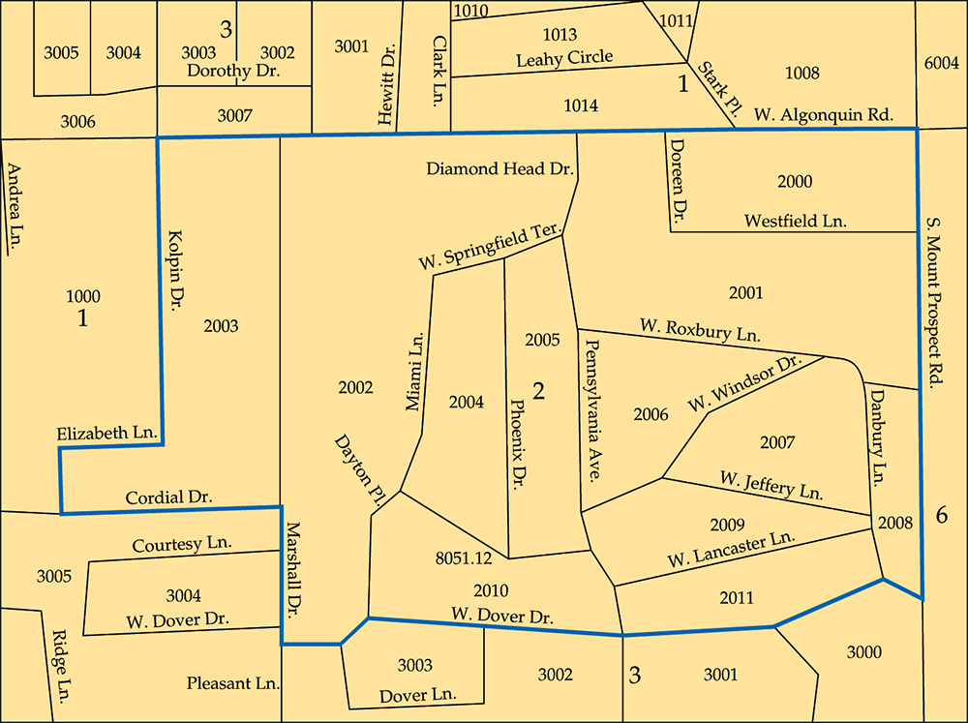
Figure 3.10
Introduction to the Practice of Statistics, Sixth Edition
© 2009 W.H. Freeman and Company

Slide 28
Definition, pg 212
Introduction to the Practice of Statistics, Sixth Edition
© 2009 W.H. Freeman and Company

Slide 29
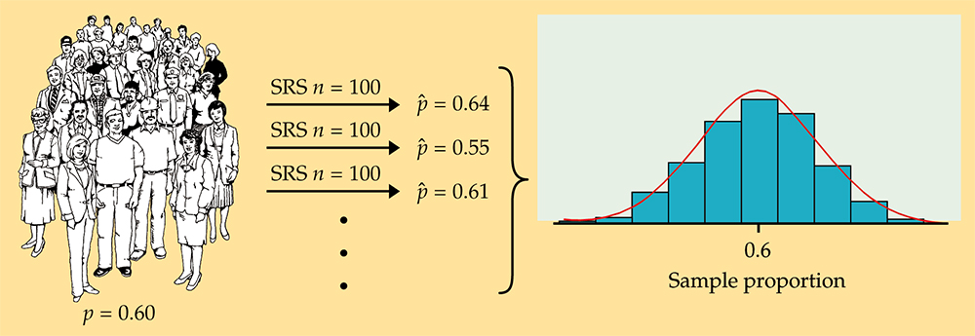
Figure 3.11
Introduction to the Practice of Statistics, Sixth Edition
© 2009 W.H. Freeman and Company

Slide 30
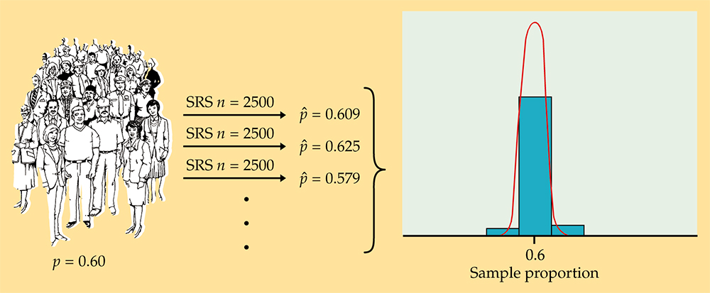
Figure 3.12
Introduction to the Practice of Statistics, Sixth Edition
© 2009 W.H. Freeman and Company

Slide 31
Definition, pg 215
Introduction to the Practice of Statistics, Sixth Edition
© 2009 W.H. Freeman and Company

Slide 32
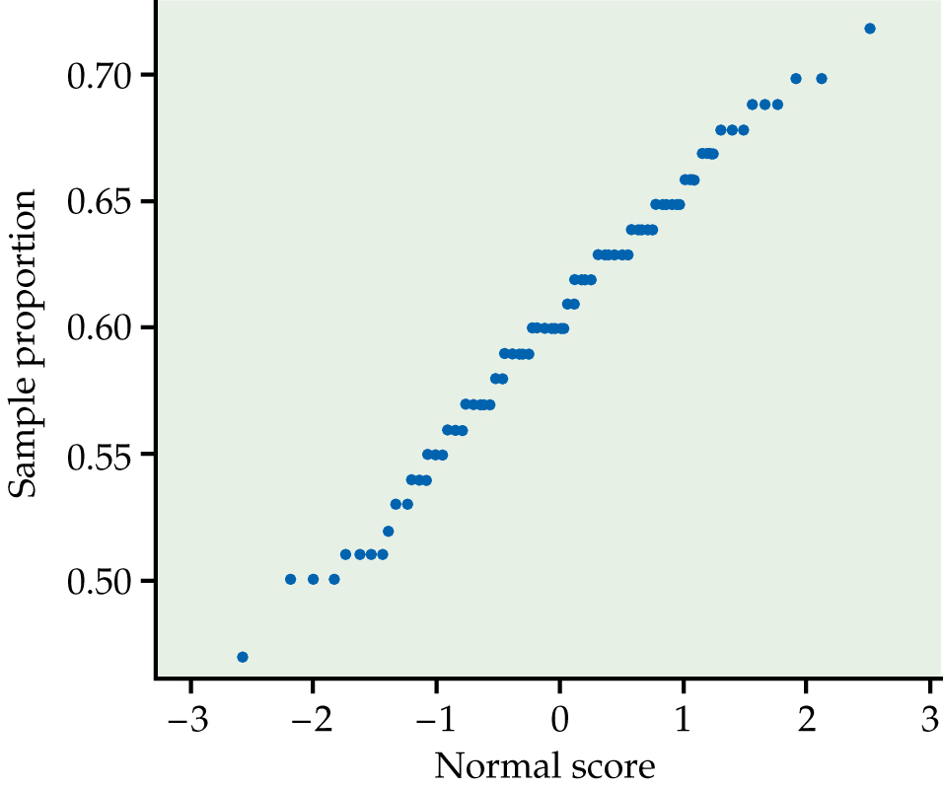
Figure 3.13
Introduction to the Practice of Statistics, Sixth Edition
© 2009 W.H. Freeman and Company

Slide 33
Definition, pg 217
Introduction to the Practice of Statistics, Sixth Edition
© 2009 W.H. Freeman and Company

Slide 34
Definition, pg 217–218
Introduction to the Practice of Statistics, Sixth Edition
© 2009 W.H. Freeman and Company

Slide 35
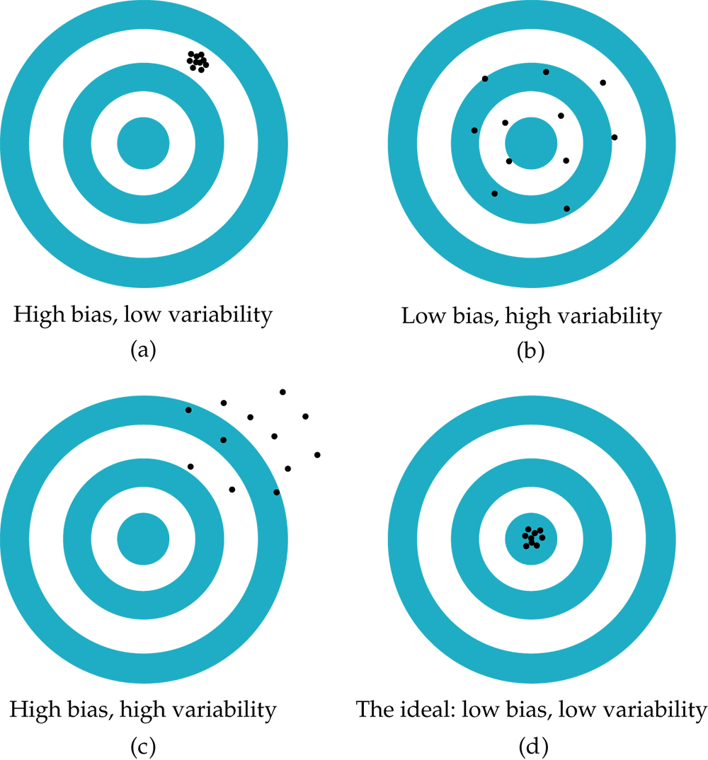
Figure 3.14
Introduction to the Practice of Statistics, Sixth Edition
© 2009 W.H. Freeman and Company

Slide 36
Definition, pg 219
Introduction to the Practice of Statistics, Sixth Edition
© 2009 W.H. Freeman and Company

Slide 37
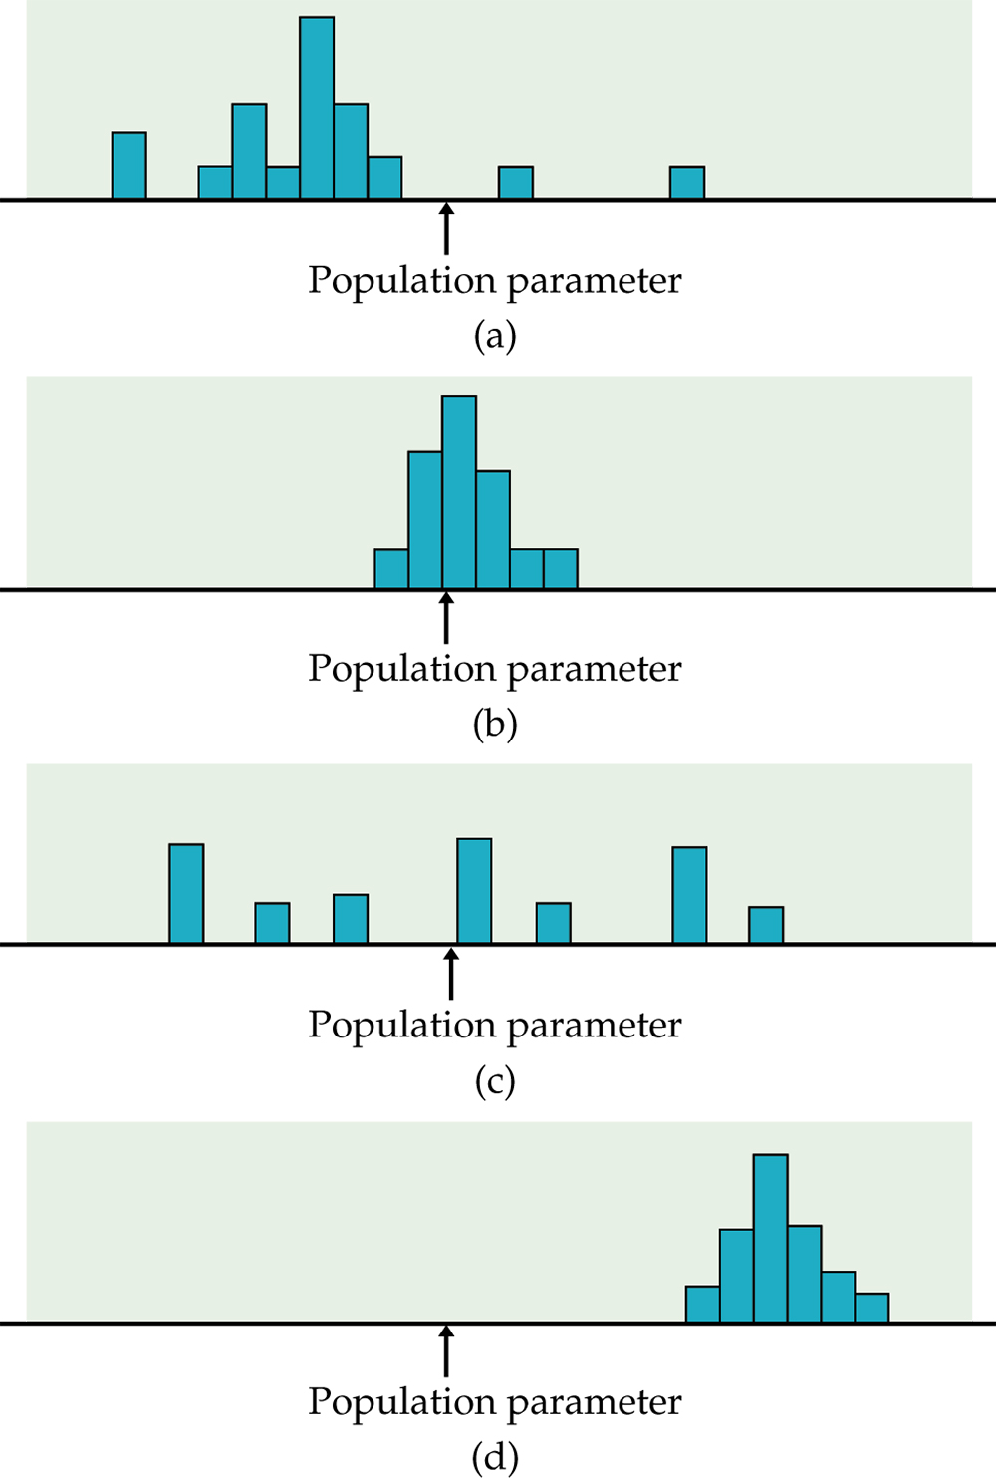
Figure 3.15
Introduction to the Practice of Statistics, Sixth Edition
© 2009 W.H. Freeman and Company

Slide 38
Definition, pg 225
Introduction to the Practice of Statistics, Sixth Edition
© 2009 W.H. Freeman and Company

