Slide 1
David S. Moore • George P. McCabe
Bruce A. Craig
Introduction to the
Practice of Statistics
Sixth Edition
Chapter 2:
Looking at Data—Relationships
Copyright © 2009 by W. H. Freeman and Company

Slide 2
Chapter 2 Opener
Introduction to the Practice of Statistics, Sixth Edition
© 2009 W.H. Freeman and Company

Slide 3
Definition, pg 84
Introduction to the Practice of Statistics, Sixth Edition
© 2009 W.H. Freeman and Company

Slide 4
Definition, pg 85
Introduction to the Practice of Statistics, Sixth Edition
© 2009 W.H. Freeman and Company

Slide 5
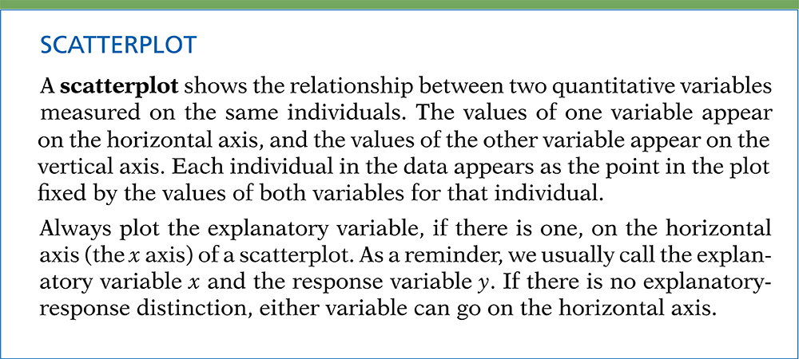
Definition, pg 86–87
Introduction to the Practice of Statistics, Sixth Edition
© 2009 W.H. Freeman and Company

Slide 6
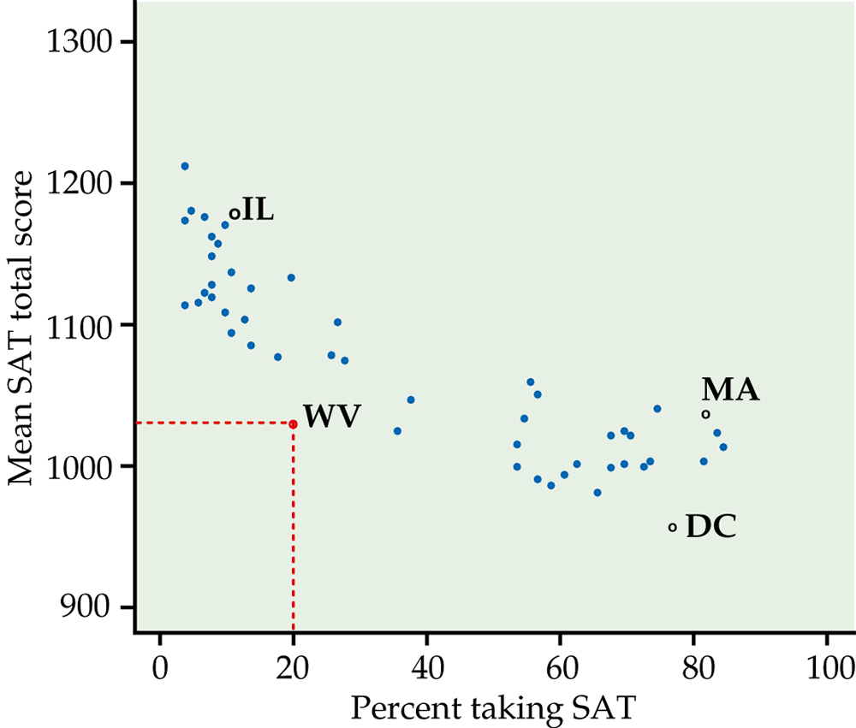
Figure 2.1
Introduction to the Practice of Statistics, Sixth Edition
© 2009 W.H. Freeman and Company

Slide 7
Definition, pg 88
Introduction to the Practice of Statistics, Sixth Edition
© 2009 W.H. Freeman and Company

Slide 8
Definition, pg 88
Introduction to the Practice of Statistics, Sixth Edition
© 2009 W.H. Freeman and Company

Slide 9
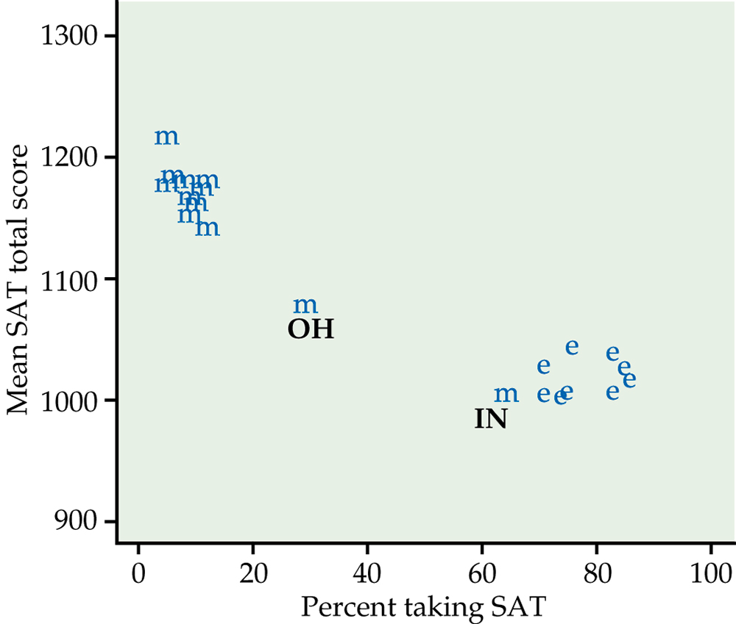
Figure 2.2
Introduction to the Practice of Statistics, Sixth Edition
© 2009 W.H. Freeman and Company

Slide 10
Definition, pg 90
Introduction to the Practice of Statistics, Sixth Edition
© 2009 W.H. Freeman and Company

Slide 11
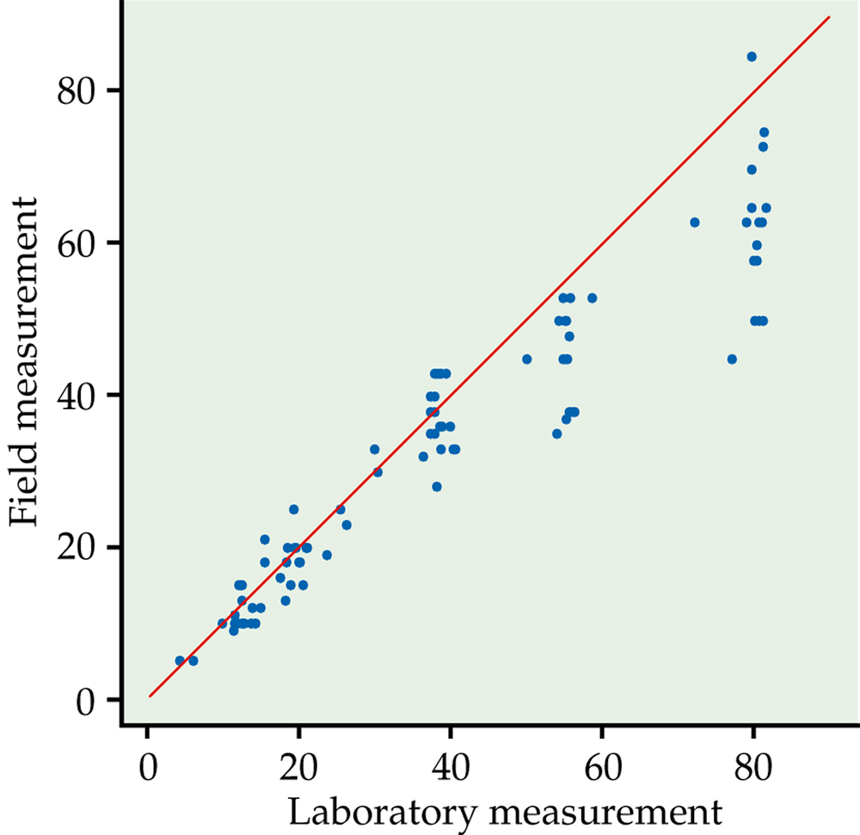
Figure 2.3
Introduction to the Practice of Statistics, Sixth Edition
© 2009 W.H. Freeman and Company

Slide 12
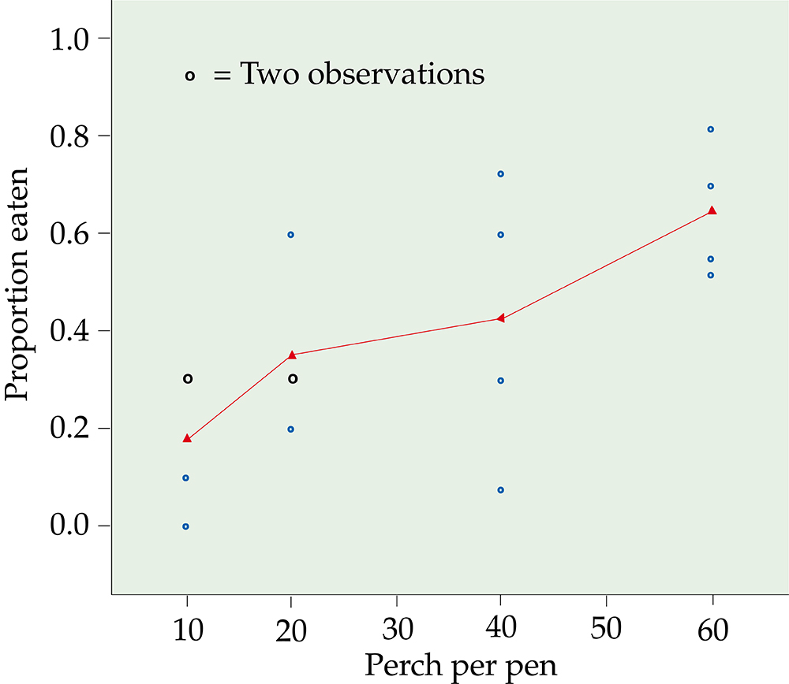
Figure 2.4
Introduction to the Practice of Statistics, Sixth Edition
© 2009 W.H. Freeman and Company

Slide 13
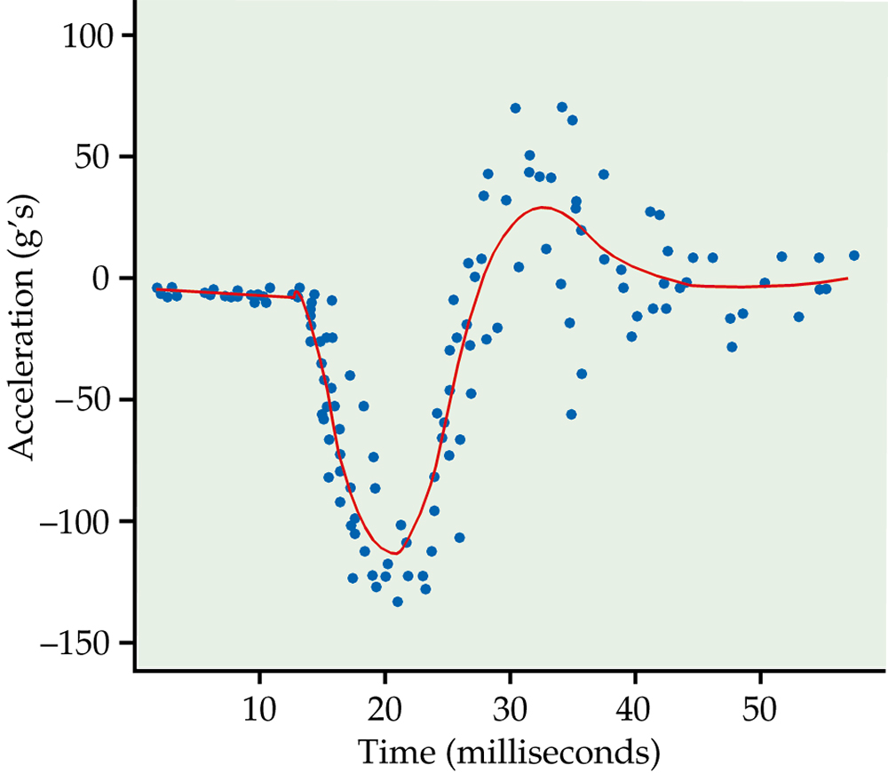
Figure 2.5
Introduction to the Practice of Statistics, Sixth Edition
© 2009 W.H. Freeman and Company

Slide 14
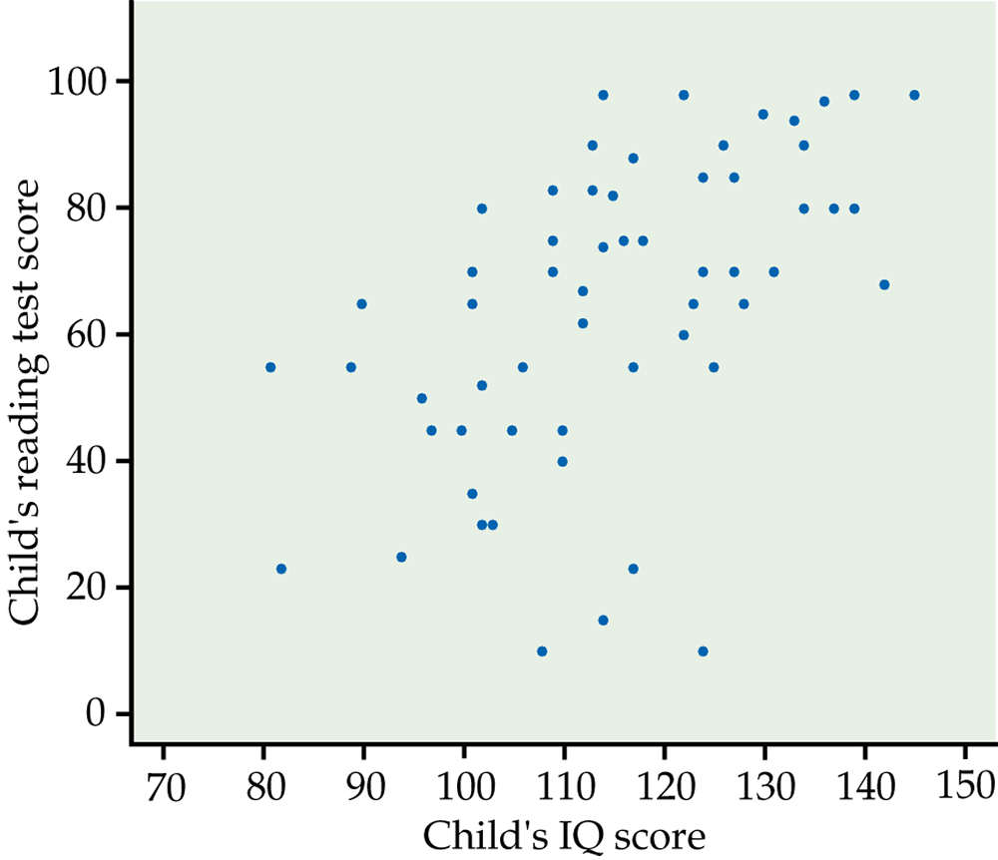
Figure 2.6
Introduction to the Practice of Statistics, Sixth Edition
© 2009 W.H. Freeman and Company

Slide 15
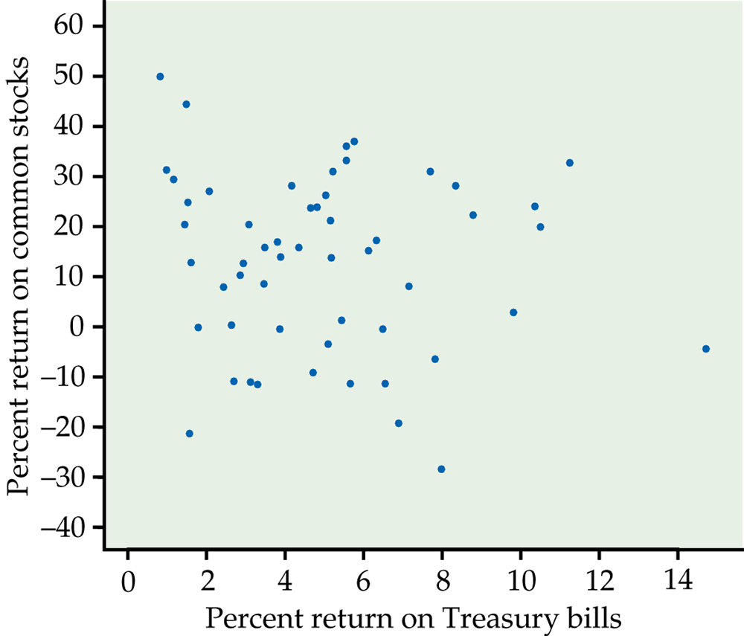
Figure 2.7
Introduction to the Practice of Statistics, Sixth Edition
© 2009 W.H. Freeman and Company

Slide 16
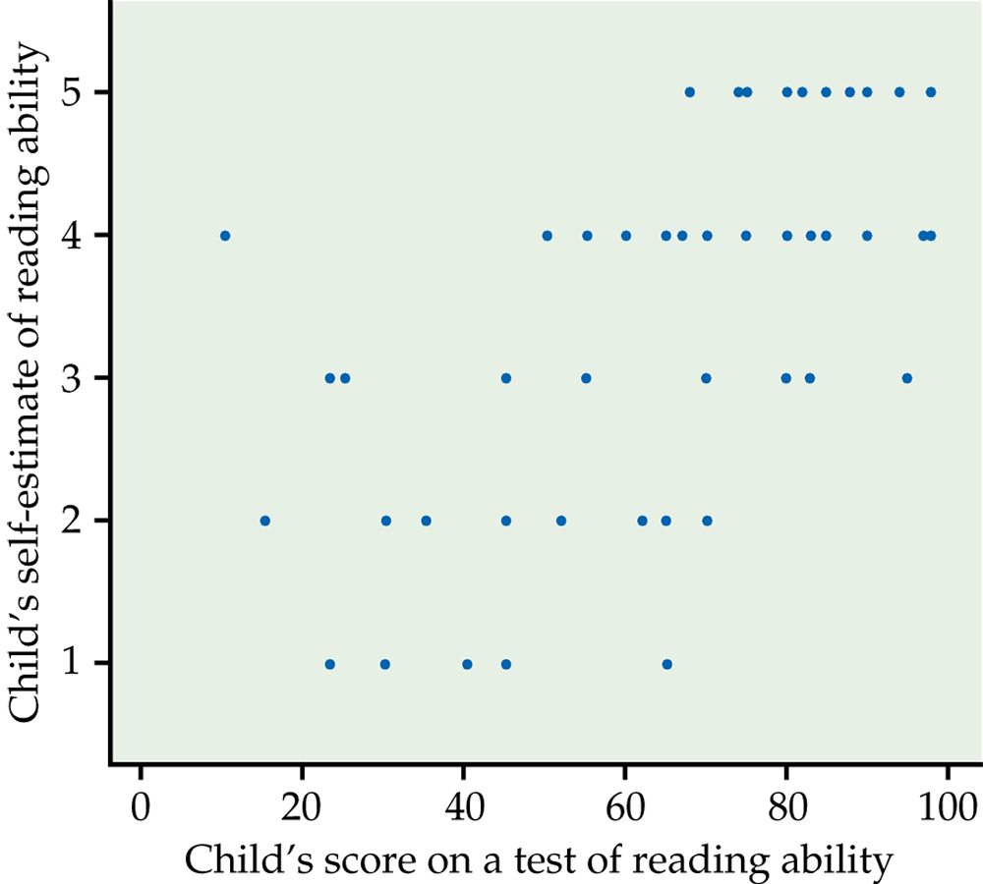
Figure 2.8
Introduction to the Practice of Statistics, Sixth Edition
© 2009 W.H. Freeman and Company

Slide 17
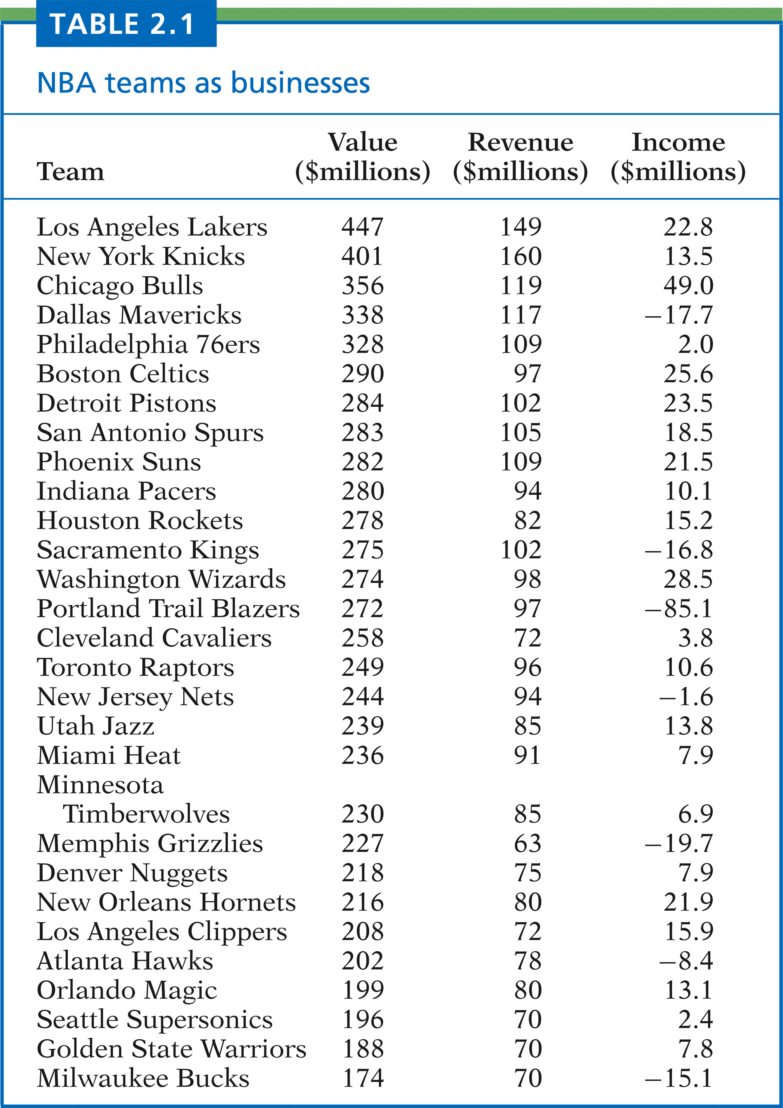
Table 2.1
Introduction to the Practice of Statistics, Sixth Edition
© 2009 W.H. Freeman and Company

Slide 18
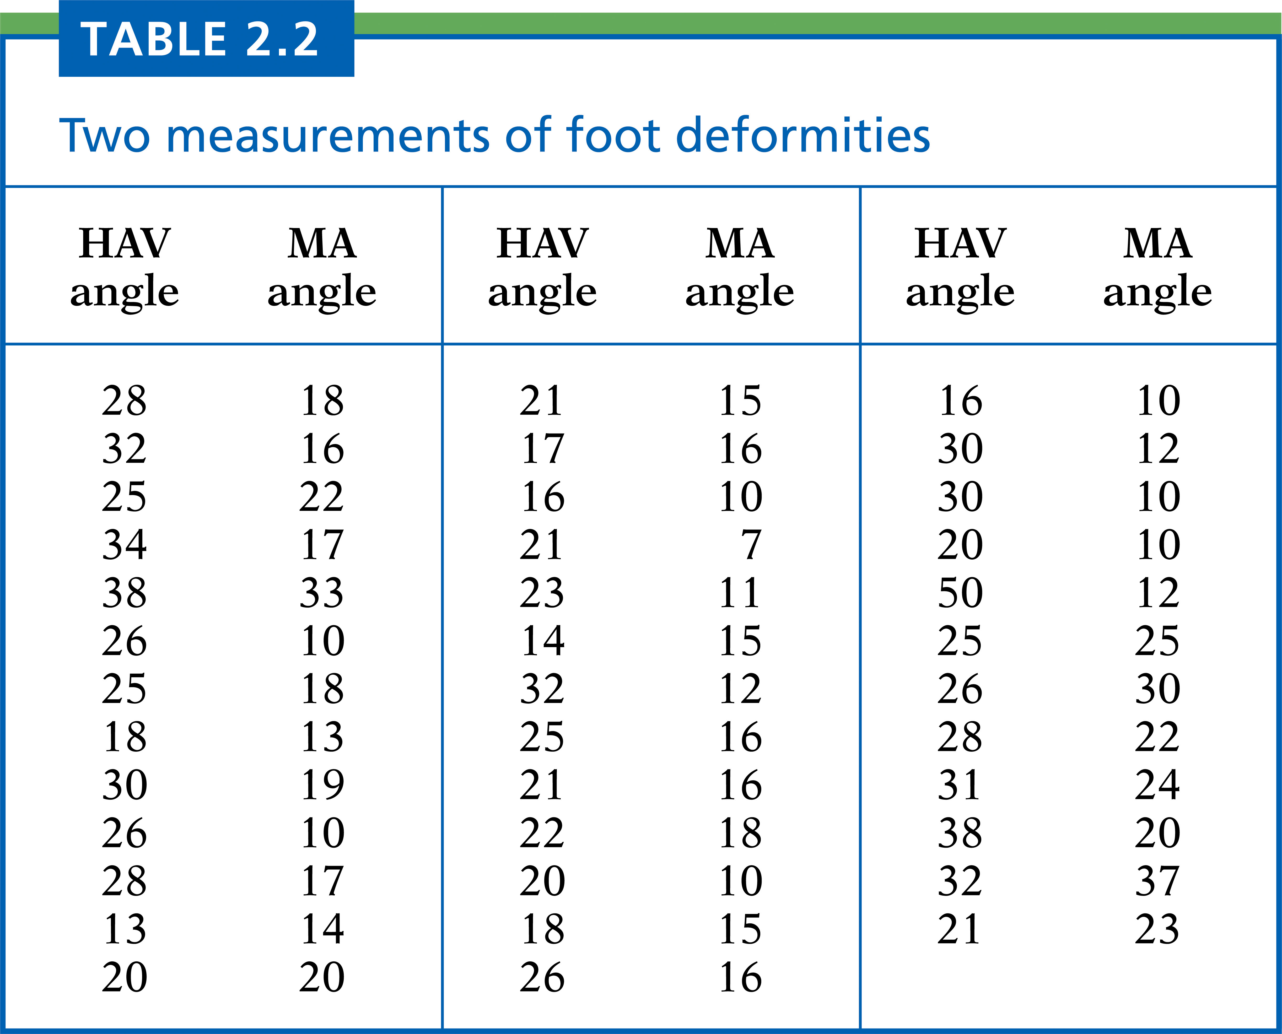
Table 2.2
Introduction to the Practice of Statistics, Sixth Edition
© 2009 W.H. Freeman and Company

Slide 19
Table 2.3
Introduction to the Practice of Statistics, Sixth Edition
© 2009 W.H. Freeman and Company

Slide 20
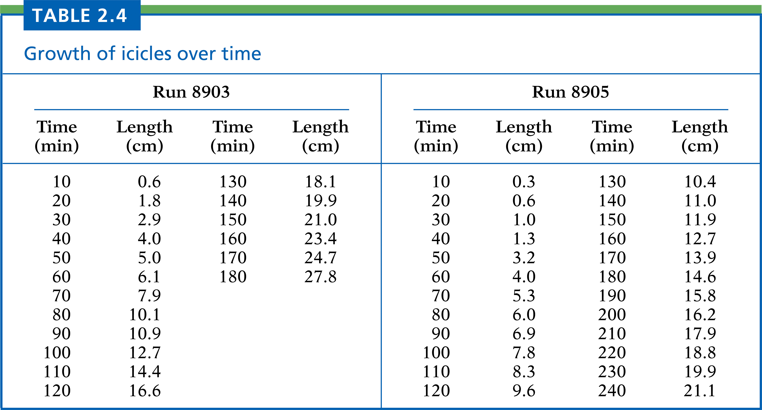
Table 2.4
Introduction to the Practice of Statistics, Sixth Edition
© 2009 W.H. Freeman and Company

Slide 21
Figure 2.9
Introduction to the Practice of Statistics, Sixth Edition
© 2009 W.H. Freeman and Company

Slide 22
Definition, pg 102
Introduction to the Practice of Statistics, Sixth Edition
© 2009 W.H. Freeman and Company

Slide 23
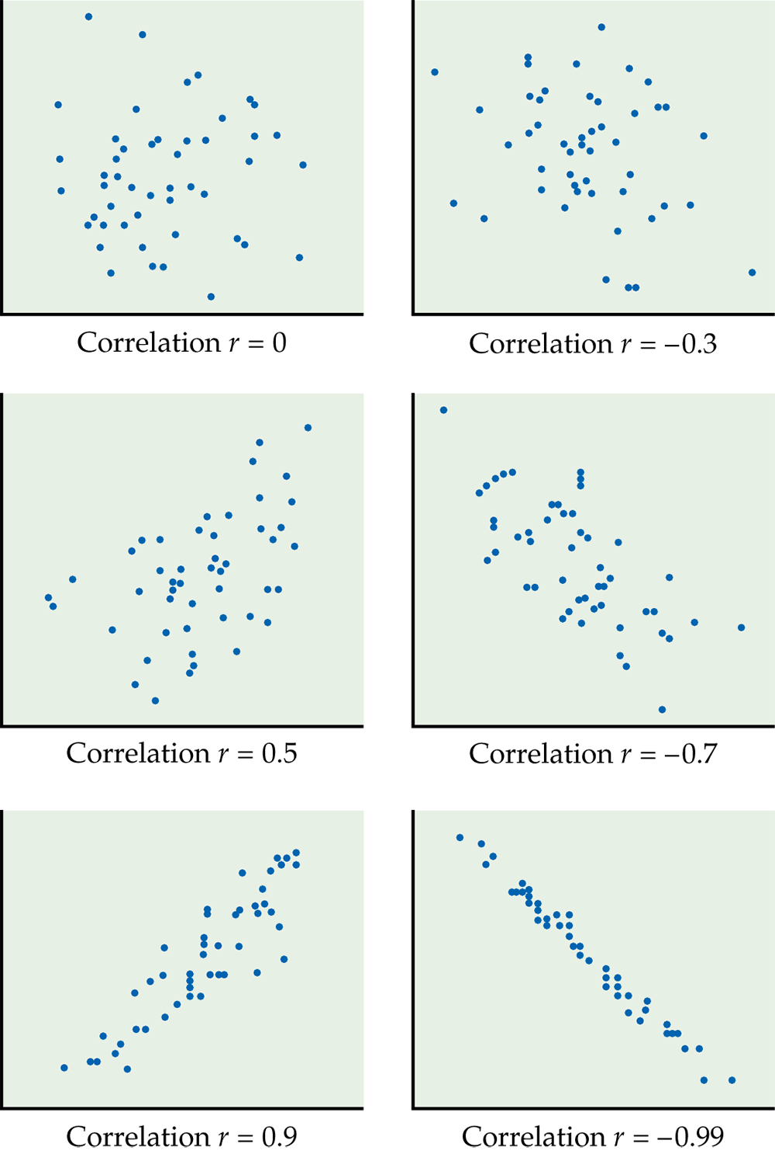
Figure 2.10
Introduction to the Practice of Statistics, Sixth Edition
© 2009 W.H. Freeman and Company

Slide 24
Definition, pg 109
Introduction to the Practice of Statistics, Sixth Edition
© 2009 W.H. Freeman and Company

Slide 25
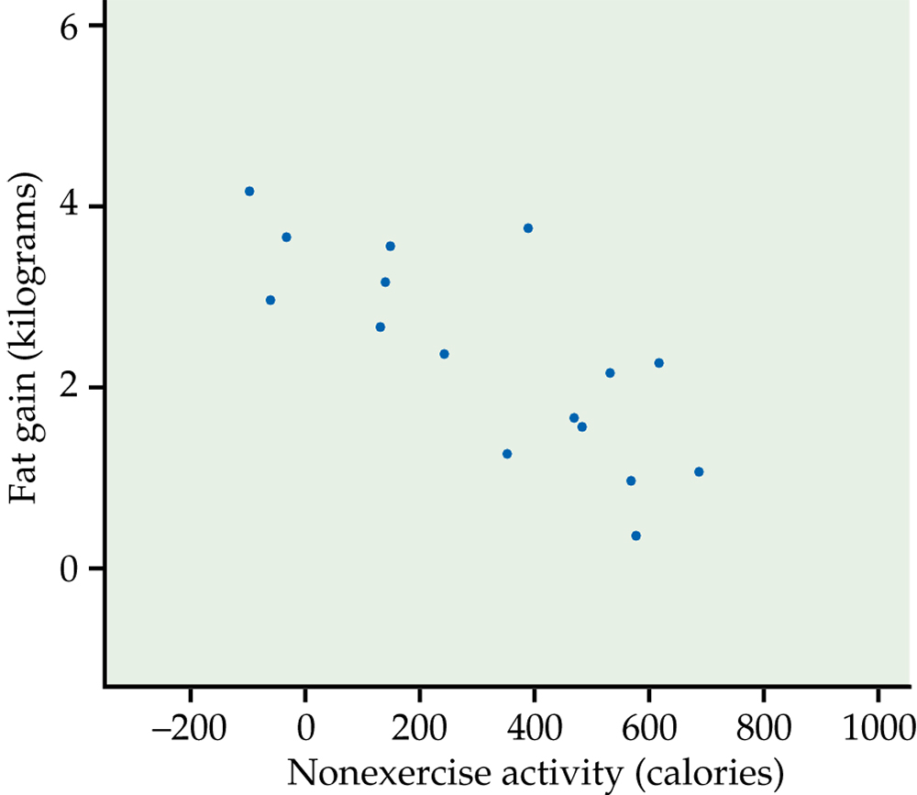
Figure 2.11
Introduction to the Practice of Statistics, Sixth Edition
© 2009 W.H. Freeman and Company

Slide 26
Definition, pg 110
Introduction to the Practice of Statistics, Sixth Edition
© 2009 W.H. Freeman and Company

Slide 27
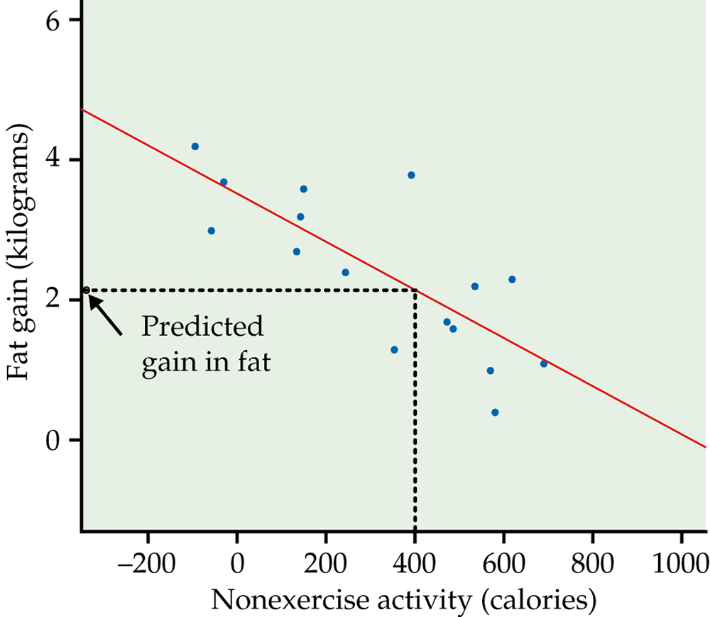
Figure 2.12
Introduction to the Practice of Statistics, Sixth Edition
© 2009 W.H. Freeman and Company

Slide 28
Definition, pg 112
Introduction to the Practice of Statistics, Sixth Edition
© 2009 W.H. Freeman and Company

Slide 29
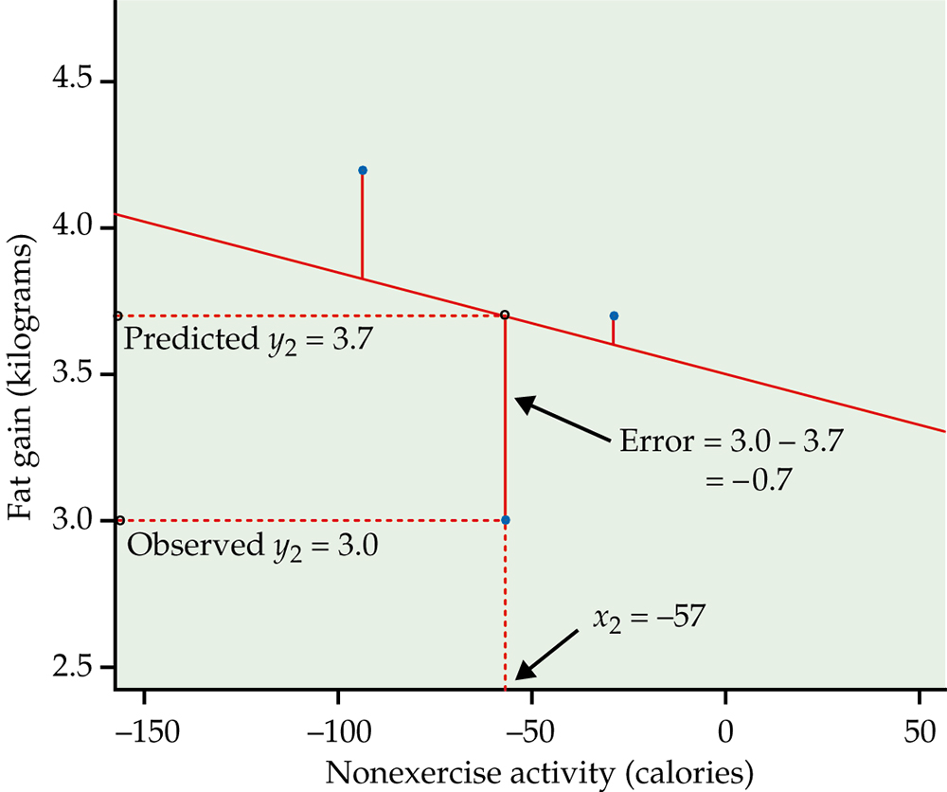
Figure 2.13
Introduction to the Practice of Statistics, Sixth Edition
© 2009 W.H. Freeman and Company

Slide 30
Definition, pg 113
Introduction to the Practice of Statistics, Sixth Edition
© 2009 W.H. Freeman and Company

Slide 31
Definition, pg 114
Introduction to the Practice of Statistics, Sixth Edition
© 2009 W.H. Freeman and Company

Slide 32
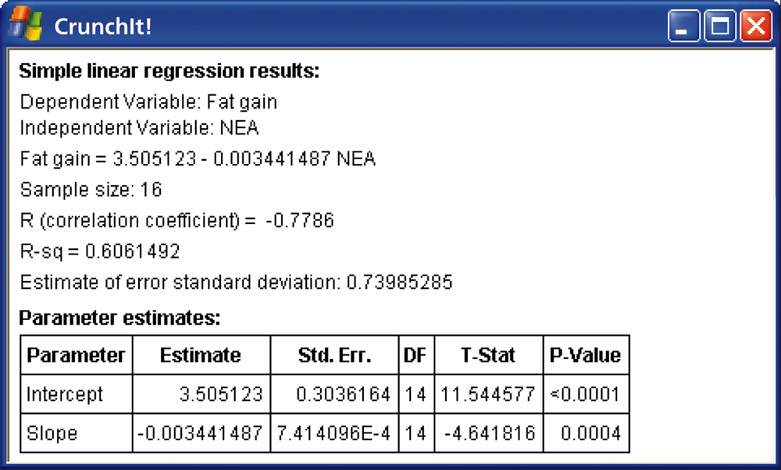
Figure 2.14a
Introduction to the Practice of Statistics, Sixth Edition
© 2009 W.H. Freeman and Company

Slide 33
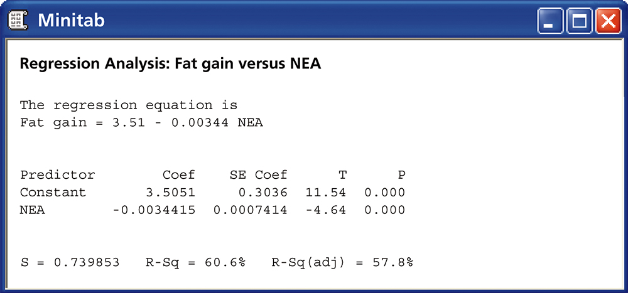
Figure 2.14b
Introduction to the Practice of Statistics, Sixth Edition
© 2009 W.H. Freeman and Company

Slide 34
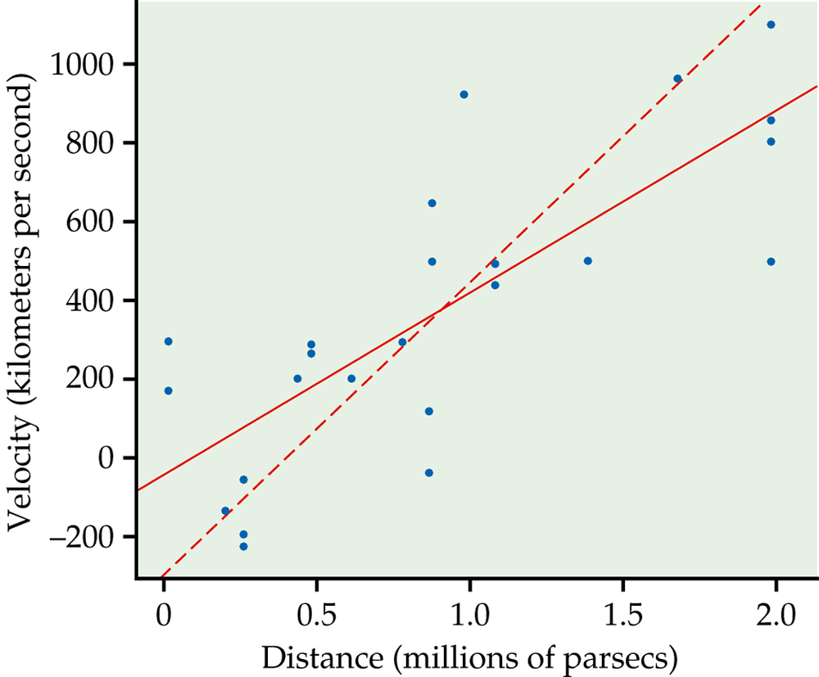
Figure 2.15
Introduction to the Practice of Statistics, Sixth Edition
© 2009 W.H. Freeman and Company

Slide 35
Definition, pg 117
Introduction to the Practice of Statistics, Sixth Edition
© 2009 W.H. Freeman and Company

Slide 36
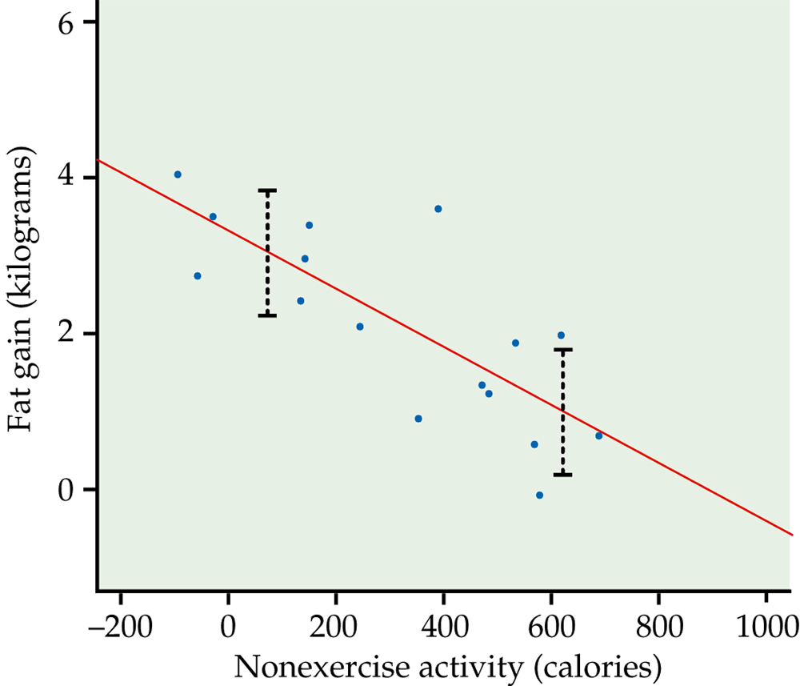
Figure 2.16
Introduction to the Practice of Statistics, Sixth Edition
© 2009 W.H. Freeman and Company

Slide 37
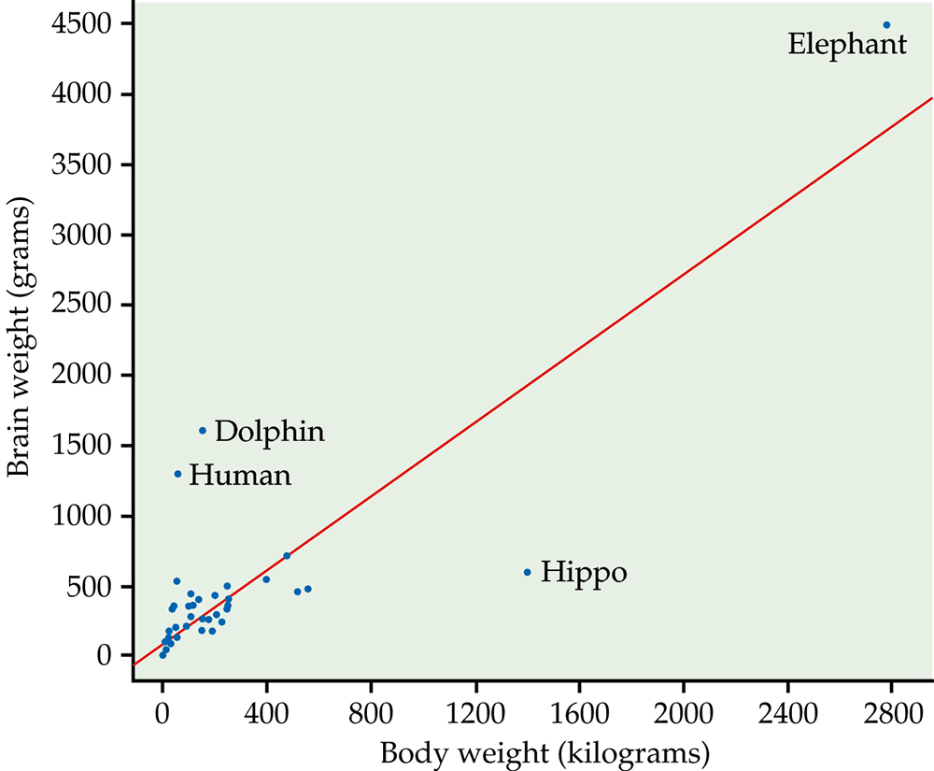
Figure 2.17
Introduction to the Practice of Statistics, Sixth Edition
© 2009 W.H. Freeman and Company

Slide 38
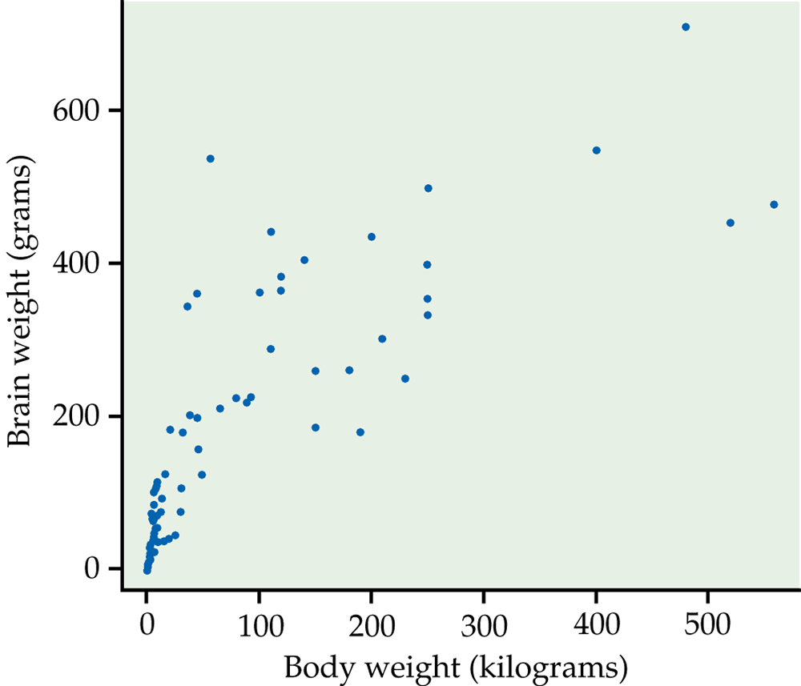
Figure 2.18
Introduction to the Practice of Statistics, Sixth Edition
© 2009 W.H. Freeman and Company

Slide 39
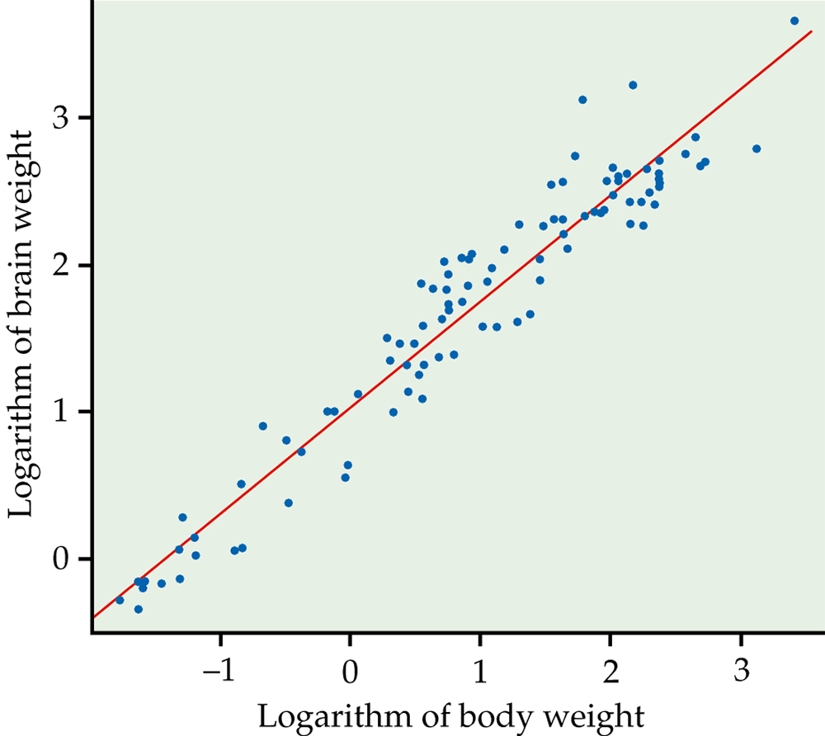
Figure 2.19
Introduction to the Practice of Statistics, Sixth Edition
© 2009 W.H. Freeman and Company

Slide 40
Definition, pg 126
Introduction to the Practice of Statistics, Sixth Edition
© 2009 W.H. Freeman and Company

Slide 41
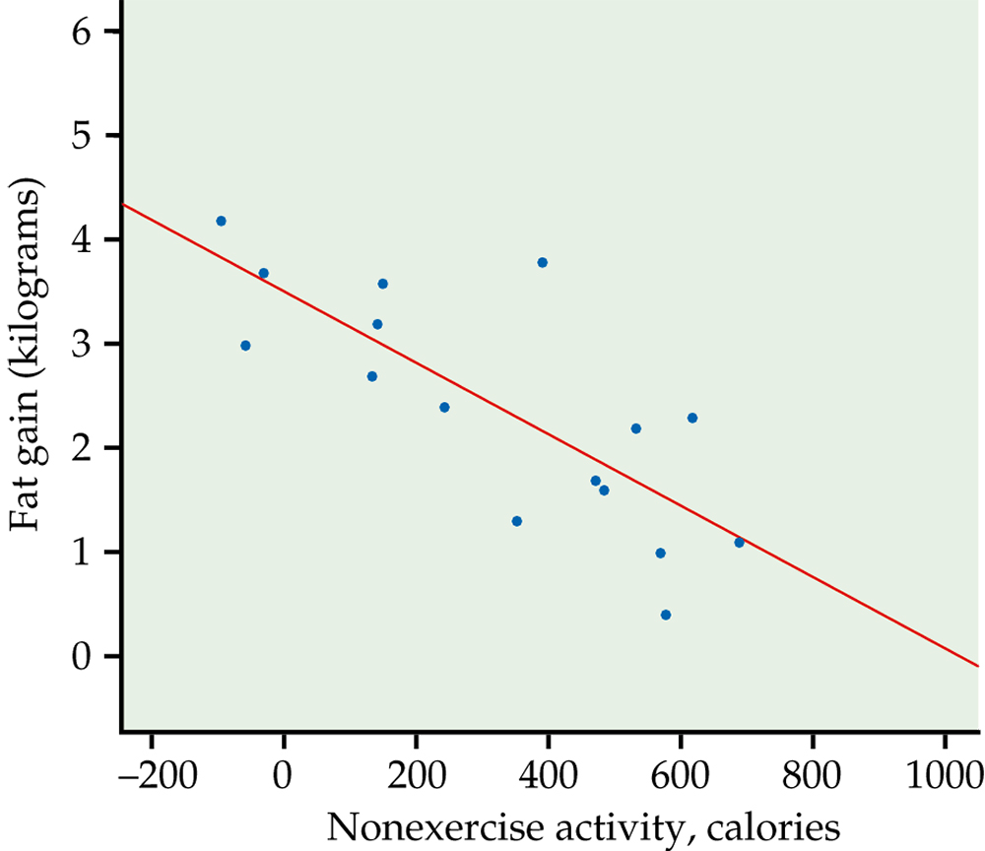
Figure 2.20a
Introduction to the Practice of Statistics, Sixth Edition
© 2009 W.H. Freeman and Company

Slide 42
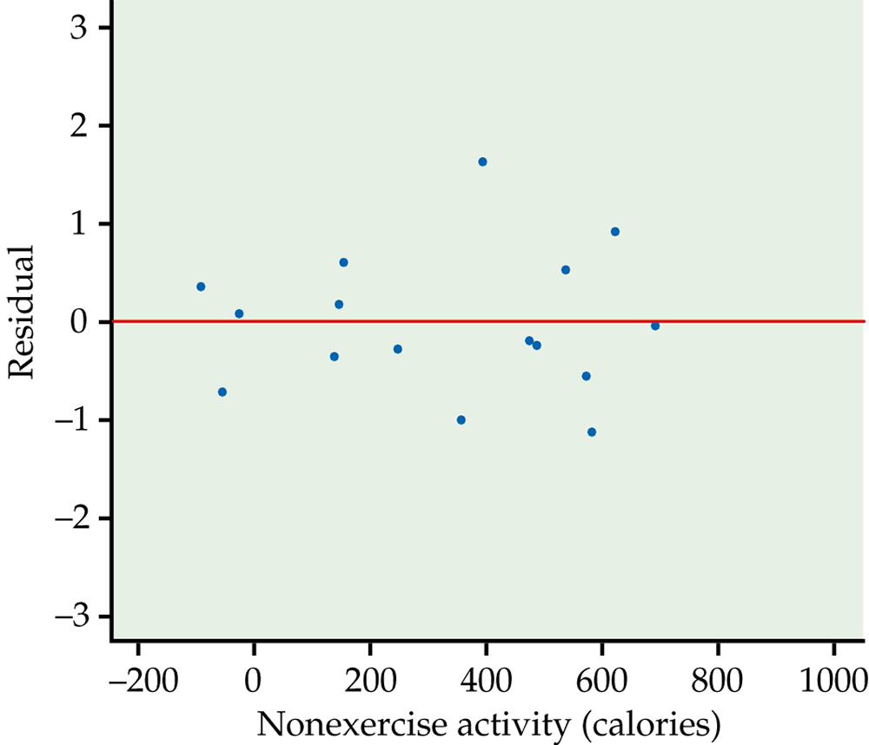
Figure 2.20b
Introduction to the Practice of Statistics, Sixth Edition
© 2009 W.H. Freeman and Company

Slide 43
Definition, pg 128
Introduction to the Practice of Statistics, Sixth Edition
© 2009 W.H. Freeman and Company

Slide 44
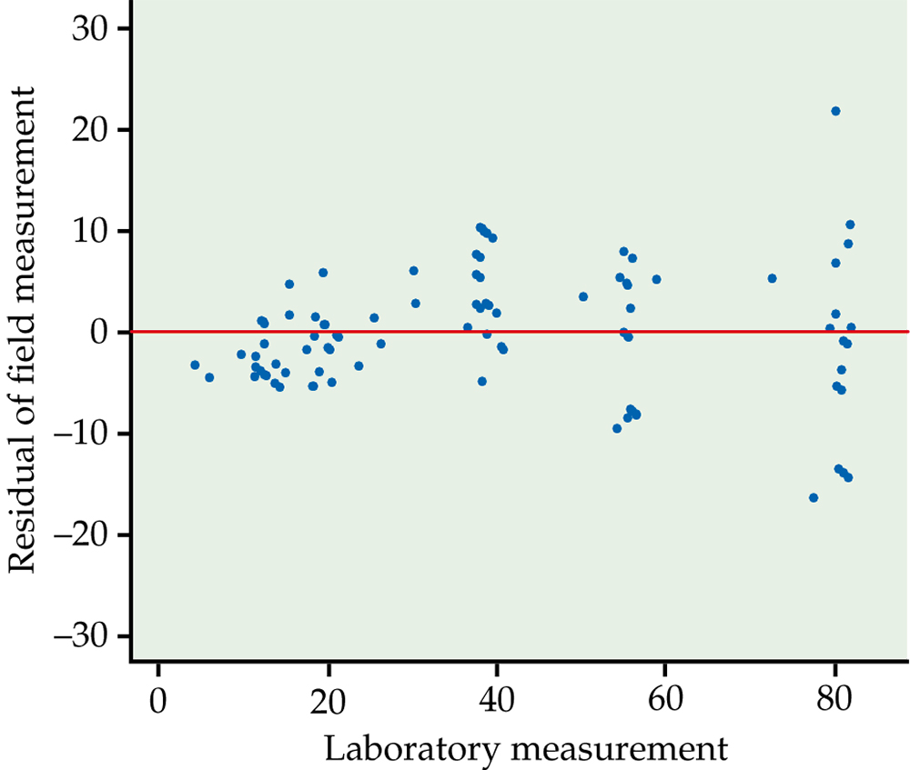
Figure 2.21
Introduction to the Practice of Statistics, Sixth Edition
© 2009 W.H. Freeman and Company

Slide 45
Table 2.5
Introduction to the Practice of Statistics, Sixth Edition
© 2009 W.H. Freeman and Company

Slide 46
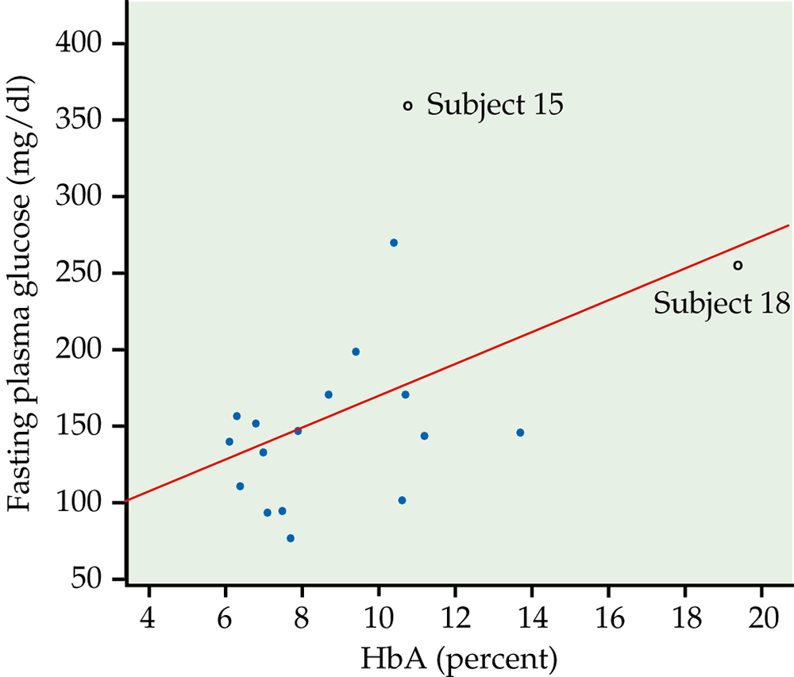
Figure 2.22
Introduction to the Practice of Statistics, Sixth Edition
© 2009 W.H. Freeman and Company

Slide 47
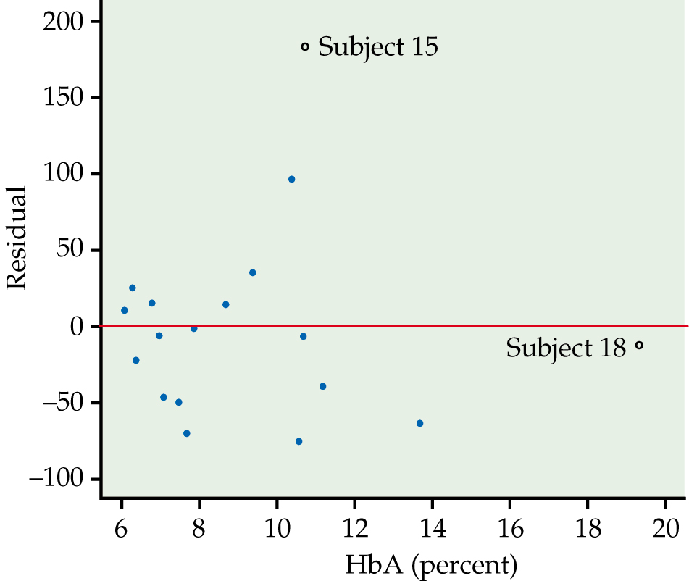
Figure 2.23
Introduction to the Practice of Statistics, Sixth Edition
© 2009 W.H. Freeman and Company

Slide 48
Definition, pg 130–131
Introduction to the Practice of Statistics, Sixth Edition
© 2009 W.H. Freeman and Company

Slide 49
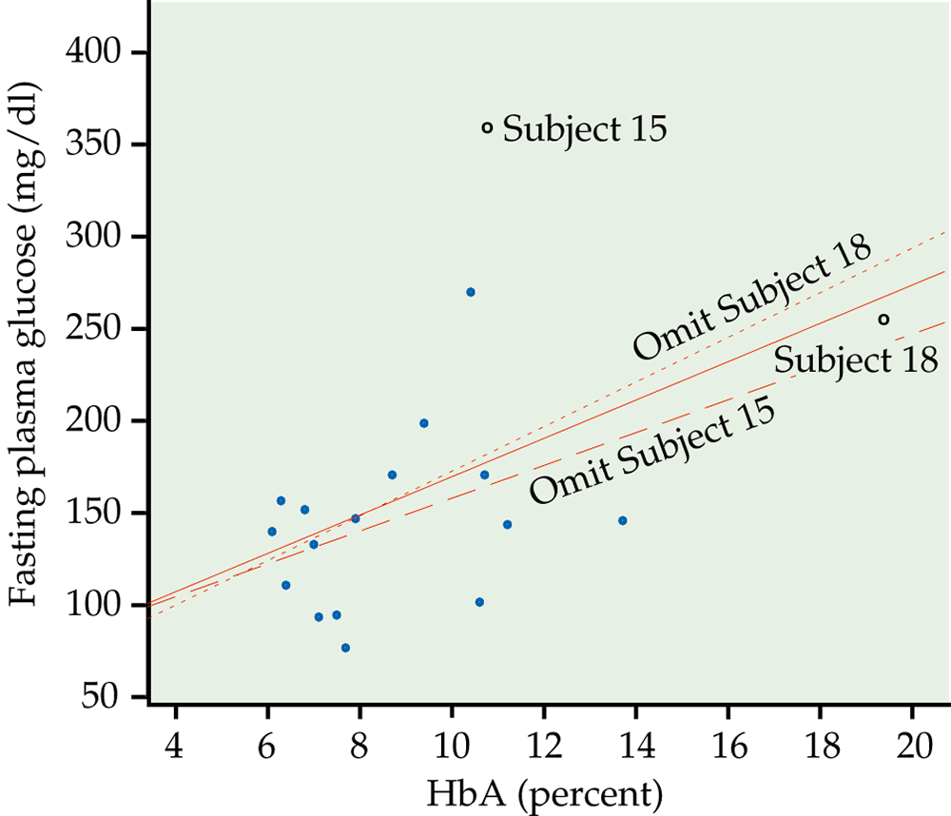
Figure 2.24
Introduction to the Practice of Statistics, Sixth Edition
© 2009 W.H. Freeman and Company

Slide 50
Definition, pg 132
Introduction to the Practice of Statistics, Sixth Edition
© 2009 W.H. Freeman and Company

Slide 51
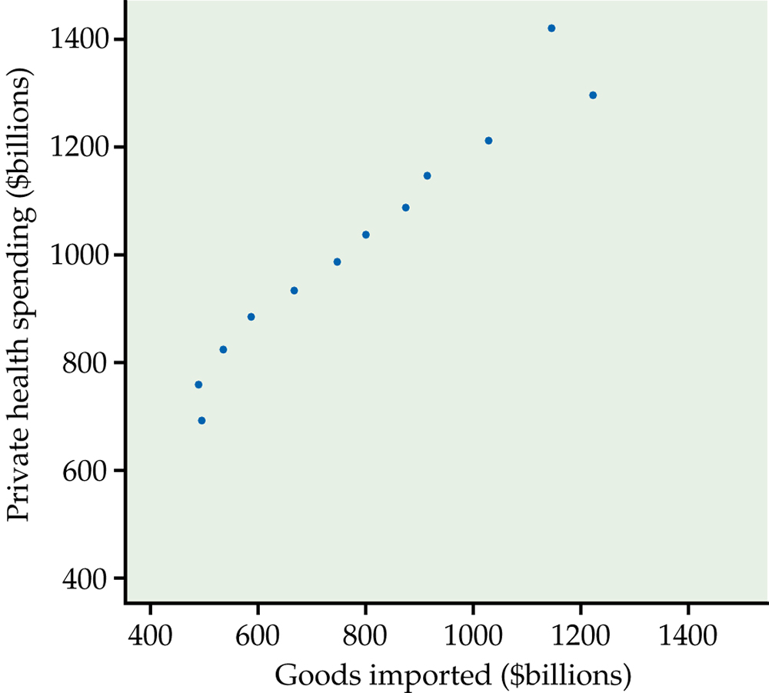
Figure 2.25
Introduction to the Practice of Statistics, Sixth Edition
© 2009 W.H. Freeman and Company

Slide 52
Definition, pg 134
Introduction to the Practice of Statistics, Sixth Edition
© 2009 W.H. Freeman and Company

Slide 53
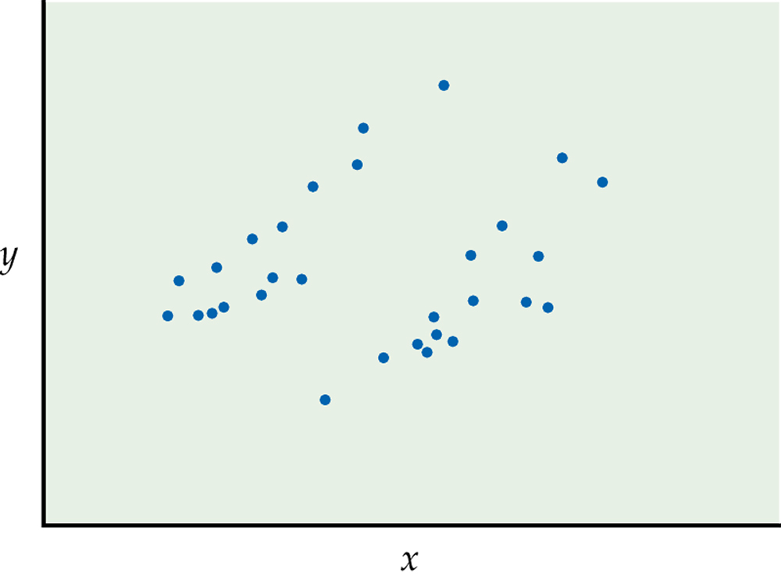
Figure 2.26
Introduction to the Practice of Statistics, Sixth Edition
© 2009 W.H. Freeman and Company

Slide 54
Table 2.6
Introduction to the Practice of Statistics, Sixth Edition
© 2009 W.H. Freeman and Company

Slide 55
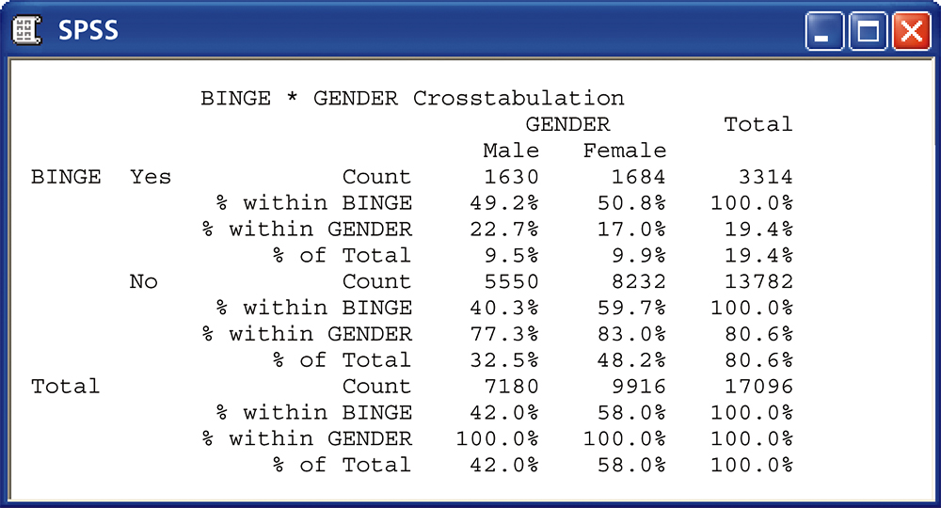
Figure 2.27a
Introduction to the Practice of Statistics, Sixth Edition
© 2009 W.H. Freeman and Company

Slide 56
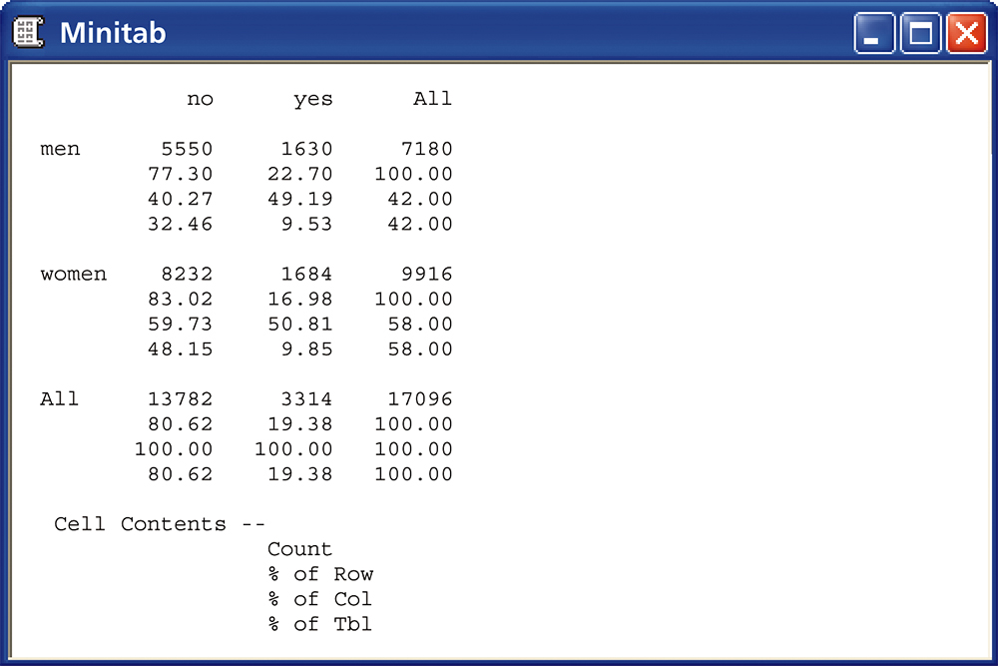
Figure 2.27b
Introduction to the Practice of Statistics, Sixth Edition
© 2009 W.H. Freeman and Company

Slide 57
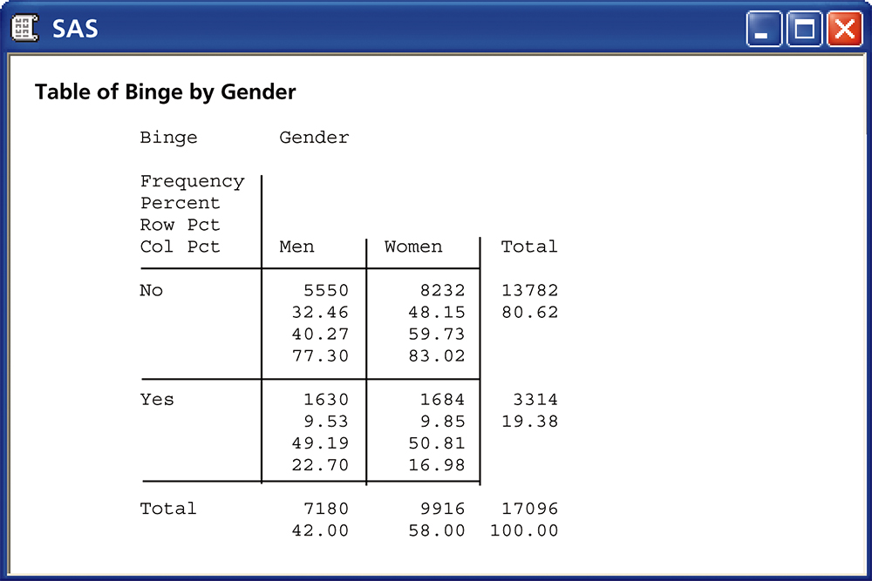
Figure 2.27c
Introduction to the Practice of Statistics, Sixth Edition
© 2009 W.H. Freeman and Company

Slide 58
Definition, pg 151
Introduction to the Practice of Statistics, Sixth Edition
© 2009 W.H. Freeman and Company

Slide 59
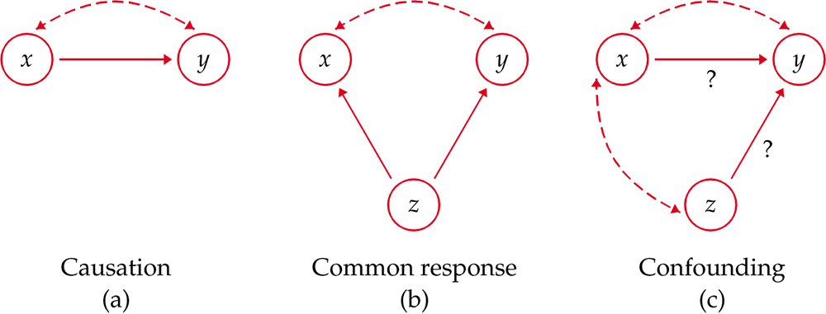
Figure 2.28
Introduction to the Practice of Statistics, Sixth Edition
© 2009 W.H. Freeman and Company

Slide 60
Definition, pg 156
Introduction to the Practice of Statistics, Sixth Edition
© 2009 W.H. Freeman and Company

Slide 61
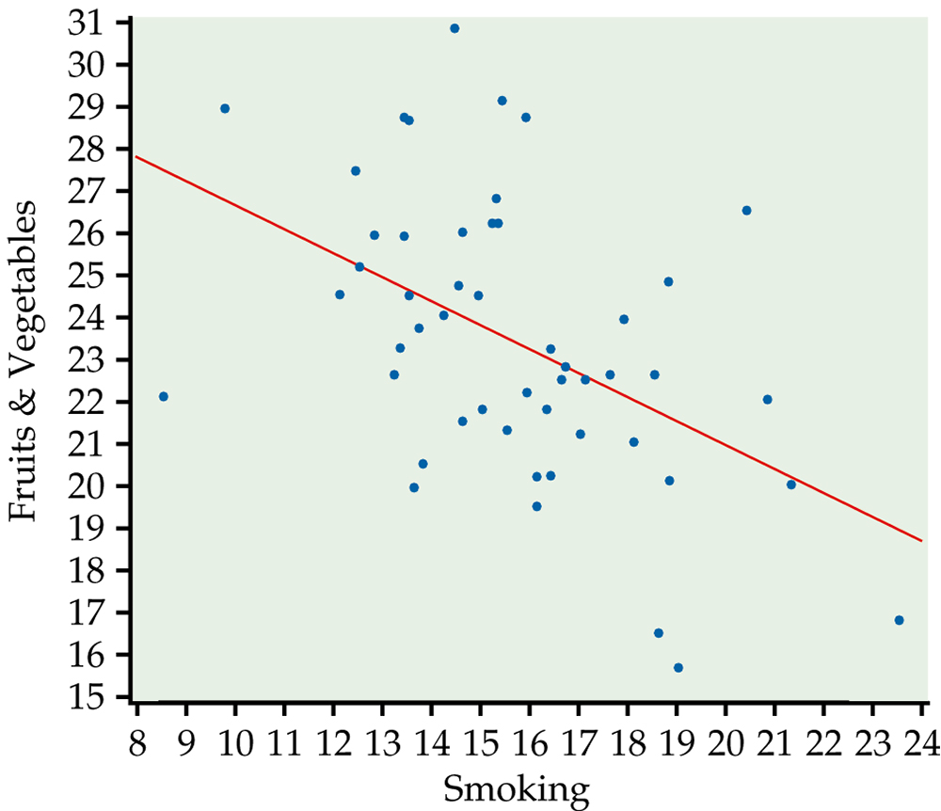
Figure 2.29
Introduction to the Practice of Statistics, Sixth Edition
© 2009 W.H. Freeman and Company

Slide 62
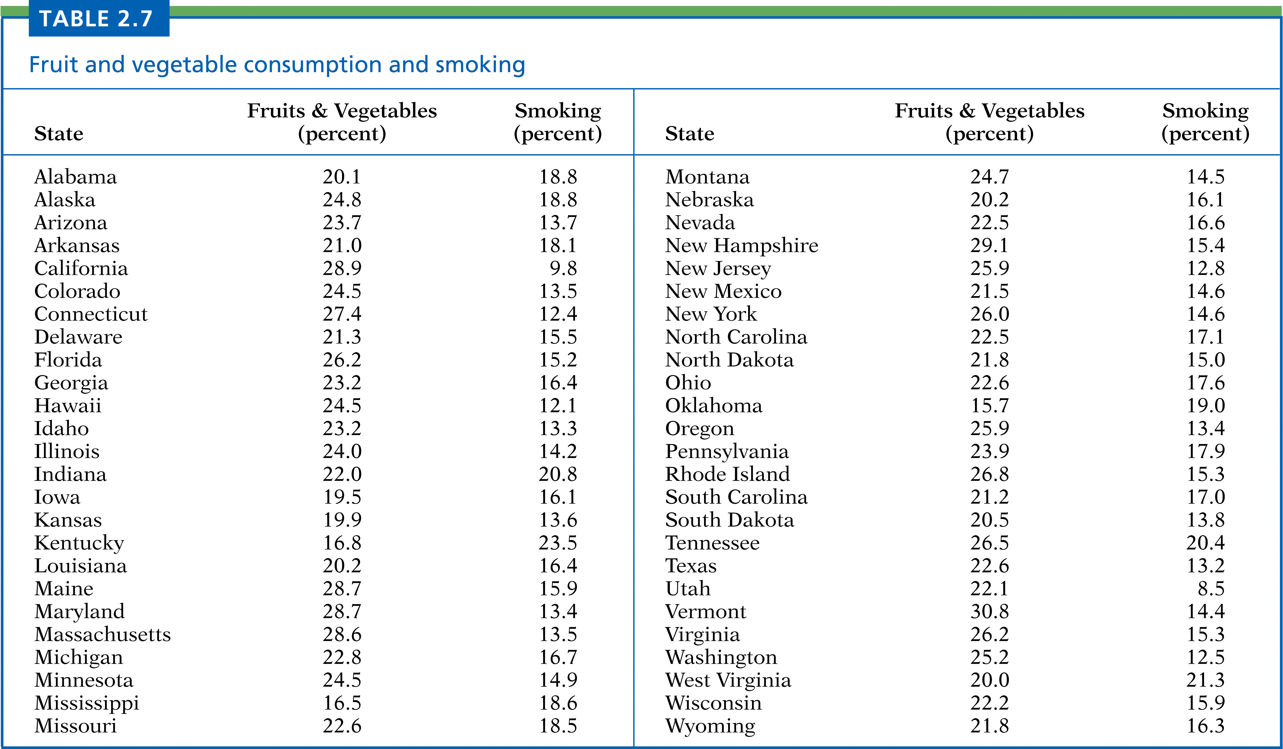
Table 2.7
Introduction to the Practice of Statistics, Sixth Edition
© 2009 W.H. Freeman and Company

Slide 63
Table 2.8
Introduction to the Practice of Statistics, Sixth Edition
© 2009 W.H. Freeman and Company

Slide 64
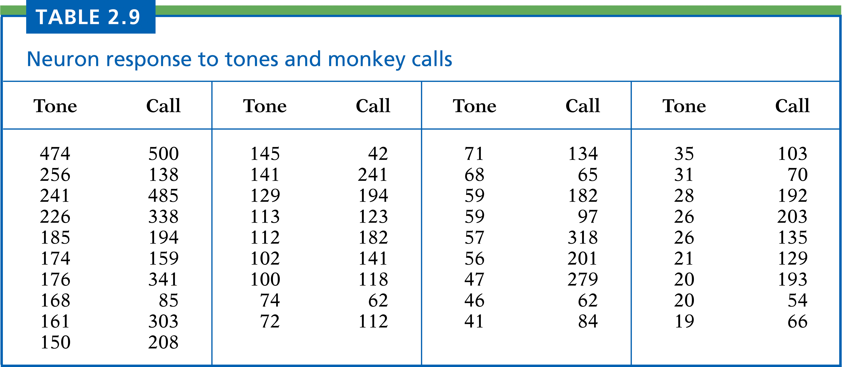
Table 2.9
Introduction to the Practice of Statistics, Sixth Edition
© 2009 W.H. Freeman and Company

Slide 65
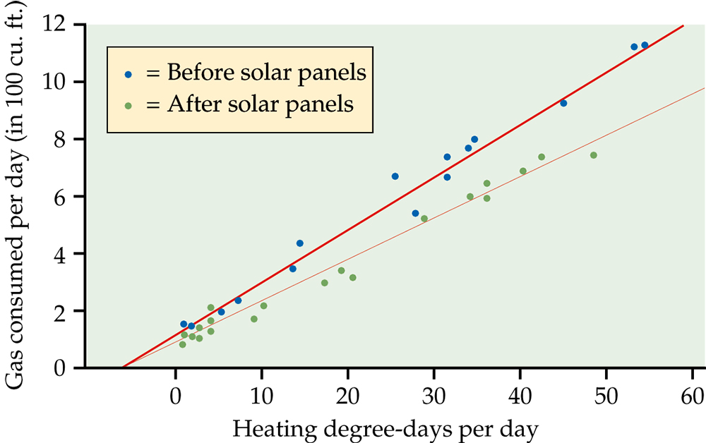
Figure 2.30
Introduction to the Practice of Statistics, Sixth Edition
© 2009 W.H. Freeman and Company

