Slide 1
David S. Moore • George P. McCabe
Bruce A. Craig
Introduction to the
Practice of Statistics
Sixth Edition
Chapter 1:
Looking at Data—Distributions
Copyright © 2009 by W. H. Freeman and Company

Slide 2

Chapter 1 Opener
Introduction to the Practice of Statistics, Sixth Edition
© 2009 W.H. Freeman and Company

Slide 3
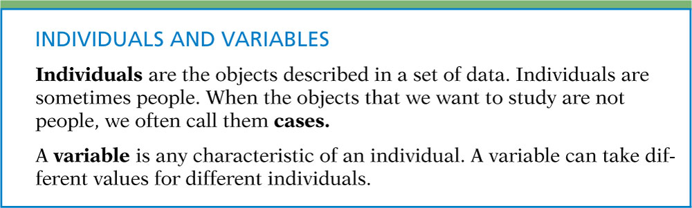
Definition, pg 2
Introduction to the Practice of Statistics, Sixth Edition
© 2009 W.H. Freeman and Company

Slide 4
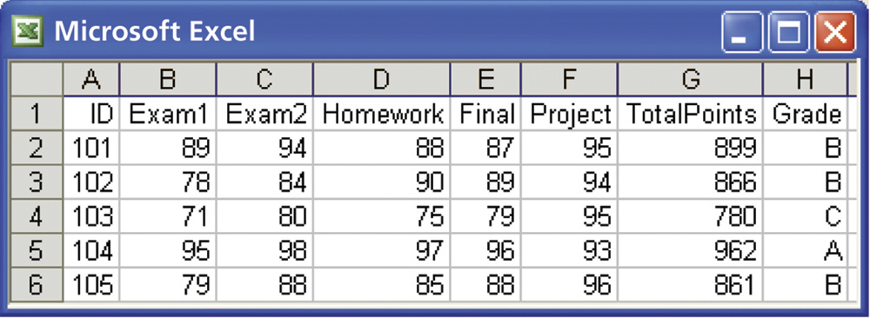
Figure 1.1
Introduction to the Practice of Statistics, Sixth Edition
© 2009 W.H. Freeman and Company

Slide 5
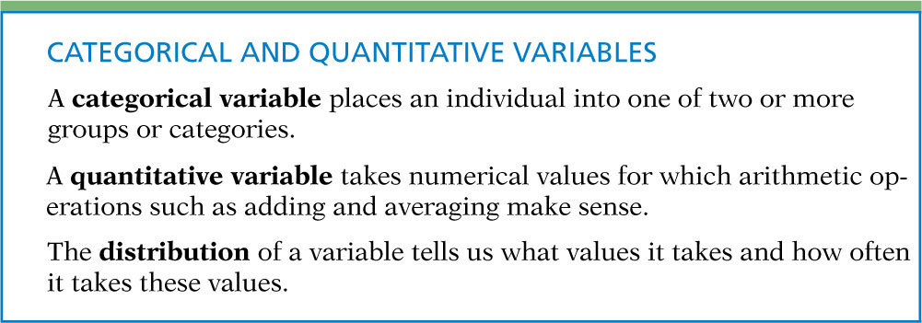
Definition, pg 4
Introduction to the Practice of Statistics, Sixth Edition
© 2009 W.H. Freeman and Company

Slide 6
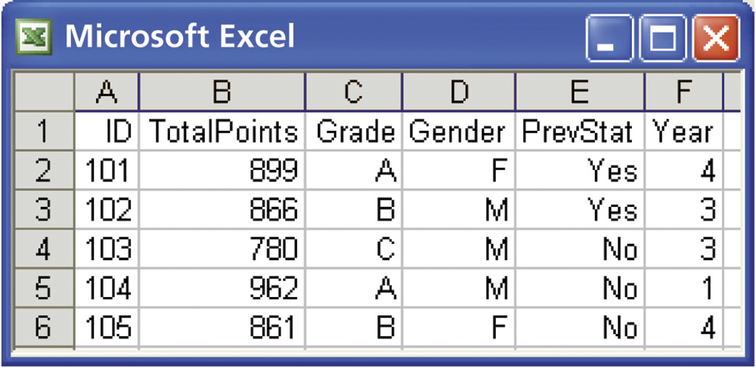
Figure 1.2
Introduction to the Practice of Statistics, Sixth Edition
© 2009 W.H. Freeman and Company

Slide 7
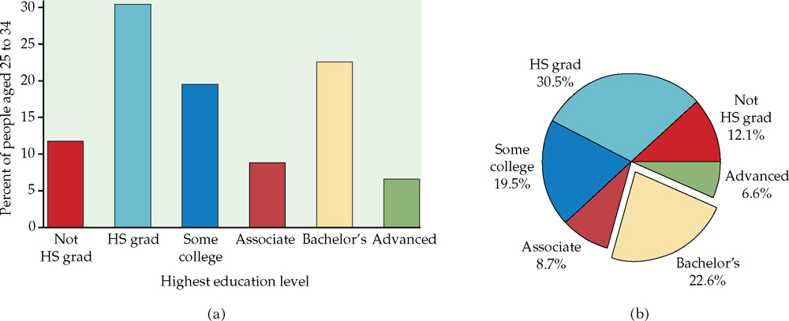
Figure 1.3
Introduction to the Practice of Statistics, Sixth Edition
© 2009 W.H. Freeman and Company

Slide 8
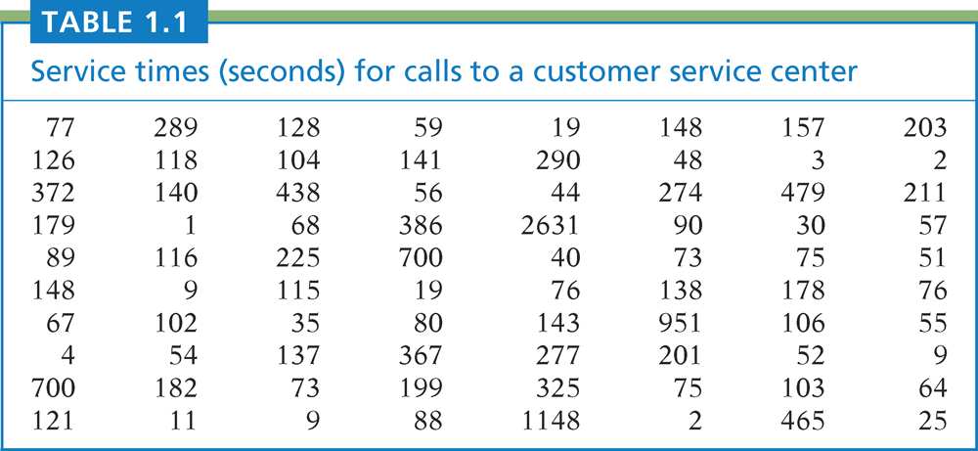
Table 1.1
Introduction to the Practice of Statistics, Sixth Edition
© 2009 W.H. Freeman and Company

Slide 9
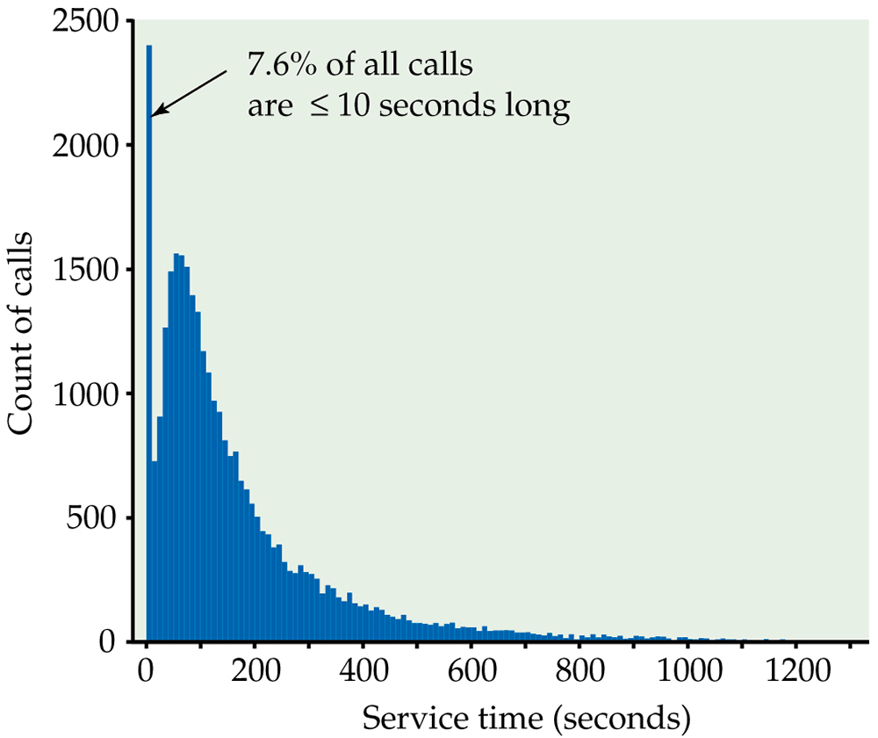
Figure 1.4
Introduction to the Practice of Statistics, Sixth Edition
© 2009 W.H. Freeman and Company

Slide 10
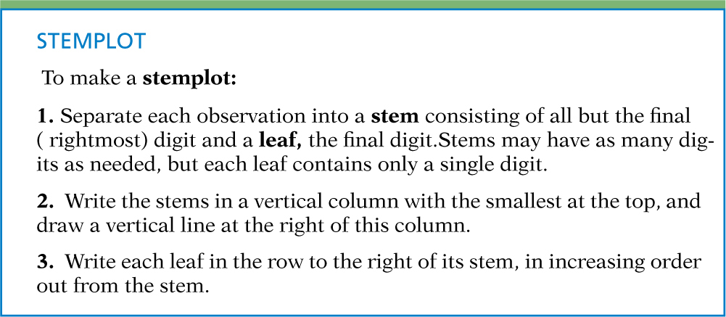
Definition, pg 9
Introduction to the Practice of Statistics, Sixth Edition
© 2009 W.H. Freeman and Company

Slide 11
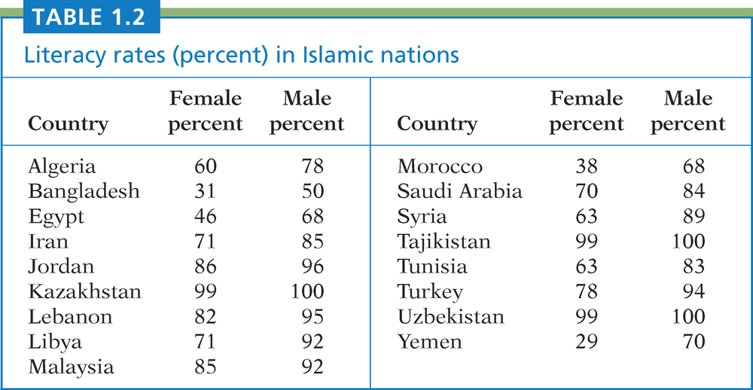
Table 1.2
Introduction to the Practice of Statistics, Sixth Edition
© 2009 W.H. Freeman and Company

Slide 12
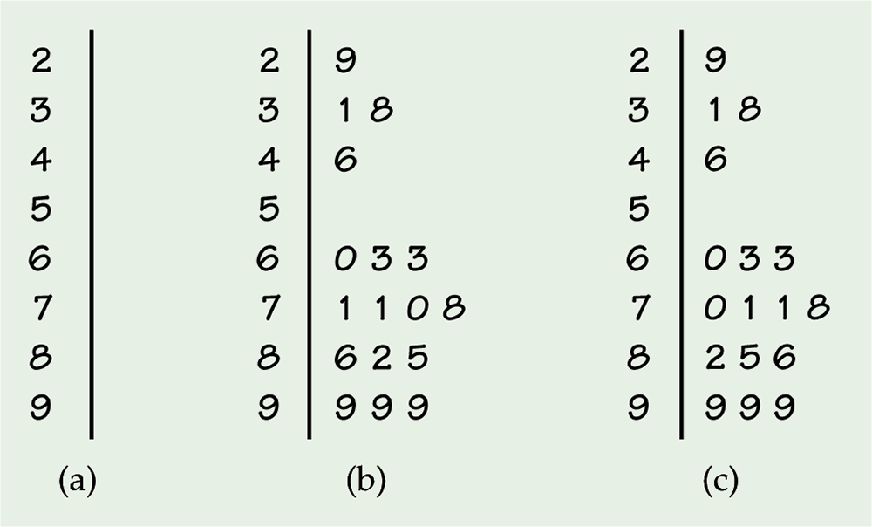
Figure 1.5
Introduction to the Practice of Statistics, Sixth Edition
© 2009 W.H. Freeman and Company

Slide 13
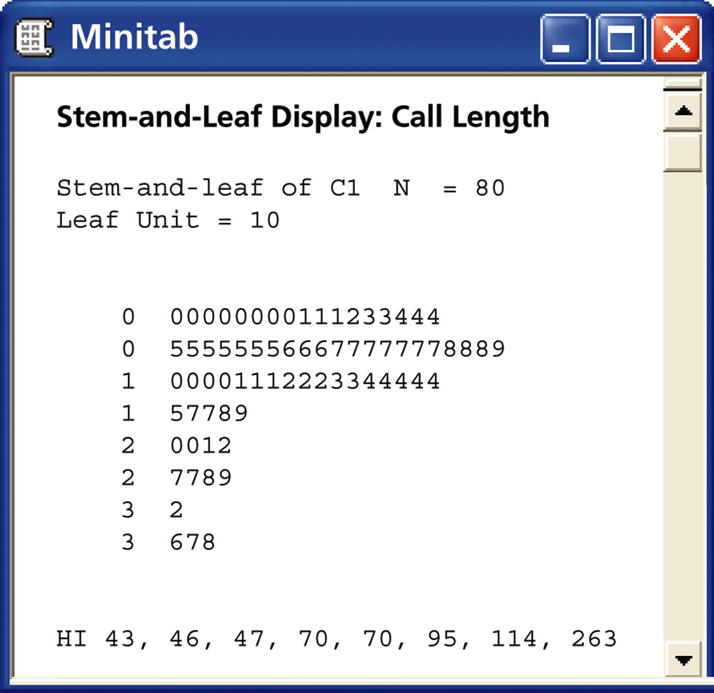
Figure 1.6
Introduction to the Practice of Statistics, Sixth Edition
© 2009 W.H. Freeman and Company

Slide 14
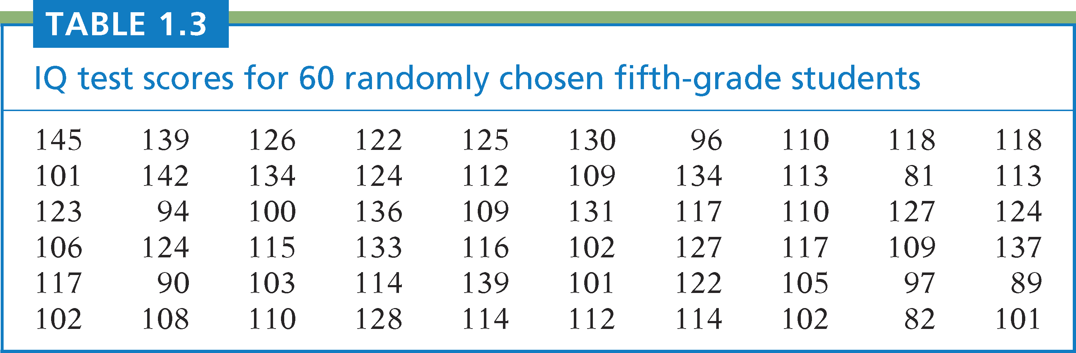
Table 1.3
Introduction to the Practice of Statistics, Sixth Edition
© 2009 W.H. Freeman and Company

Slide 15
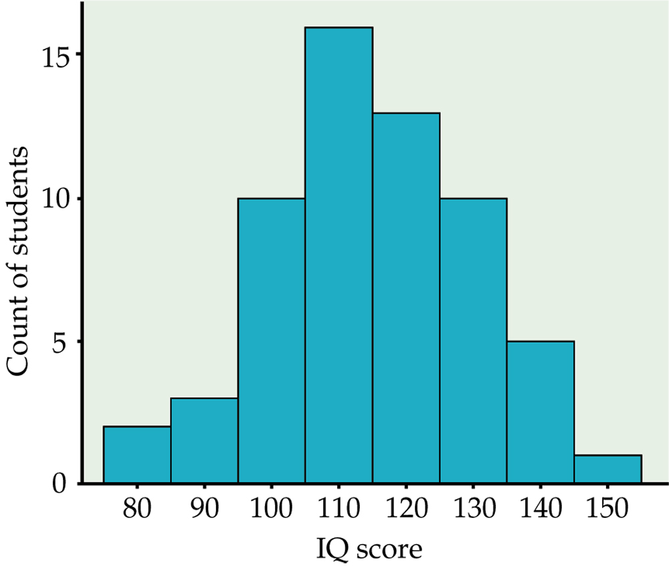
Figure 1.7
Introduction to the Practice of Statistics, Sixth Edition
© 2009 W.H. Freeman and Company

Slide 16
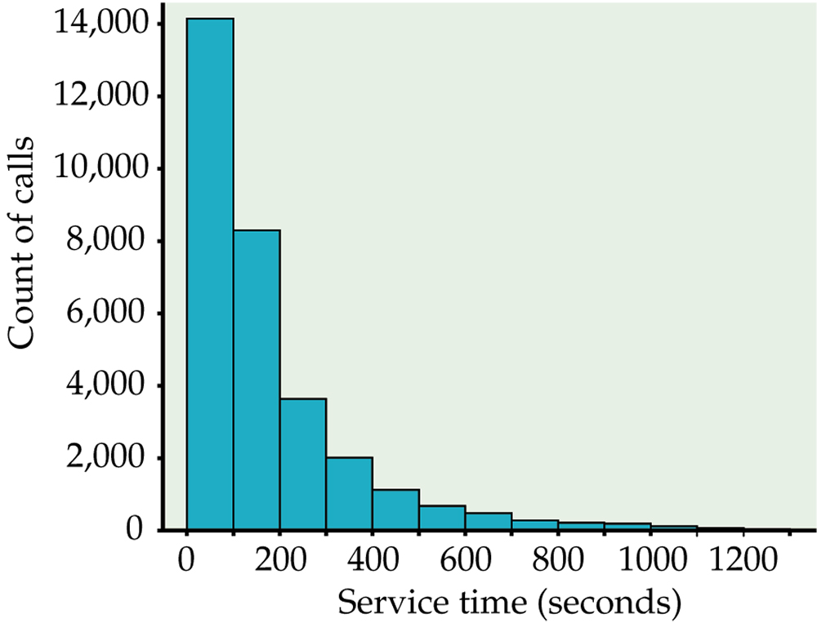
Figure 1.8
Introduction to the Practice of Statistics, Sixth Edition
© 2009 W.H. Freeman and Company

Slide 17
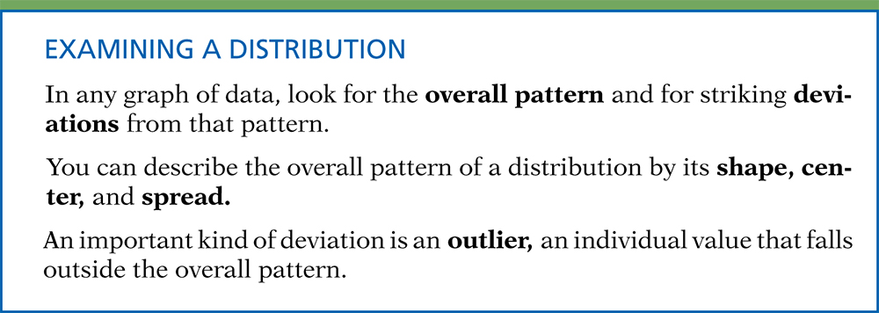
Definition, pg 15
Introduction to the Practice of Statistics, Sixth Edition
© 2009 W.H. Freeman and Company

Slide 18
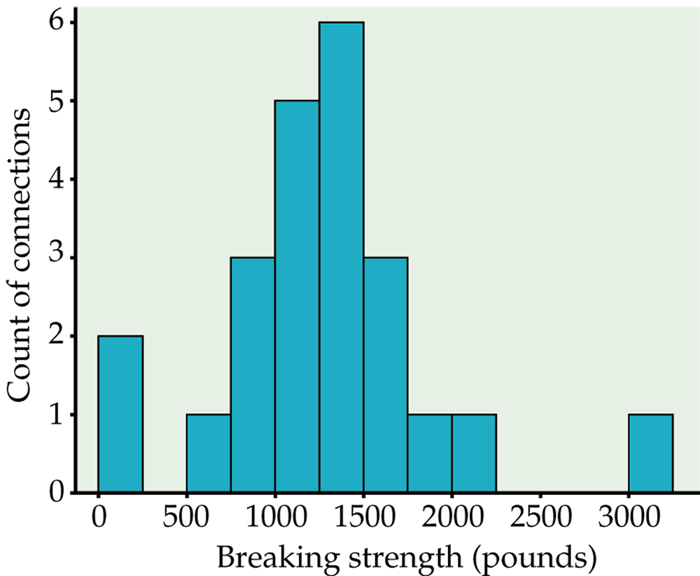
Figure 1.9
Introduction to the Practice of Statistics, Sixth Edition
© 2009 W.H. Freeman and Company

Slide 19
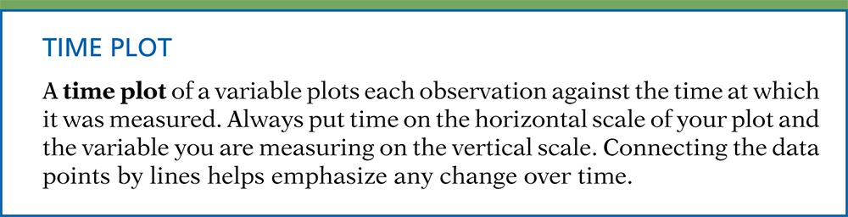
Definition, pg 18
Introduction to the Practice of Statistics, Sixth Edition
© 2009 W.H. Freeman and Company

Slide 20
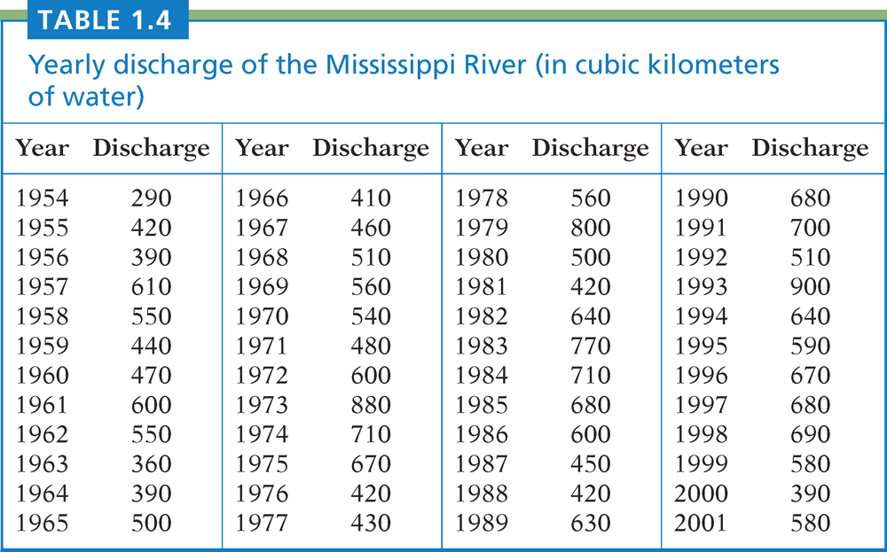
Table 1.4
Introduction to the Practice of Statistics, Sixth Edition
© 2009 W.H. Freeman and Company

Slide 21
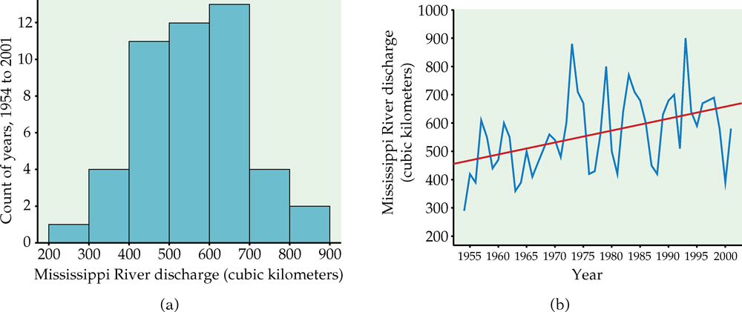
Figure 1.10
Introduction to the Practice of Statistics, Sixth Edition
© 2009 W.H. Freeman and Company

Slide 22
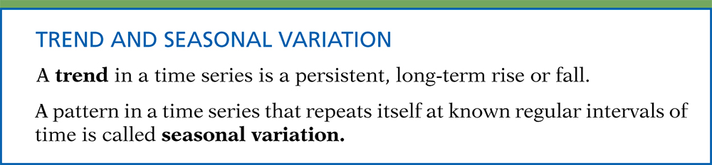
Definition, pg 20
Introduction to the Practice of Statistics, Sixth Edition
© 2009 W.H. Freeman and Company

Slide 23
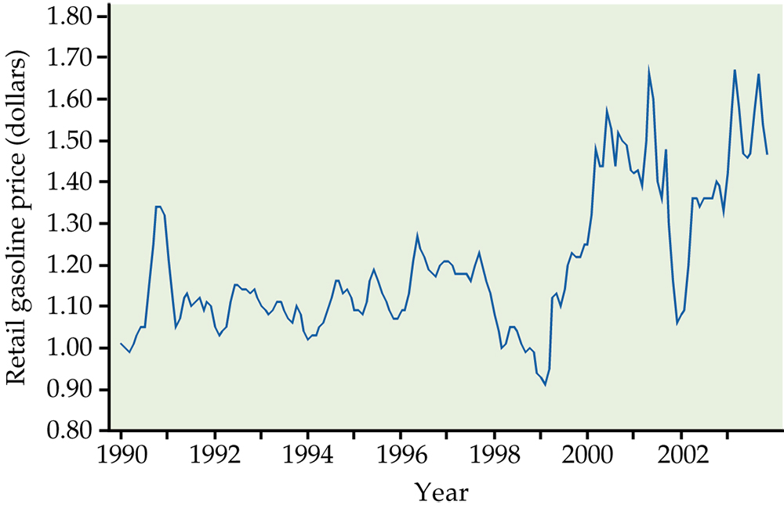
Figure 1.11
Introduction to the Practice of Statistics, Sixth Edition
© 2009 W.H. Freeman and Company

Slide 24
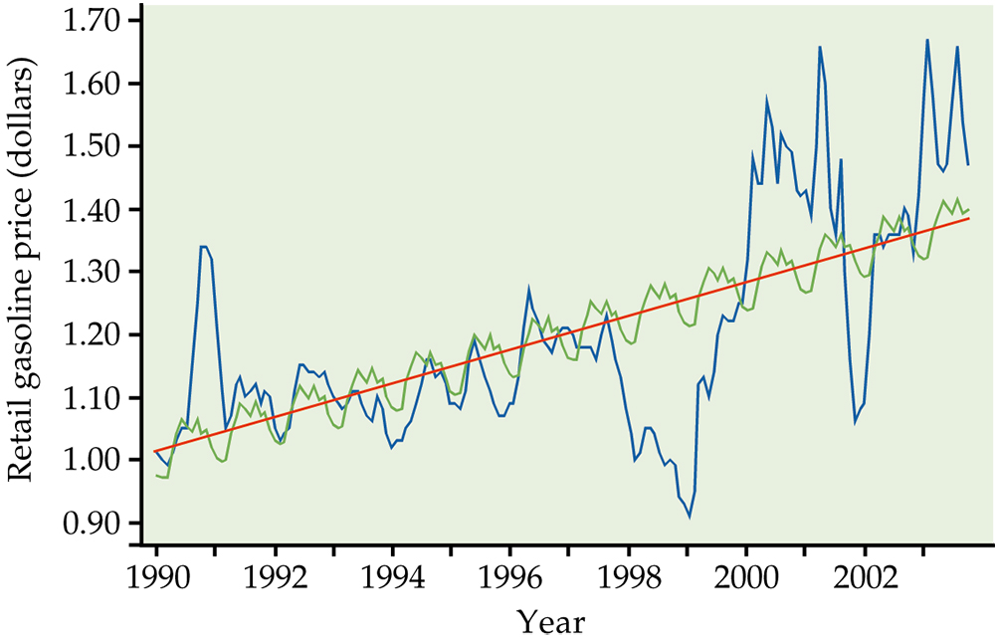
Figure 1.12
Introduction to the Practice of Statistics, Sixth Edition
© 2009 W.H. Freeman and Company

Slide 25
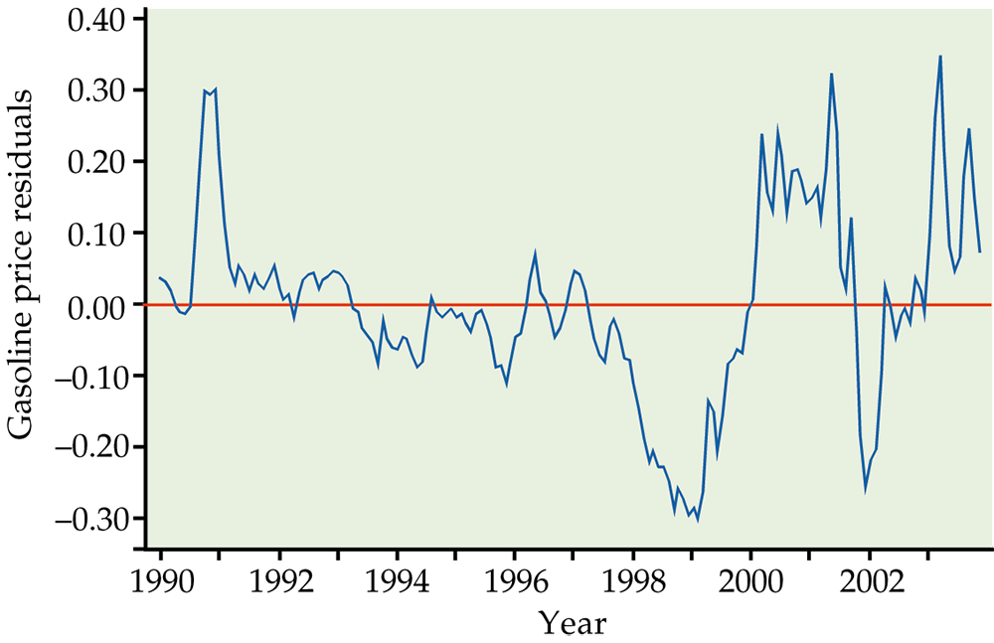
Figure 1.13
Introduction to the Practice of Statistics, Sixth Edition
© 2009 W.H. Freeman and Company

Slide 26
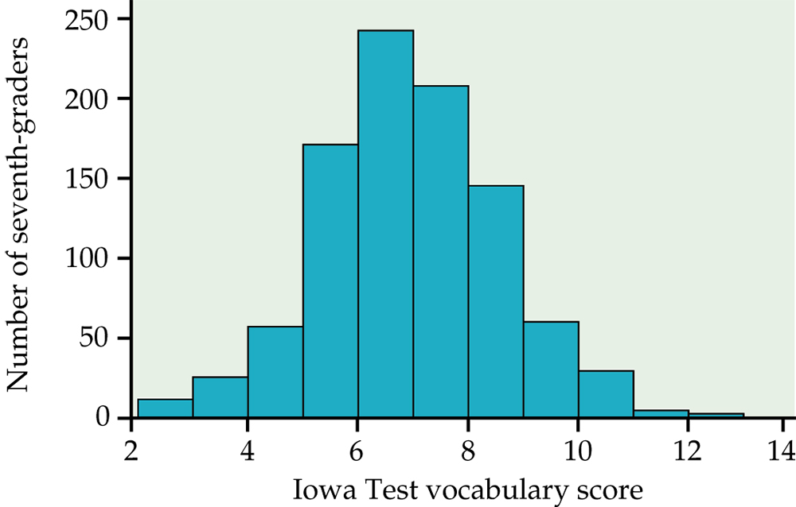
Figure 1.14
Introduction to the Practice of Statistics, Sixth Edition
© 2009 W.H. Freeman and Company

Slide 27
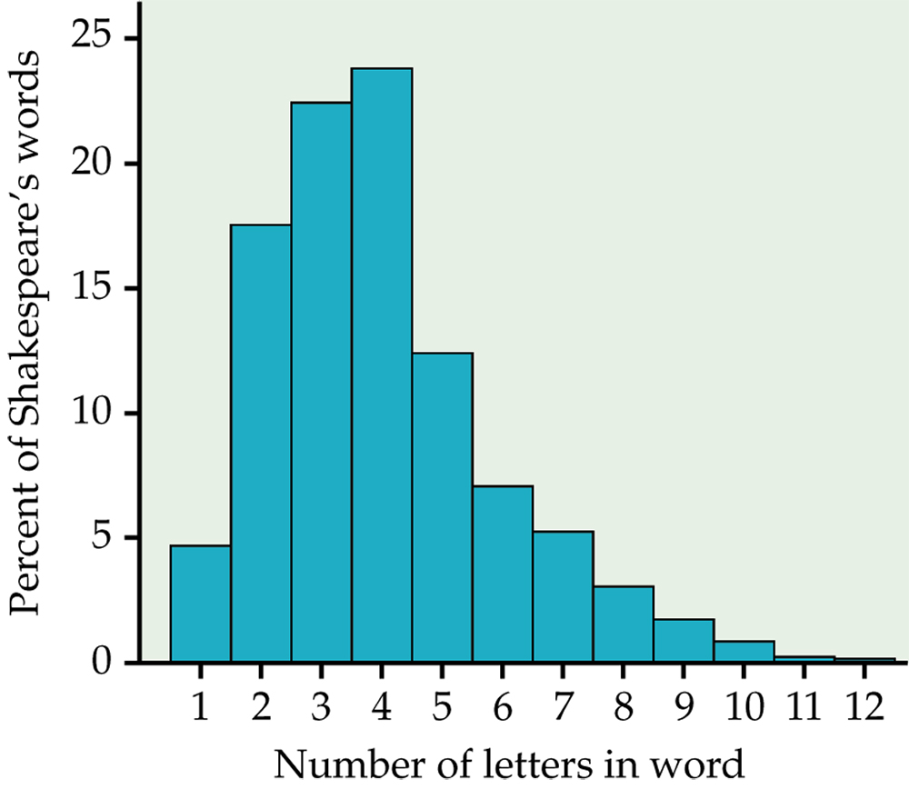
Figure 1.15
Introduction to the Practice of Statistics, Sixth Edition
© 2009 W.H. Freeman and Company

Slide 28
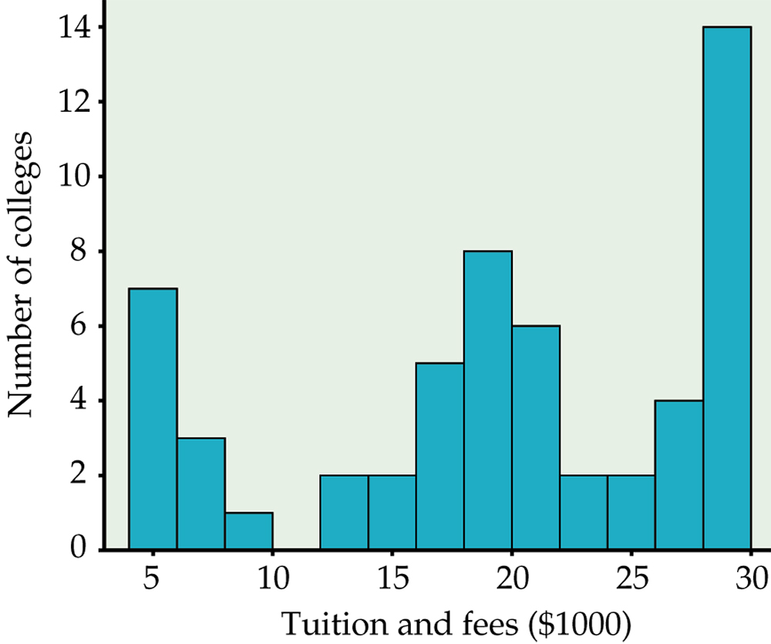
Figure 1.16
Introduction to the Practice of Statistics, Sixth Edition
© 2009 W.H. Freeman and Company

Slide 29
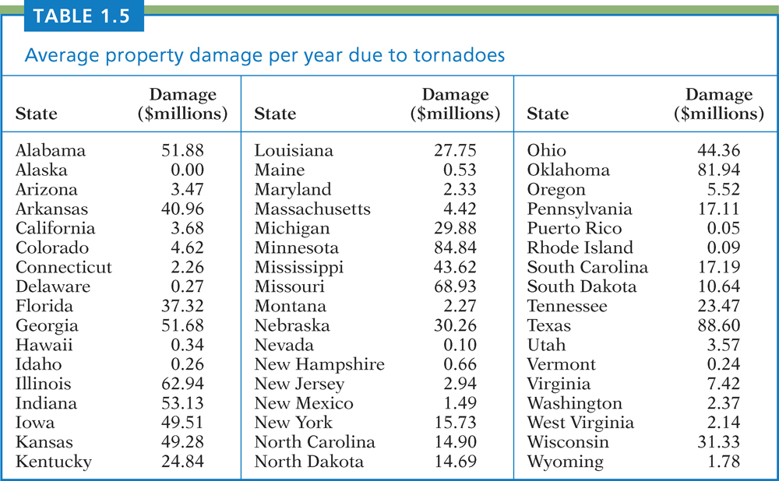
Table 1.5
Introduction to the Practice of Statistics, Sixth Edition
© 2009 W.H. Freeman and Company

Slide 30
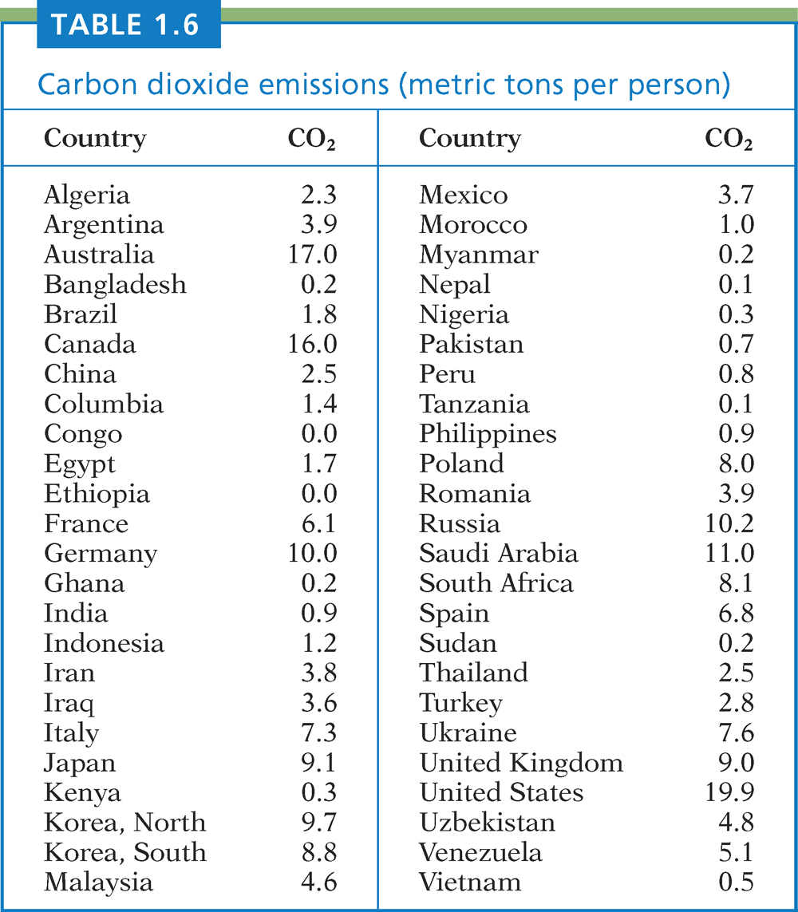
Table 1.6
Introduction to the Practice of Statistics, Sixth Edition
© 2009 W.H. Freeman and Company

Slide 31
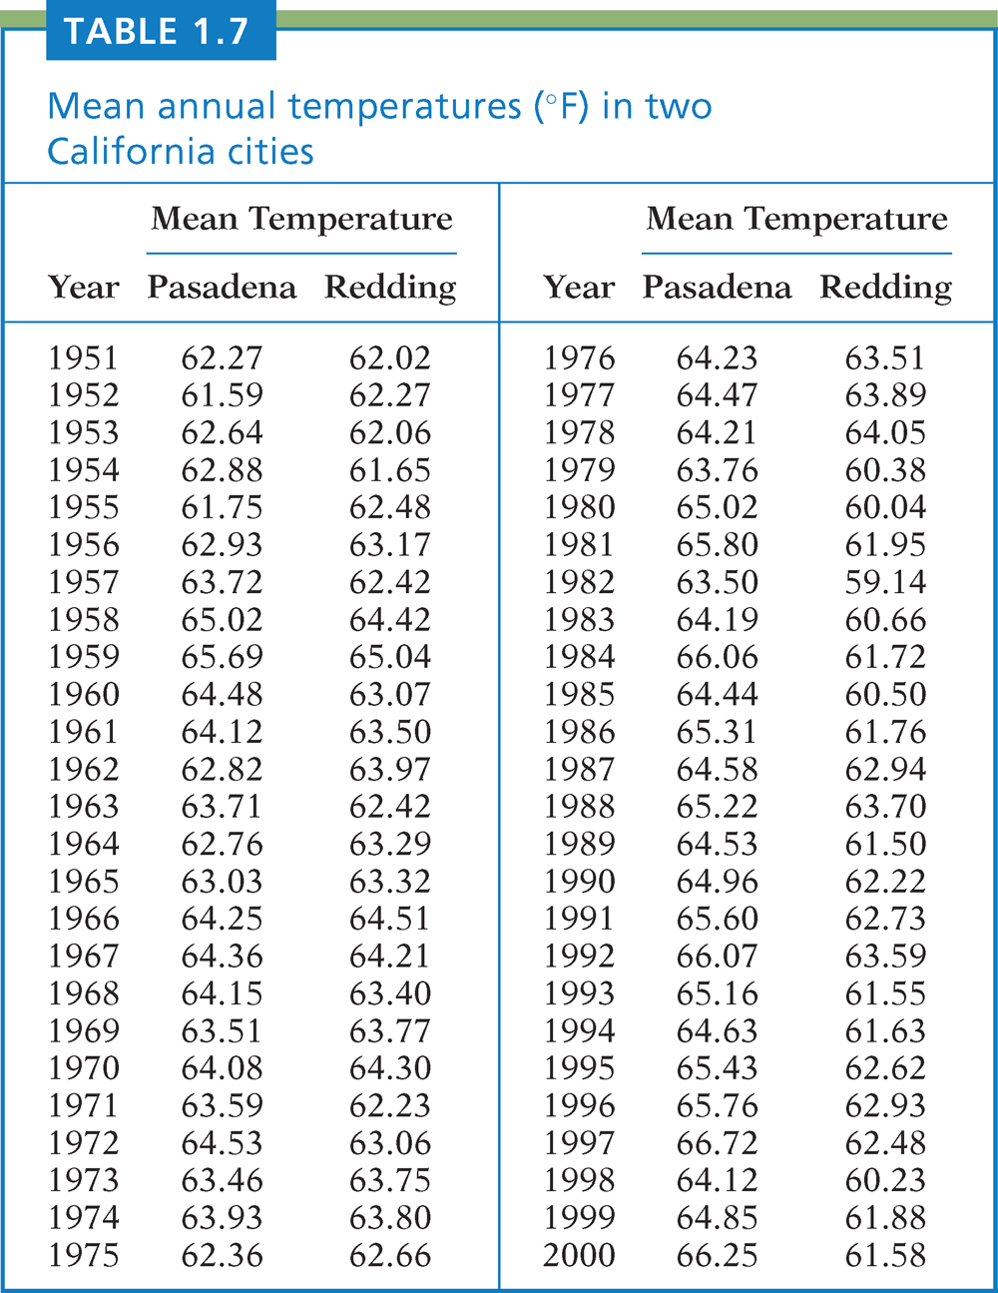
Table 1.7
Introduction to the Practice of Statistics, Sixth Edition
© 2009 W.H. Freeman and Company

Slide 32
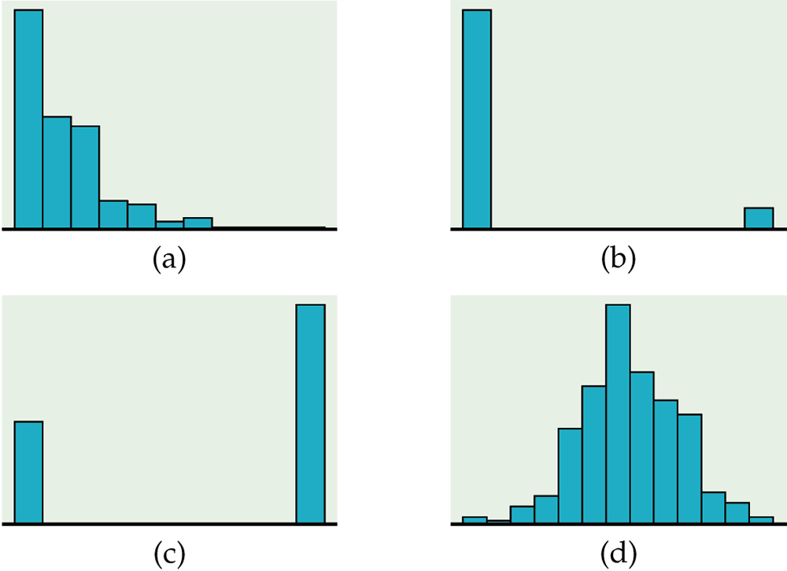
Figure 1.17
Introduction to the Practice of Statistics, Sixth Edition
© 2009 W.H. Freeman and Company

Slide 33
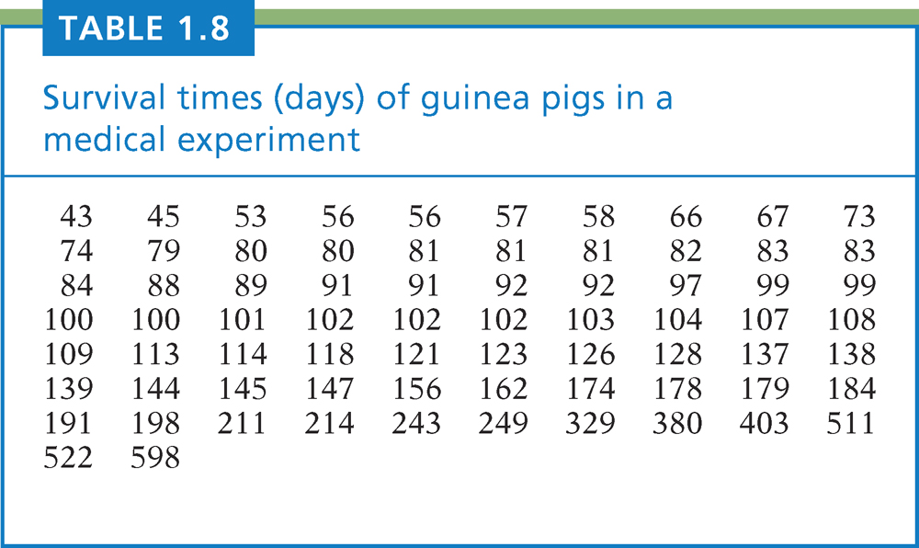
Table 1.8
Introduction to the Practice of Statistics, Sixth Edition
© 2009 W.H. Freeman and Company

Slide 34
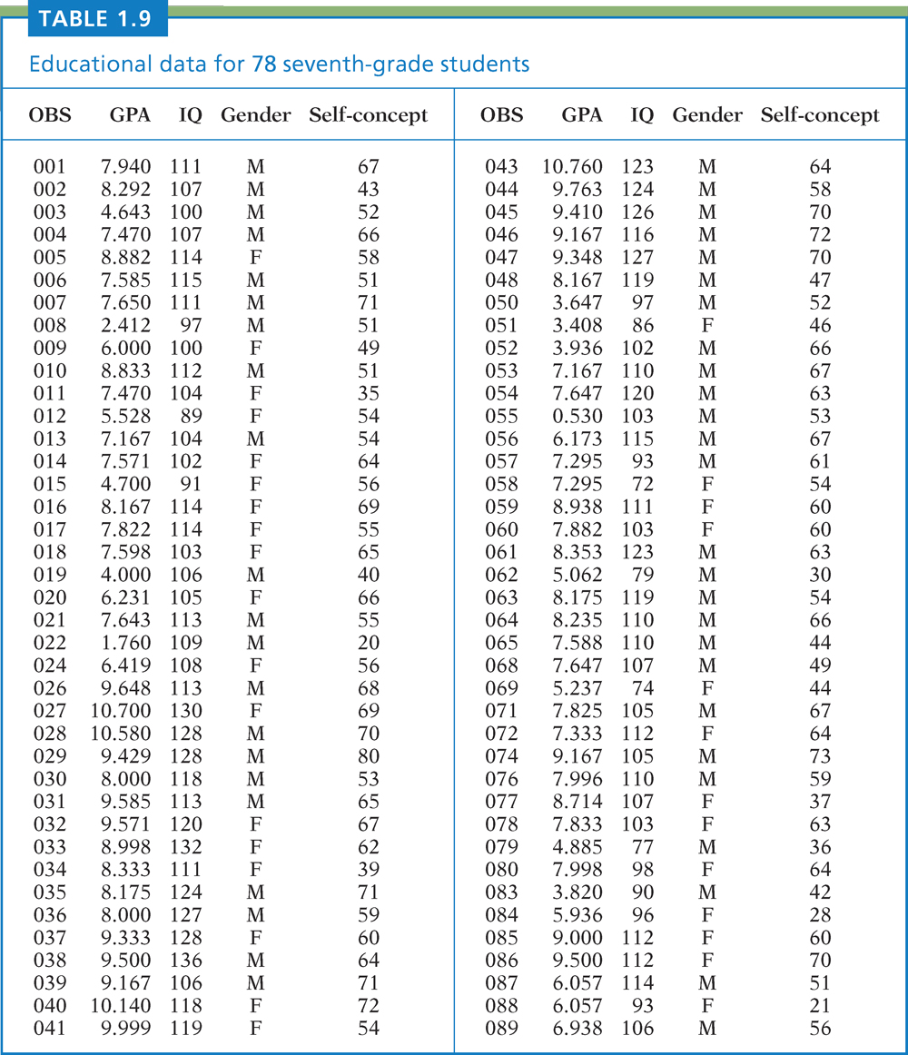
Table 1.9
Introduction to the Practice of Statistics, Sixth Edition
© 2009 W.H. Freeman and Company

Slide 35
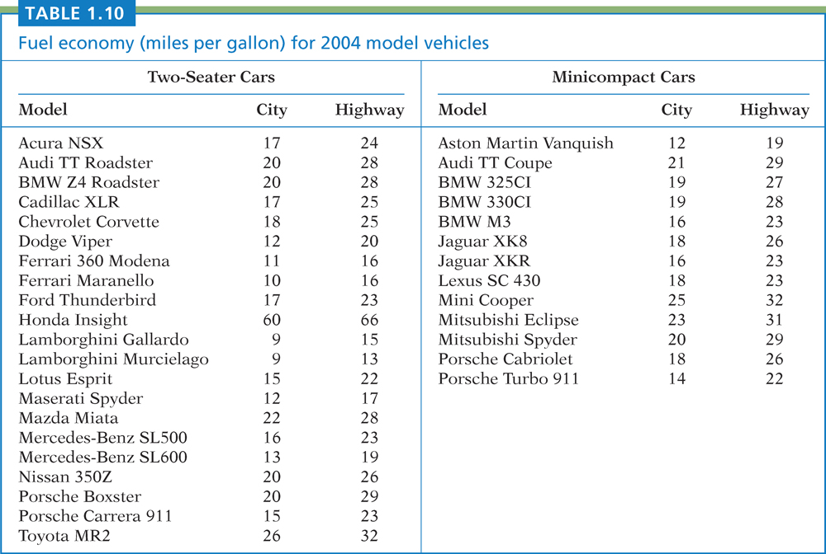
Table 1.10
Introduction to the Practice of Statistics, Sixth Edition
© 2009 W.H. Freeman and Company

Slide 36
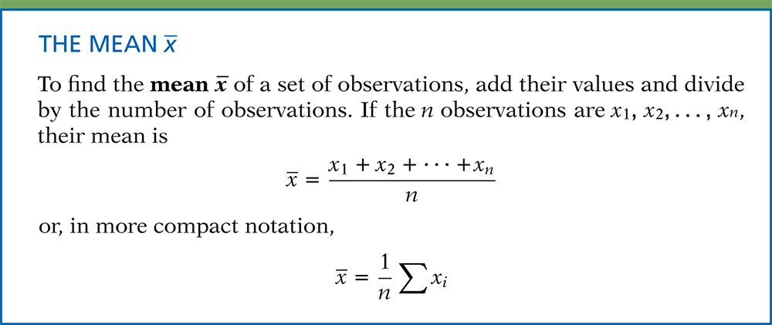
Definition, pg 31
Introduction to the Practice of Statistics, Sixth Edition
© 2009 W.H. Freeman and Company

Slide 37
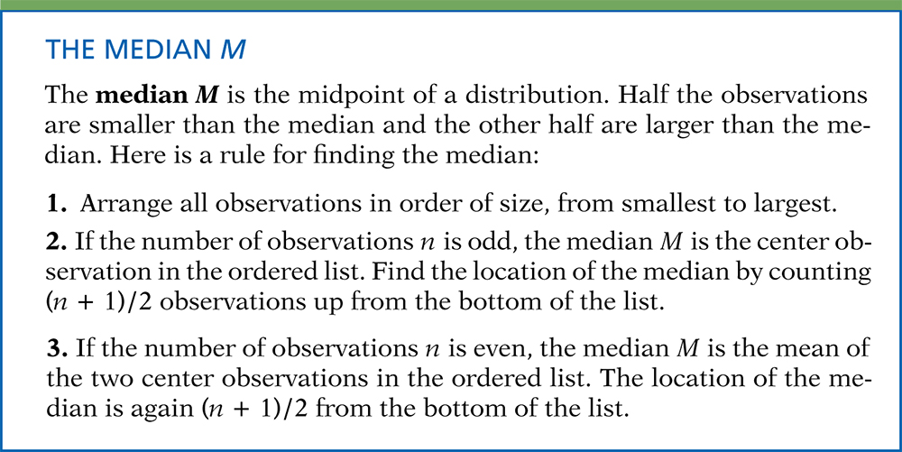
Definition, pg 32–33
Introduction to the Practice of Statistics, Sixth Edition
© 2009 W.H. Freeman and Company

Slide 38
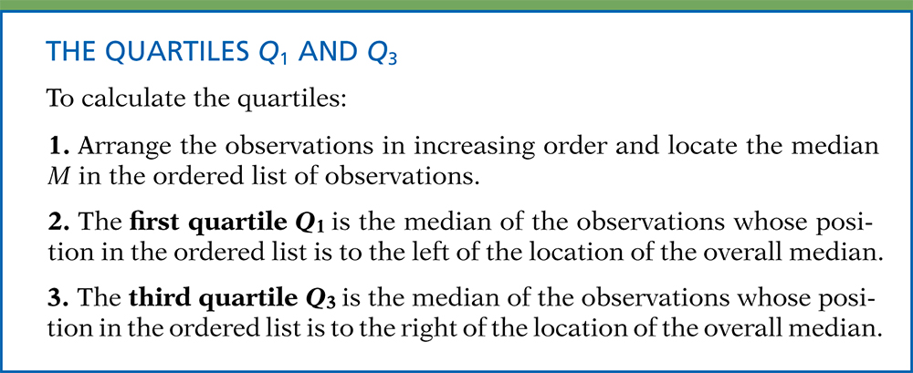
Definition, pg 35
Introduction to the Practice of Statistics, Sixth Edition
© 2009 W.H. Freeman and Company

Slide 39
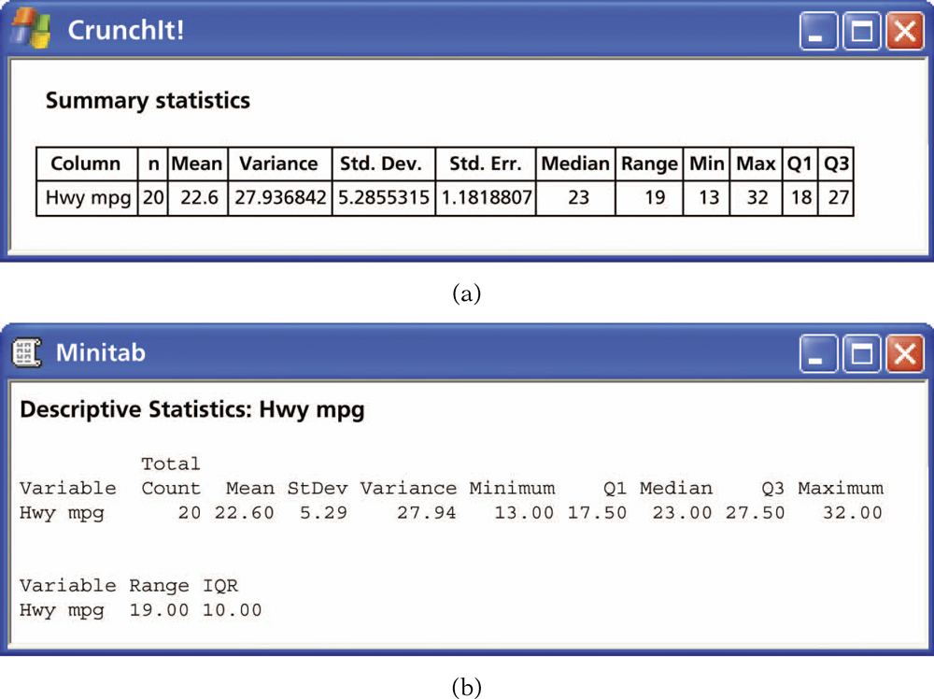
Figure 1.18
Introduction to the Practice of Statistics, Sixth Edition
© 2009 W.H. Freeman and Company

Slide 40
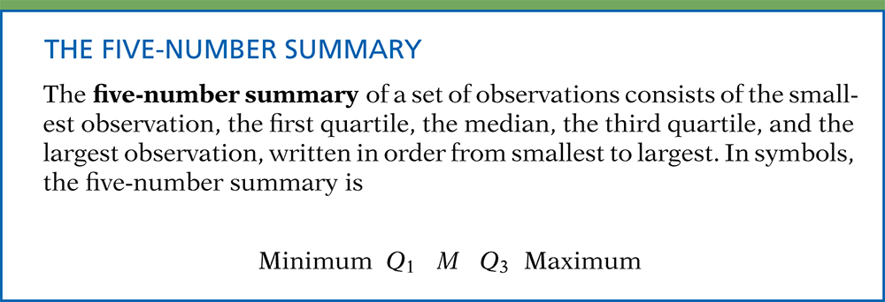
Definition, pg 37
Introduction to the Practice of Statistics, Sixth Edition
© 2009 W.H. Freeman and Company

Slide 41
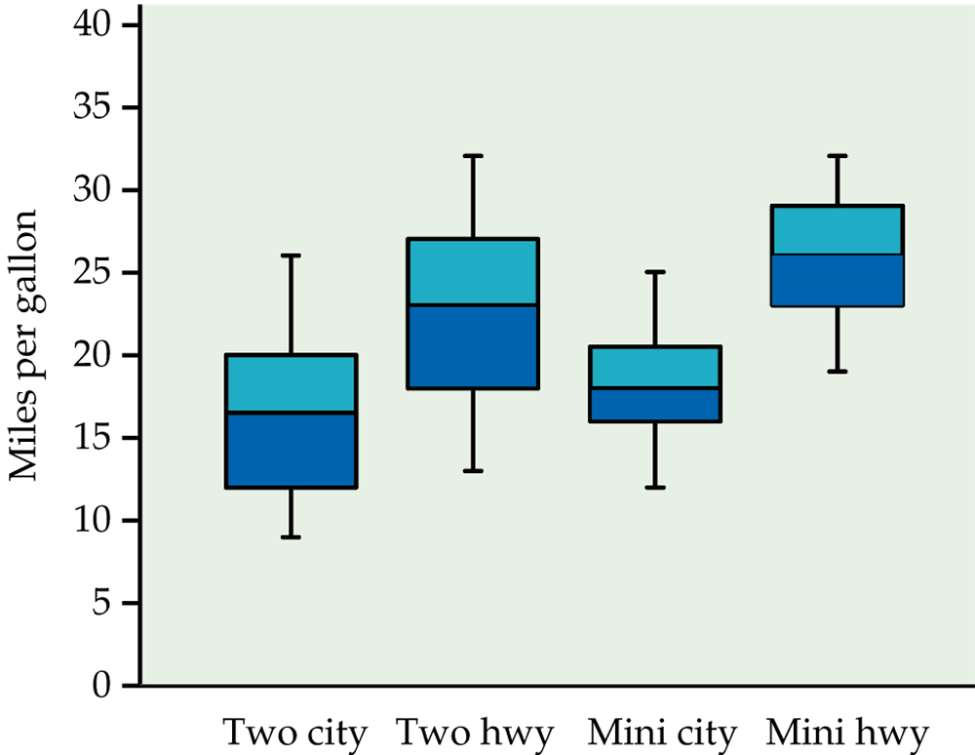
Figure 1.19
Introduction to the Practice of Statistics, Sixth Edition
© 2009 W.H. Freeman and Company

Slide 42
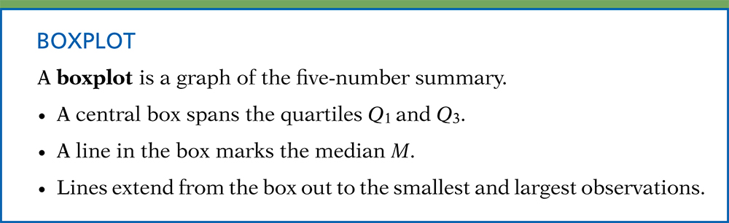
Definition, pg 38a
Introduction to the Practice of Statistics, Sixth Edition
© 2009 W.H. Freeman and Company

Slide 43

Definition, pg 38b
Introduction to the Practice of Statistics, Sixth Edition
© 2009 W.H. Freeman and Company

Slide 44
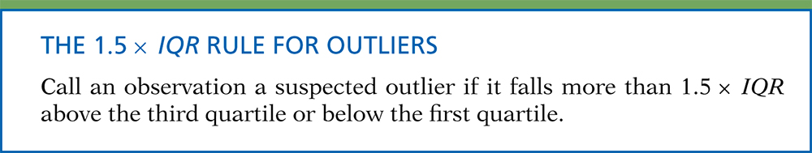
Definition, pg 39
Introduction to the Practice of Statistics, Sixth Edition
© 2009 W.H. Freeman and Company

Slide 45
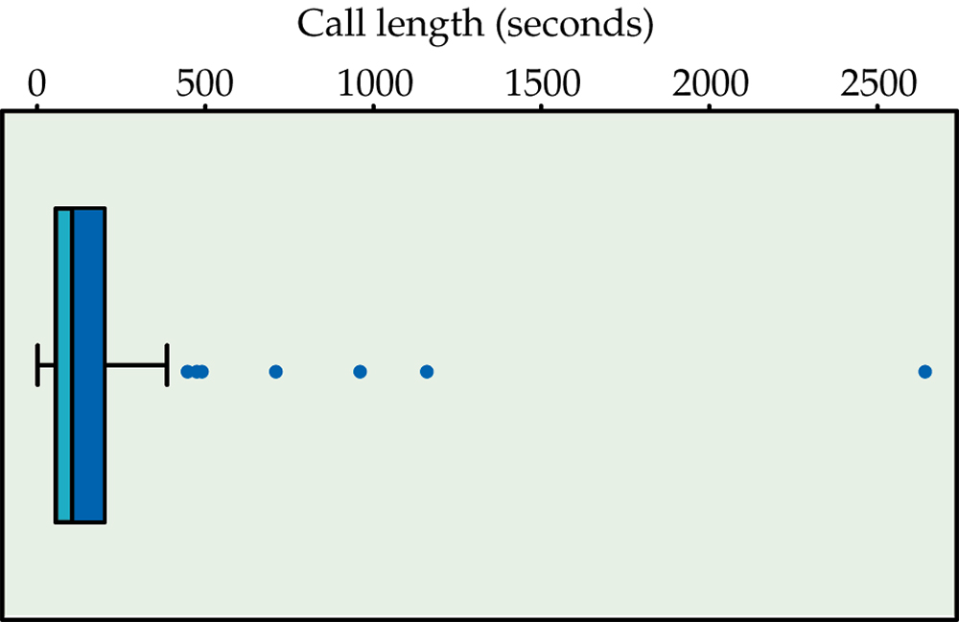
Figure 1.20
Introduction to the Practice of Statistics, Sixth Edition
© 2009 W.H. Freeman and Company

Slide 46
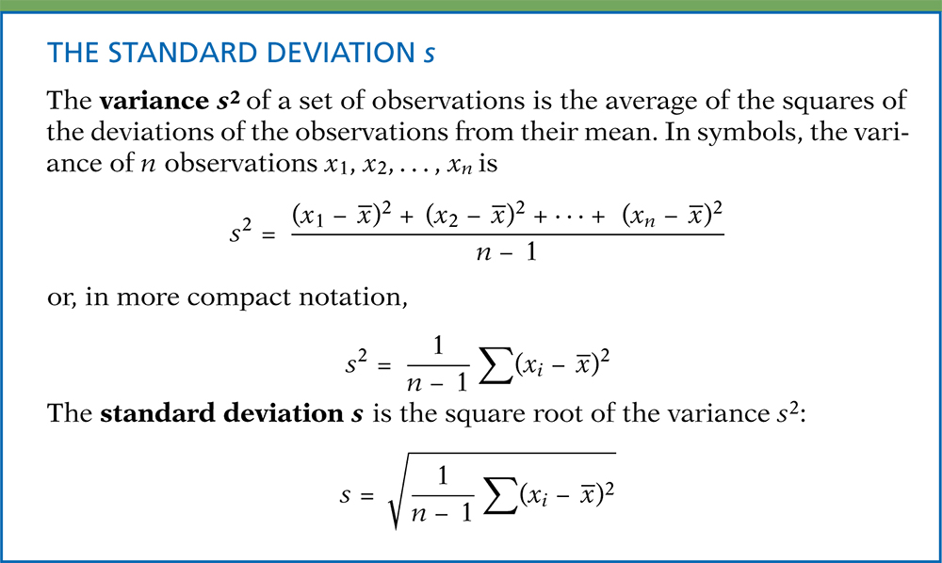
Definition, pg 40–41
Introduction to the Practice of Statistics, Sixth Edition
© 2009 W.H. Freeman and Company

Slide 47
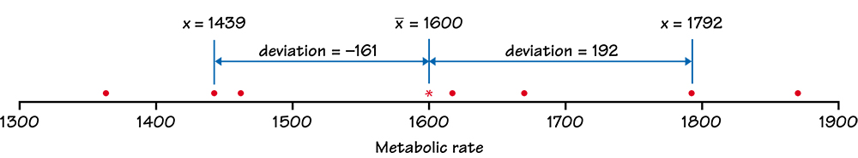
Figure 1.21
Introduction to the Practice of Statistics, Sixth Edition
© 2009 W.H. Freeman and Company

Slide 48
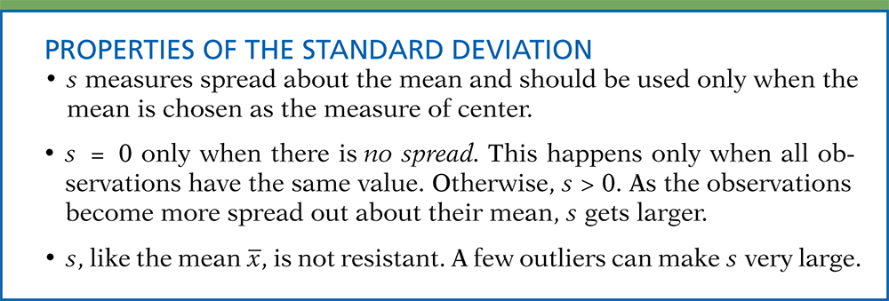
Definition, pg 43a
Introduction to the Practice of Statistics, Sixth Edition
© 2009 W.H. Freeman and Company

Slide 49
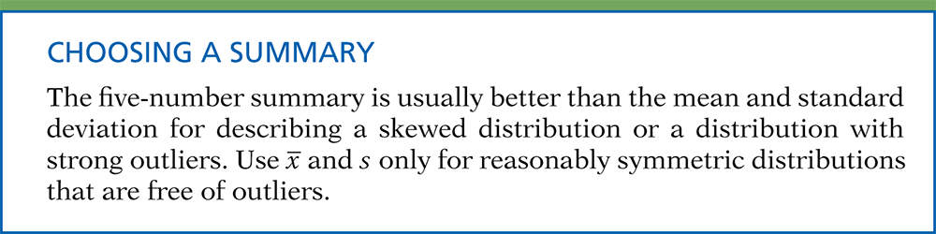
Definition, pg 43b
Introduction to the Practice of Statistics, Sixth Edition
© 2009 W.H. Freeman and Company

Slide 50
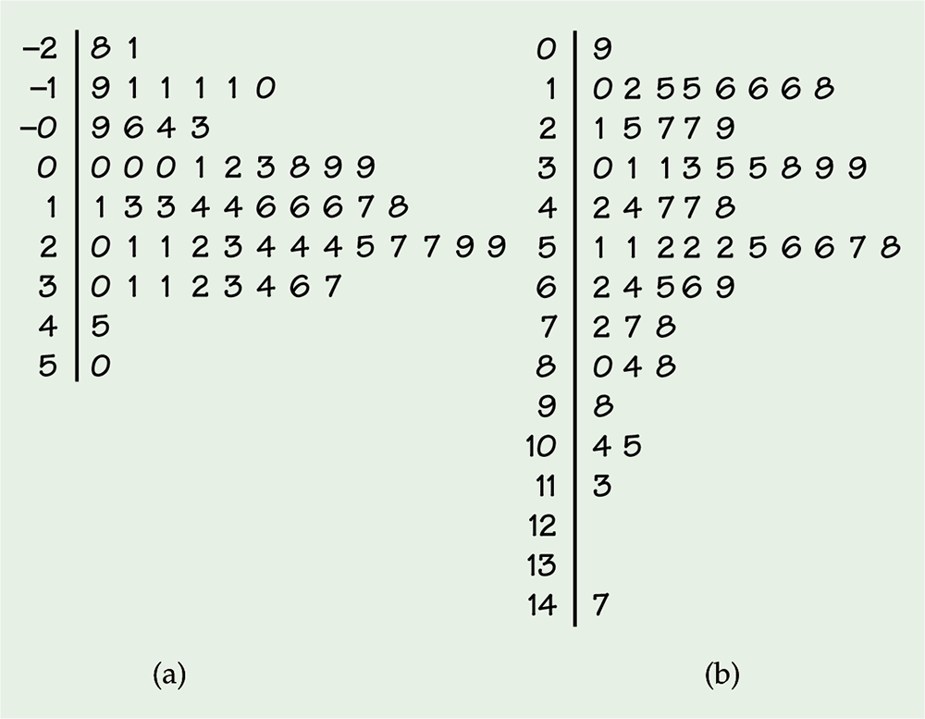
Figure 1.22
Introduction to the Practice of Statistics, Sixth Edition
© 2009 W.H. Freeman and Company

Slide 51
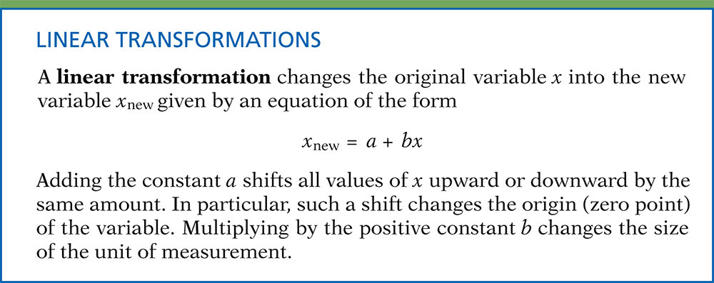
Definition, pg 45
Introduction to the Practice of Statistics, Sixth Edition
© 2009 W.H. Freeman and Company

Slide 52
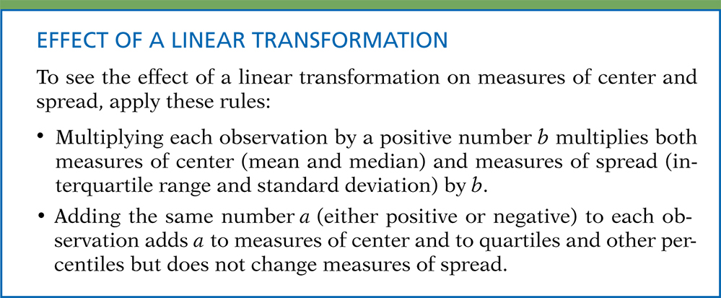
Definition, pg 46–47
Introduction to the Practice of Statistics, Sixth Edition
© 2009 W.H. Freeman and Company

Slide 53
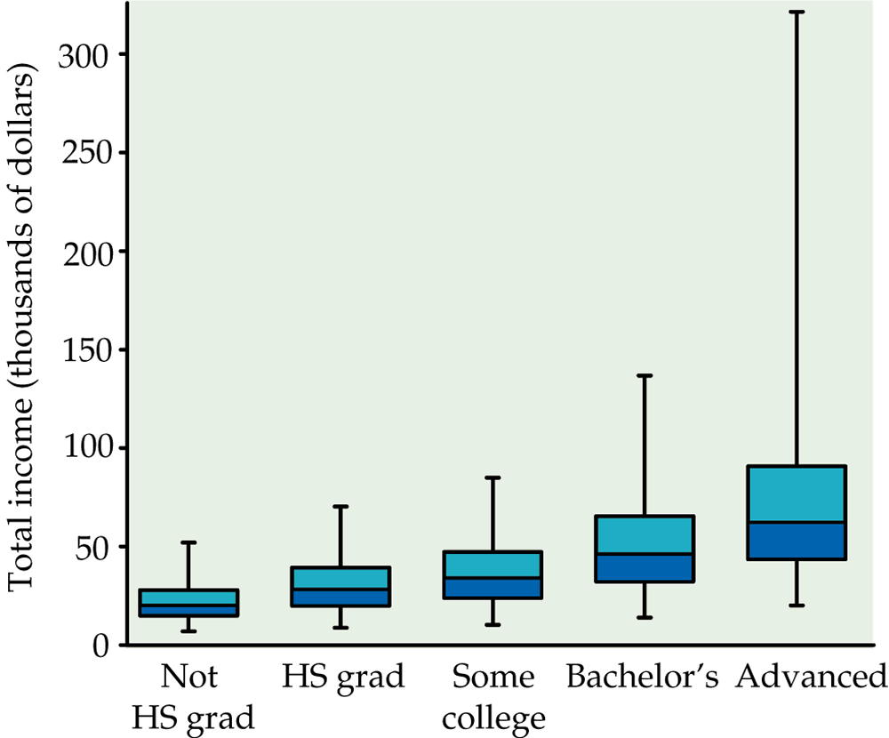
Figure 1.23
Introduction to the Practice of Statistics, Sixth Edition
© 2009 W.H. Freeman and Company

Slide 54

Figure 1.24
Introduction to the Practice of Statistics, Sixth Edition
© 2009 W.H. Freeman and Company

Slide 55

Figure 1.25
Introduction to the Practice of Statistics, Sixth Edition
© 2009 W.H. Freeman and Company

Slide 56

Definition, pg 56
Introduction to the Practice of Statistics, Sixth Edition
© 2009 W.H. Freeman and Company

Slide 57

Figure 1.26
Introduction to the Practice of Statistics, Sixth Edition
© 2009 W.H. Freeman and Company

Slide 58

Figure 1.27
Introduction to the Practice of Statistics, Sixth Edition
© 2009 W.H. Freeman and Company

Slide 59

Definition, pg 57
Introduction to the Practice of Statistics, Sixth Edition
© 2009 W.H. Freeman and Company

Slide 60

Figure 1.28
Introduction to the Practice of Statistics, Sixth Edition
© 2009 W.H. Freeman and Company

Slide 61

Definition, pg 59
Introduction to the Practice of Statistics, Sixth Edition
© 2009 W.H. Freeman and Company

Slide 62

Figure 1.29
Introduction to the Practice of Statistics, Sixth Edition
© 2009 W.H. Freeman and Company

Slide 63

Figure 1.30
Introduction to the Practice of Statistics, Sixth Edition
© 2009 W.H. Freeman and Company

Slide 64

Definition, pg 61
Introduction to the Practice of Statistics, Sixth Edition
© 2009 W.H. Freeman and Company

Slide 65

Definition, pg 62
Introduction to the Practice of Statistics, Sixth Edition
© 2009 W.H. Freeman and Company

Slide 66

Figure 1.31
Introduction to the Practice of Statistics, Sixth Edition
© 2009 W.H. Freeman and Company

Slide 67

Figure 1.32
Introduction to the Practice of Statistics, Sixth Edition
© 2009 W.H. Freeman and Company

Slide 68

Figure 1.33
Introduction to the Practice of Statistics, Sixth Edition
© 2009 W.H. Freeman and Company

Slide 69

Definition, pg 69
Introduction to the Practice of Statistics, Sixth Edition
© 2009 W.H. Freeman and Company

Slide 70

Figure 1.34
Introduction to the Practice of Statistics, Sixth Edition
© 2009 W.H. Freeman and Company

Slide 71

Figure 1.35
Introduction to the Practice of Statistics, Sixth Edition
© 2009 W.H. Freeman and Company

Slide 72

Figure 1.36
Introduction to the Practice of Statistics, Sixth Edition
© 2009 W.H. Freeman and Company

Slide 73

Figure 1.37
Introduction to the Practice of Statistics, Sixth Edition
© 2009 W.H. Freeman and Company

Slide 74

Figure 1.38
Introduction to the Practice of Statistics, Sixth Edition
© 2009 W.H. Freeman and Company

Slide 75

Figure 1.39
Introduction to the Practice of Statistics, Sixth Edition
© 2009 W.H. Freeman and Company

Slide 76

Figure 1.40
Introduction to the Practice of Statistics, Sixth Edition
© 2009 W.H. Freeman and Company0

Slide 77

Figure 1.41
Introduction to the Practice of Statistics, Sixth Edition
© 2009 W.H. Freeman and Company

Slide 78

Figure 1.42
Introduction to the Practice of Statistics, Sixth Edition
© 2009 W.H. Freeman and Company

Slide 79

Figure 1.43
Introduction to the Practice of Statistics, Sixth Edition
© 2009 W.H. Freeman and Company

Slide 80

Table 1.11
Introduction to the Practice of Statistics, Sixth Edition
© 2009 W.H. Freeman and Company

Slide 81

Figure 1.44
Introduction to the Practice of Statistics, Sixth Edition
© 2009 W.H. Freeman and Company

