Slide 1
MDS & Cluster Analysis Project
Jason Niemann
Taylor Evansen

Slide 2
Data
Variables (all z-scores):
Excessive Drinking
Fatal Car Crashes
Uninsured
Highschool Graduation
Preventable Hospital Stays
Single Parent Households
Violent Crime Rates
Percent Under 18

Slide 3
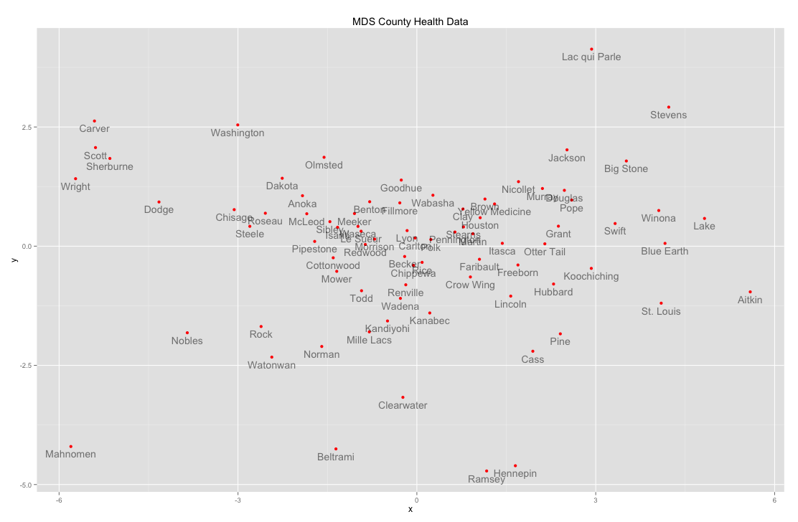

Slide 4
MDS graph analysis
Dimension 1 seems to indicate wealth of different counties, and we can see this because the wealthier counties are going to have a lower uninsured rate (pushing these counties to the left of the graph) whereas the less wealthy counties would have a higher uninsured rate (pushing them to the right).
Dimension 2 correlates strongly with our “preventable hospital stays” variable, where the z-score of Lac Qui Parle county and Stevens county were very high, with Ramsey and Hennepin counties having a very negative z-score. This can indicate the level more reckless/dangerous behaviors.

Slide 5
In these two dimensions, we can see a few distinct clusters forming. The top left corner is the suburban counties that are more wealthy and populated. The large center cluster is the “norm” of the state, basically showing the average health behaviors. Ramsey and Hennepin counties behave very similarly almost in a cluster of their own, maybe because of the diverse nature of their population (including both metropolitan and suburban areas).

Slide 6
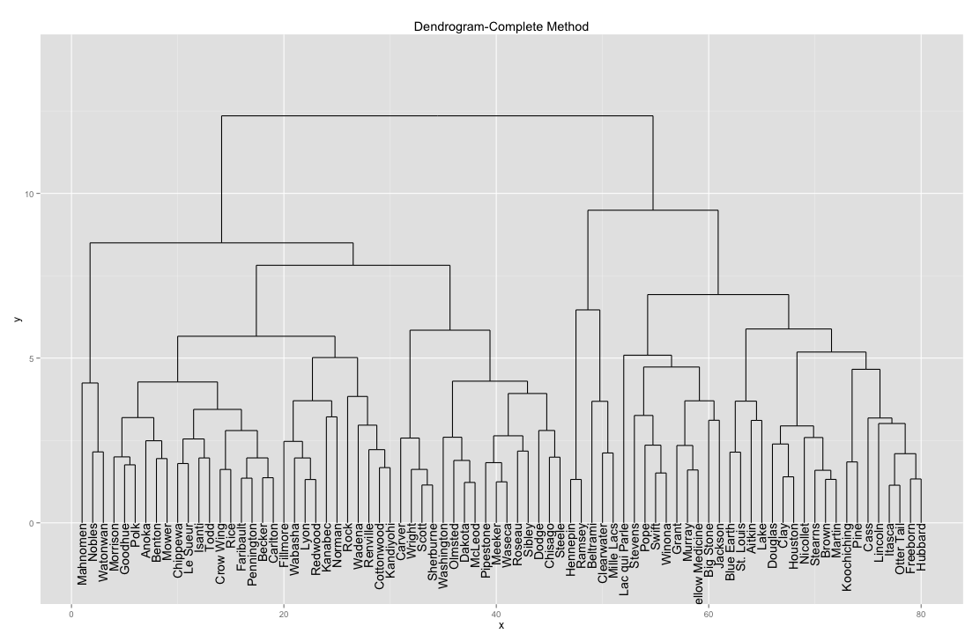

Slide 7
Cluster Analysis
We used the “complete” method to form our dendrogram. From our k-means analysis, 3 clusters was the ideal amount for our data so this is what we’ll use to interpret the dendrogram.
The smallest cluster (above the red section) includes Ramsey, Hennepin, Beltrami, Mille Lacs, and Clearwater counties. This cluster seems to be the one where the diverse/unrelated counties get put, simply because they don’t fit anywhere else. Ramsey and Hennepin counties both have high violent crime rates, which makes sense due to their metropolitan areas.

Slide 8
The cluster to the very right (above the green section) seems to correspond with our MDS top right cluster. These counties are more rural, and are associated with more uninsured people and reckless behavior. If we look at the data we can see that these counties have more preventable hospital stays, more fatal car crashes, and things like this.
The cluster to the very left (above the blue section) has many suburban counties, like our MDS top left cluster. These counties cluster together probably due to their low uninsured rates, low single parent z-scores, high high school graduation, low violent crime rates, etc. These counties have good health overall and demonstrate that through their clustering patterns.

Slide 9
These MDS and cluster analysis graphs showed us that we can divide the counties up into three basic clusters based on these health variables, and that there are observable patterns throughout the state.

